Slide 1
The Relationship Between Attitude, Research Data Service, and Data Quality:
A Study in Indonesian State Higher Education Institutions’ Libraries
¹Aulia Puspaning Galih, ²Ágnes Hajdu Barát
^{1,2}Eötvös Loránd University, Budapest, Hungary
¹Universitas Brawijaya, Malang, Indonesia

Slide 2

OUTLINE
Introduction
Objective of the Study
Research Question
Model and Hypotheses
Literature Review
Methods
Results
Discussion
Conclusion
Reference

Slide 3
INTRODUCTION
The way the library staff responds to customer requests reflects their attitude.
A significant relationship exists between the attitude of library staff and the value of services provided by library employees (Oden and Owolabi, 2022).
Librarians believe research data service is an essential service and it will increase the visibility of institutional research and have a greater impact on the field (Tenopir et al., 2013).
Academic libraries' research data services are crucial because they act as hubs for data quality at universities (Giarlo, 2013).
A suitable and customized data quality assessment framework, as well as Research Data Service, are required to control and supervise critical data quality control phases (Hassenstein and Vanella, 2022).
These services can provide research communities with audits and verifications of data quality.

Slide 4
PROBLEM STATEMENT and OBJECTIVE of THE STUDY
Not much information is published regarding the research data service in academic libraries in Indonesia.
By actively engaging in research collaborations with academic professionals, librarians can strengthen their position as research collaborators within their institutions.
The aim is to investigate the research data service practiced by Indonesian academic librarians, and to assess the attitudes of academic librarians, which are crucial for enhancing research data services, leading to the quality of research data.

Slide 5
Research question
What is the relationship between Attitude, Research Data Service, and Data Quality?
How do Attitude, Research Data Service, and Data Quality impact each other?

Slide 6
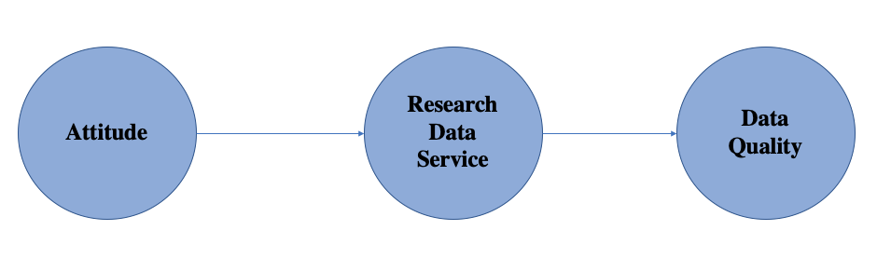
MODEL and HYPOTHESES
H1: There is a significant relationship between Attitude and Research Data Service.
H2: There is a significant relationship between the Research Data Service and Data Quality.

Slide 7
Literature review
Attitude
Research Data Service
Data Quality

Slide 8
METHODS
A quantitative approach
This study targeted Indonesian academic librarians
Purposive sampling
Online questionnaire
4 months
SEM-PLS

Slide 9
RESULTS
 | Frequency | Percent
Yes | 45 | 77.6
Some | 13 | 22.4
Academic librarians claim that their libraries provide research data service.

Slide 10
RESULTS
 | Frequency | Percent
< 5 years | 14 | 24.1
5 – 9 years | 5 | 8.6
10 - 14 years | 8 | 13.8
15 - 19 years | 11 | 19.0
> 19 years | 20 | 34.5
5 categories of academic librarians’s working years.

Slide 11
RESULTS
 | Cronbach’s alpha | rho_A | Composite Reliability | AVE
Attitude | 0.918 | 0.928 | 0.960 | 0.924
Research Data Service | 0.980 | 0.981 | 0.982 | 0.798
Data Quality | 0.938 | 0.944 | 0.945 | 0.537
Validity and reliability test using Cronbach’s alpha, rho_A, composite reliability, and Average Variance Extracted (AVE).

Slide 12
RESULTS
 | R² | R² Adjusted
Data Quality | 0.521 | 0.512
RDS | 0.470 | 0.460
R² values represent the proportion of variance in the dependent variable that the model explains.

Slide 13
RESULTS
 | β | t-value | p-value | f²
Attitude → RDS | 0.685 | 8.916 | 0.000 | 0.886
RDS → Data Quality | 0.722 | 9.450 | 0.000 | 1.087
Path coefficient, hypotheses, and effect size are tested.
The path coefficients (β) serve as indicators of the strength and direction of the relationships between constructs in the model.
The t-values and p-values demonstrate the statistical significance of model construct relationships.
The f² values indicate the estimated effect sizes of the predictors on the endogenous constructs in the model.

Slide 14
DISCUSSION
Attitude has a significant relationship with library services, including the research data service, which aligns with Oden & Owalobi’s research (2022).
Academic librarians must maintain a positive attitude to realize the full potential of research data service delivery.

Slide 15
DISCUSSION
Since research data services in the academic libraries can be the centre of audits and data quality verification (Giarlo, 2013), it is important to have the right attitude towards research data services.
The results of this study indicate that Indonesian academic librarians have a positive attitude towards research data services, which leads to improved data quality.

Slide 16
conclusion
Attitude has a positive effect on the Research Data Service, which in turn positively impacts data quality.
Librarians’ attitudes are important to library service delivery, especially in this case, research data service, and data quality through structured service and activities.
Academic libraries can improve research data services and data quality by fostering librarian development, training, and an encouraging work environment to improve librarians’ attitudes.

Slide 17
REFERENCE
Giarlo, M.J. (2013), “Academic Libraries as Data Quality Hubs”, Journal of Librarianship and Scholarly Communication, Iowa State University, Vol. 1 No. 3, doi: 10.7710/2162-3309.1059.
Hassenstein, M.J. and Vanella, P. (2022), “Data Quality—Concepts and Problems”, Encyclopedia, MDPI AG, Vol. 2 No. 1, pp. 498–510, doi: 10.3390/encyclopedia2010032
Oden, A.N. and Owolabi, R.O. (2022), “Staff Attitude and Service Delivery in University Libraries in Ogun State, Nigeria”, Information Impact: Journal of Information and Knowledge Management, Vol. 12 No. 2, pp. 17–29, doi: 10.4314/iijikm.v12i2.2.
Tenopir, C., Sandusky, R.J., Allard, S. and Birch, B. (2013), “Academic librarians and research data services: preparation and attitudes”, IFLA Journal, Vol. 39 No. 1, pp. 70–78, doi: 10.1177/0340035212473089.

