Slide 1
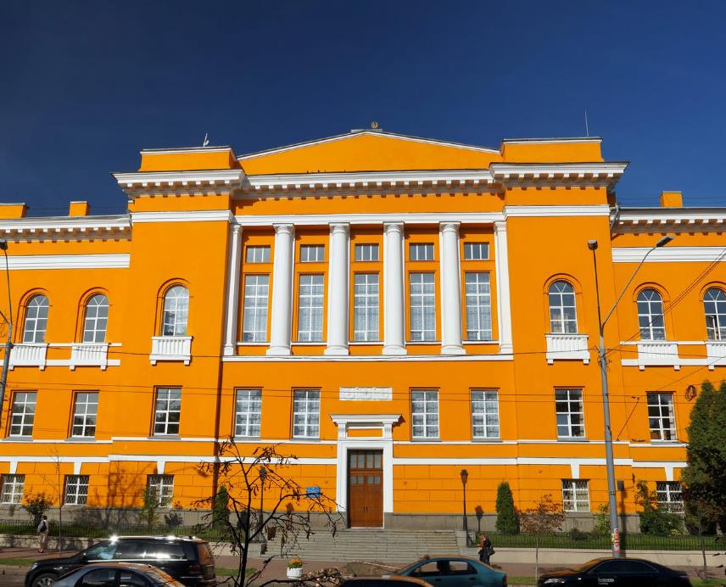
University libraries of Ukraine during the Russian invasion
Oleh Serbin
Director of the Maksymovych Scientific Library of the Taras Shevchenko National University of Kyiv
Notes:
ПРИМІТКА.
Щоб змінити зображення на цьому слайді, виділіть зображення та видаліть його. Потім у покажчику місця заповнення клацніть піктограму "Зображення", щоб вставити власне зображення.

Slide 2
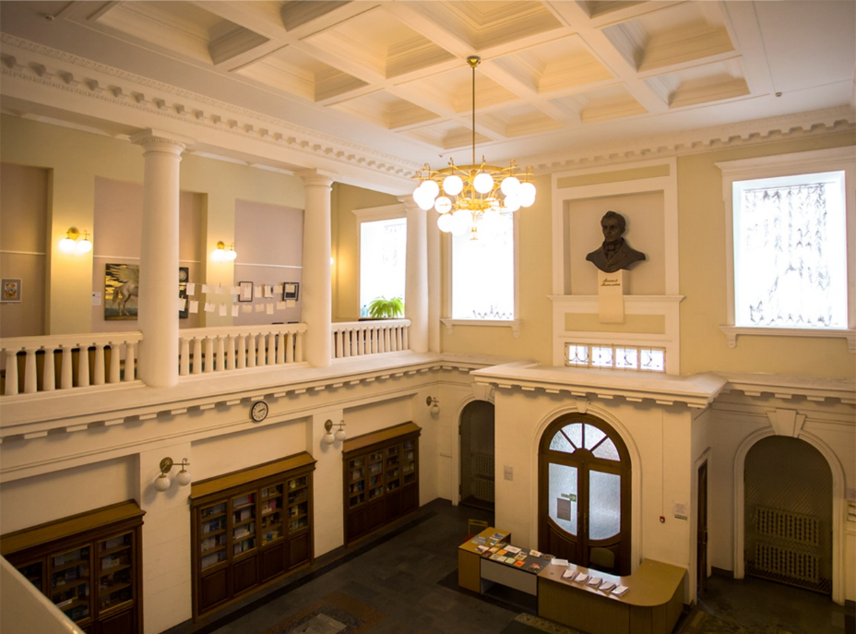
Maksymovych Scientific Library of the Taras Shevchenko National University of Kyiv
The Maksymovych Scientific Library of the Taras Shevchenko National University of Kyiv is a scientific and methodical center that provides general methodical guidance and coordination of libraries of higher education institutions of Ukraine.
Despite the difficult times that our country is going through, we work as usual and continue to provide users with a full range of information and library services.

Slide 3
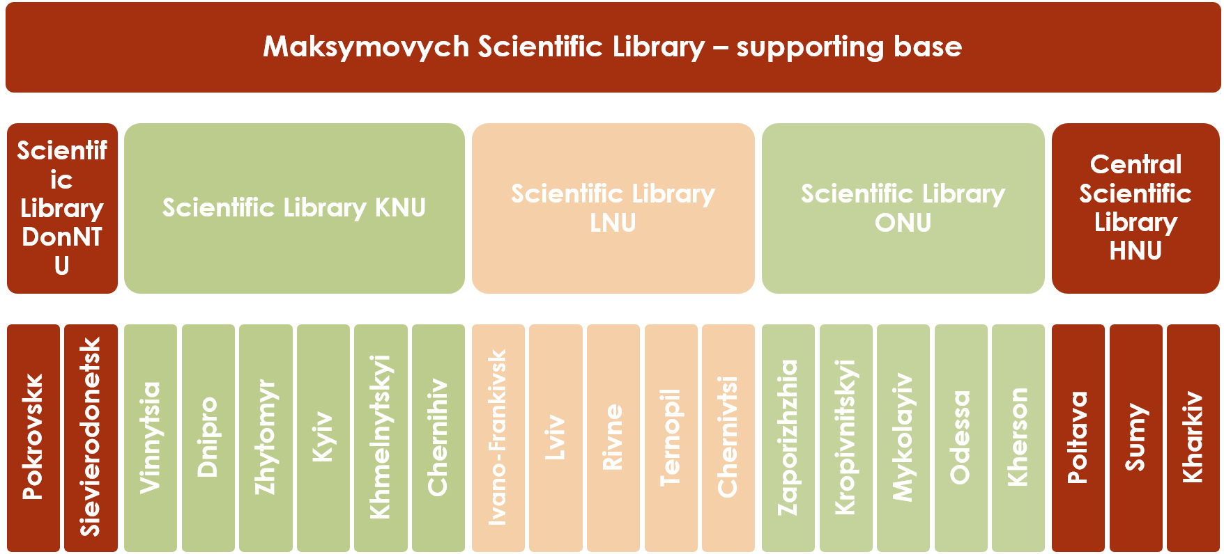
The organizational structure of methodological guidance and interaction

Slide 4
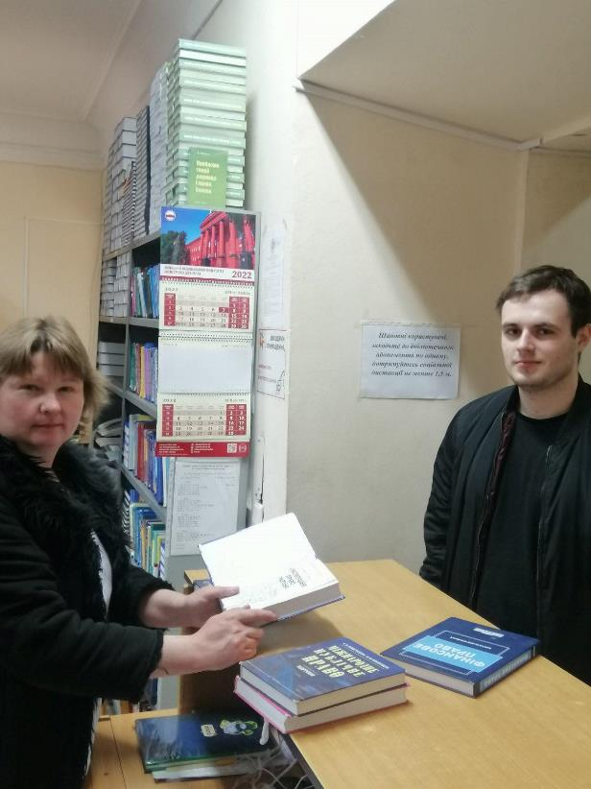
Educational & Scientific Literature Circulation Departments
During the war, the work of librarians not only remained useful, but also gained new importance for supporting readers with books.
The demand for books among students and teachers of the Taras Shevchenko National University of Kyiv has remained.
On a full-time basis we continue to serve users with both scientific and educational literature, as well as provide them with information and advisory assistance.

Slide 5






Information and Bibliographic Department
Information and bibliographic department provide daily analytical reviews of Internet publications in periodicals about Russian aggression, in particular, attacks on military and civilian infrastructure, resistance of Ukrainians and the reaction of the world community to these events.

Slide 6


Service of Information Monitoring
Service of Information Monitoring (SIM) of our library tracks the effectiveness of the presentation of scientific achievements of university research and teaching staff in the global information space.
It generates monthly digests of these publications that appear in the world periodicals with the highest CiteScore (Scopus) and Impact Factor (Web of Science Core Collection).
In addition, SIM continue to provide DOI registration services for the publications in University scientific journals and conference materials.

Slide 7

Marketing and Promotion Department
We implement the approach of providing our audience with quality and relevant content.
In particular, our Marketing and Promotion Department continues to inform readers and colleagues on social networks Facebook and Instagram about actual news and current results of activities in the library.
We also present virtual exhibitions of books on current topics.

Slide 8






Continuation of international cooperation during the war
Meeting «Voices from Ukraine: Ukrainian librarians in the struggle against the Russian invasion» (University of California, Berkeley, USA)
Working meeting on providing free remote access to British library resources (The University of Edinburgh, United Kingdom)
Online forum «Ukrainian librarians in the fight against Russian invasion" (Georgian Library Association, Georgia)
Project «Ukrainian Book in Croatia»: providing the Ukrainian community abroad with literature from our library’s exchange fund
Press conference «Cultural projects: supply of books to the centers of temporarily displaced residents of Ukraine in Montenegro and Poland»

Slide 9
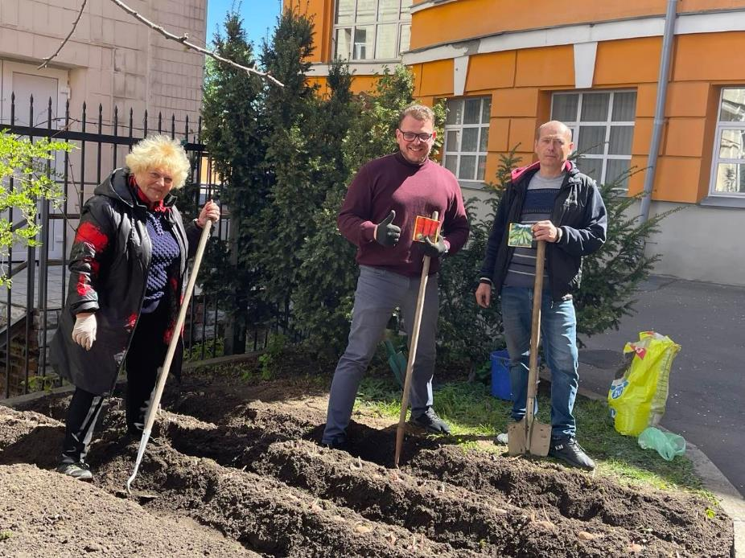
«Victory Gardens»
«Victory Gardens» is a project initiated by President Volodymyr Zelensky, which recommends to maximize the potential of Ukraine’s fertile soils.
Part of the land plot in the courtyard of our library we planted with vegetables used for cooking borscht.
We also called on all departments of the University and other libraries in Ukraine to join this initiative.

Slide 10
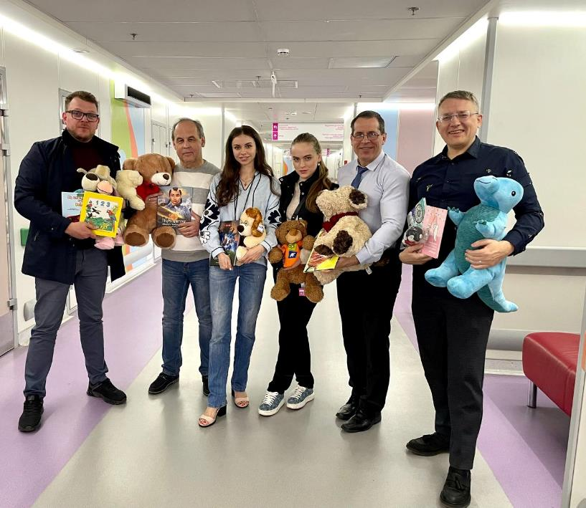
«Book Treats»
Once again, we have continued our long-standing project «Book Treats», which aims to collecting aid for the patients at the National Children’s Specialized Hospital «Okhmatdyt».
This time we handed over books and stuffed toys from our British partners to the children.

Slide 11
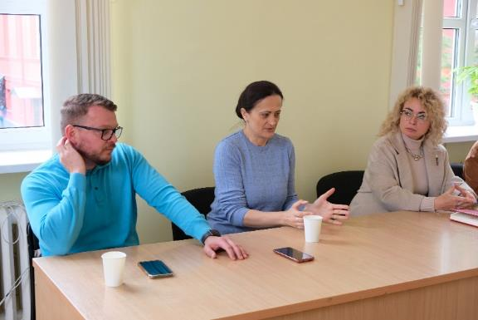
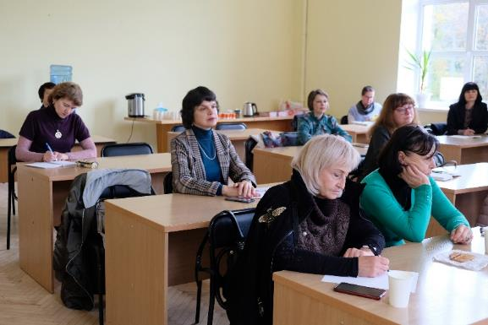
Methodical guidance of the university libraries
A meeting of directors of the university libraries from Kyiv took place on the basis of our library for the participation of the heads of the Ukrainian Library Association.
It was discussed the situation and features of the work of libraries during the period of martial law.
The urgent issues at the moment are the actualization of library funds and the mechanisms of writing off information resources in connection with the Russian armed aggression against Ukraine, as well as the development of new methods of reader service.

Slide 12
The main economics consequences of war for libraries
Infrastructure damage
Loss of book funds
Reduction of employees
Suspension of work and downtime
Forced part-time work

Slide 13
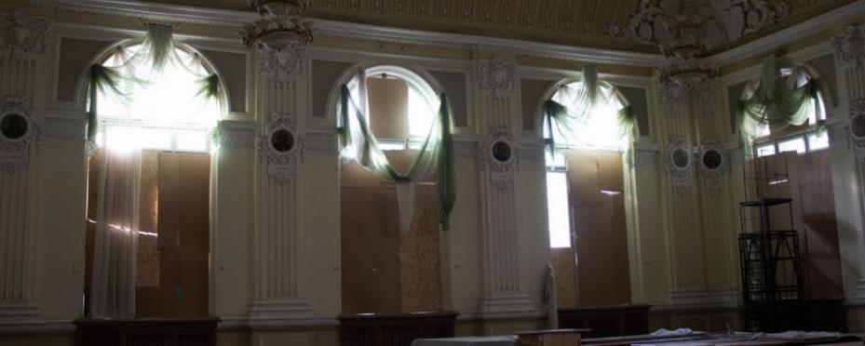
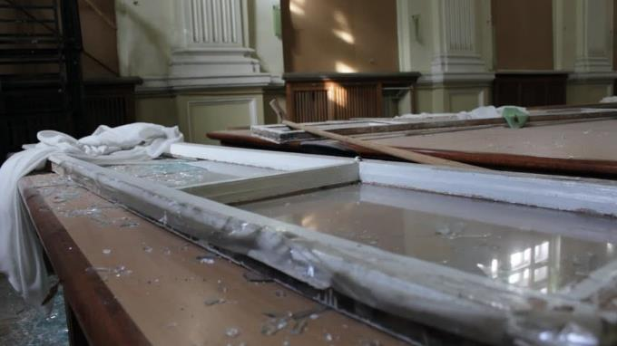
University libraries affected by the Russian invasion
Librarians in Kharkiv, Donetsk, Luhansk and other regions were forced to flee their working places because of the bombing of their buildings, the complete destruction of higher education institutions or occupation.
As a result, Volodymyr Dahl East Ukrainian National University (Severodonetsk), Luhansk State Medical University (Rubizhne) and others have moved to more safe regions of Ukraine.

Slide 14
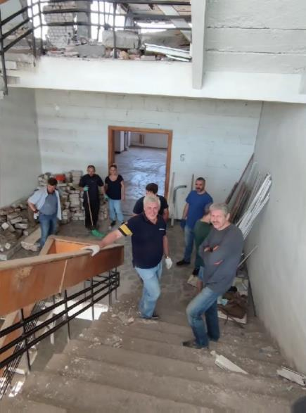
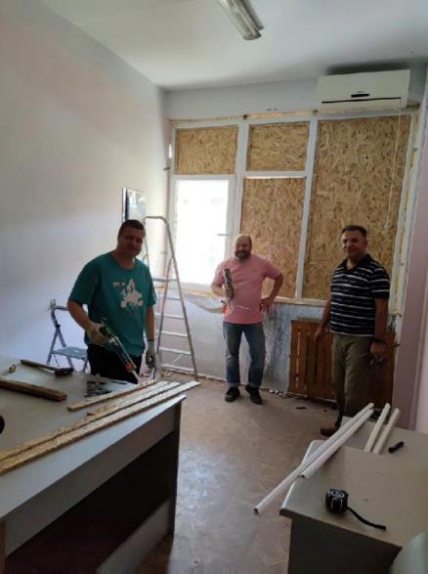
University libraries affected by the Russian invasion
The destruction of civilian infrastructure in the areas where the fighting continues, touched university libraries too. For example, the Central Scientific Library of Karazin National University of Kharkiv and Admiral Makarov National University of Shipbuilding in Mykolaiv were damaged.
If there is such a possibility, restoration of infrastructure and repairing are carried out.

Slide 15
How do other librarians help in safe regions of Ukraine?
Joining volunteer centers
Collecting aid for servicemen of the Armed Forces and internally displaced persons
Sorting food, clothing and essentials
Making camouflage nets for the militaries
Preparing food
Offering leisure for displaced children
Organizing trainings on first aid
Sending Ukrainian-language books to refugees abroad
Providing temporary shelters to colleagues evacuated from dangerous regions

Slide 16
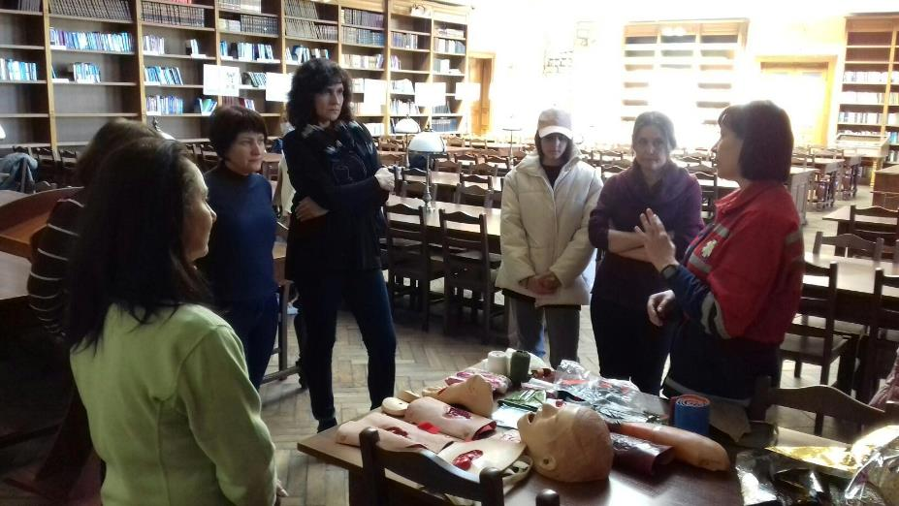
Scientific Library of the Ivan Franko National University of Lviv
The scientific Library of the Ivan Franko National University of Lviv has organized a volunteer center for humanitarian support for meeting the needs of the Armed Forces and the residents of affected regions.

Slide 17
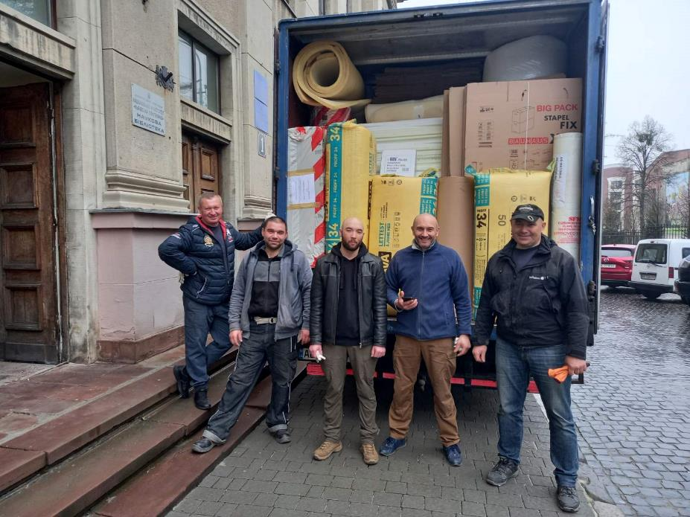
Scientific and Technical Library of the National University «Lviv Polytechnic»
The public initiative «Cultural Heritage Center» was established in the Scientific and Technical Library of the National University «Lviv Polytechnic» for collection of equipment and materials from foreign partners and patrons for the protection and preservation of historical and cultural monuments, religious buildings and museum collections throughout Ukraine.

Slide 18
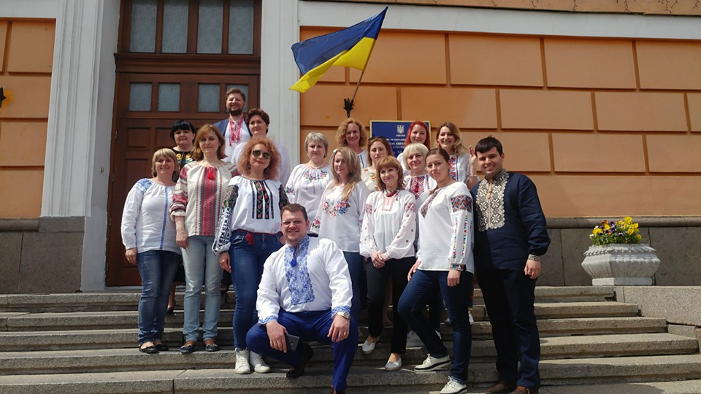


Thank you for your attention!
Volodymyrska St, 58
(044) 239-34-40
http://www.library.univ.kiev.ua/
libcancel@univ.kiev.ua
MaksymovychScientificLibrary
maksymovych.library

