Slide 1


Professional Competencies and Job Performance of Select Academic Librarians in the 21st Century
Novie Claire Rambuyon
Joseph M. Yap
Analou P. Duguil
Jenefer D. Padilla
University of Perpetual Help System - Binan
Presented by
Novie Claire Rambuyon
UniLibNSCD Conference| 2023

Slide 2


Presentation Outline
Intoduction
Objectives
Theoretical Framework
Methodology
Findings/Result
Discussion
Conclusion
Recommendations

Slide 3
Presented by
Novie Claire Rambuyon
UniLibNSCD Conference| 2023
INTRODUCTION
According to Budd (1998), the academic library is an integral aspect of the institution's politics and culture. Any event that has an impact on higher education has an immediate impact on academic libraries.
There are issues with how librarianship is introduced, particularly in post-generation Z, when individuals have misconceptions about the functions of librarians. After intense education and training, Filipino librarians are prepared to be part of the workforce.
The Commission on Higher Education (CHED) and accrediting organizations set requirements for libraries in the Philippines. Standards have also been set by organizations that promote libraries, such as the Philippine Association of Academic and Research Librarians (PAARL).

Slide 4
Presented by
Novie Claire Rambuyon
UniLibNSCD Conference| 2023
INTRODUCTION
The Professional Regulatory Board for Librarians (PRBFL) launched a consultative workshop to define standards and competencies for library professionals and to develop National Competency-Based Standards for Librarians (NCBSL).
Visible abilities such as knowledge and skills may be somewhat technical competencies that are essentially required by the job and drive an individual's job performance (Vathanophas, 2007).

Slide 5
Presented by
Novie Claire Rambuyon
UniLibNSCD Conference| 2023
OBJECTIVE
  Determine the demographic profile of respondents
  Identify the level of academic librarian’s professional competencies
  Identify the level of academic librarian’s job performance
  Determine the significant difference of respondents’ level of professional competencies and job performance when grouped according to their profile variables
  Determine the significant relationship between the respondents’ level of professional competencies and level of job performance

Slide 6
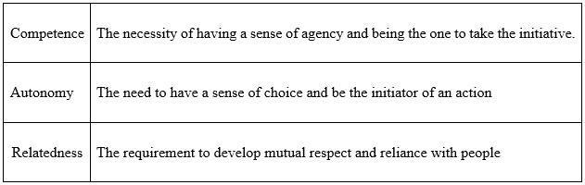
Presented by
Novie Claire Rambuyon
UniLibNSCD Conference| 2023
THEORETICAL FRAMEWORK
Self-Determination Theory by Garraido (2023)

Slide 7
Presented by
Novie Claire Rambuyon
UniLibNSCD Conference| 2023
METHODOLOGY
Descriptive-correlation method of research is used to answer the specific questions. The self-made questionnaire was based on the National Competency-Based Standards for Filipino Librarians by the Professional Regulatory Commission (PRC). The respondent’s sample size was calculated using a Raosoft calculator with a 95% confidence level and a 5% margin of error.

Slide 8
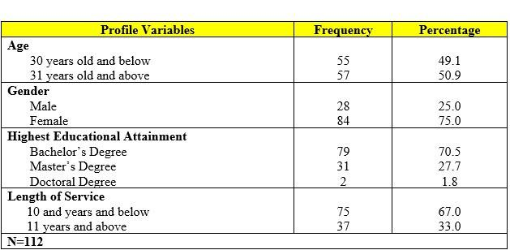
Presented by
Novie Claire Rambuyon
UniLibNSCD Conference| 2023
FINDINGS/RESULT
Profile of respondents

Slide 9
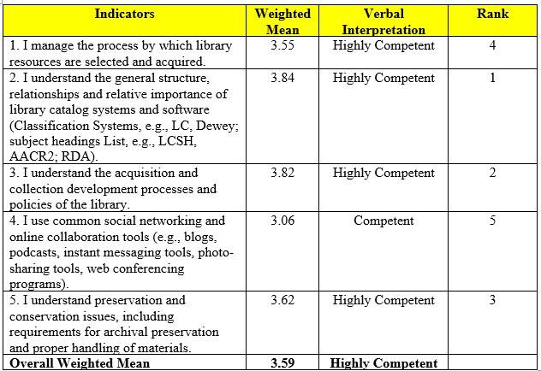
Presented by
Novie Claire Rambuyon
UniLibNSCD Conference| 2023
Respondents’ Level of
Professional Competencies:
Managing Information Sources

Slide 10
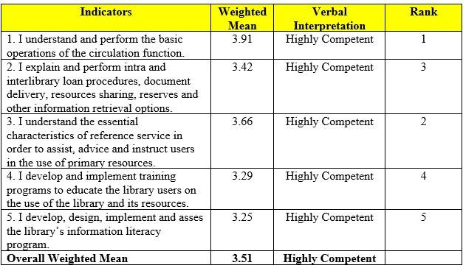
Presented by
Novie Claire Rambuyon
UniLibNSCD Conference| 2023
Respondents’ Level
of Professional
Competencies:
Managing
Information Services

Slide 11
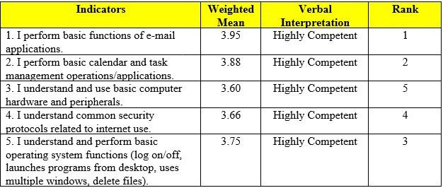
Presented by
Novie Claire Rambuyon
UniLibNSCD Conference| 2023
Respondents’ Level of Professional Competencies: Managing Information Technologies

Slide 12
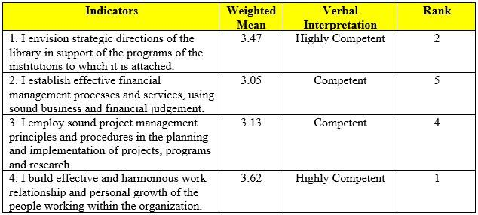
Presented by
Novie Claire Rambuyon
UniLibNSCD Conference| 2023
Respondents’ Level of Professional Competencies: Managing Information Organization

Slide 13
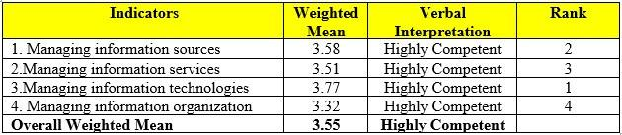
Presented by
Novie Claire Rambuyon
UniLibNSCD Conference| 2023
Summary Table of the Respondents’ Level of Professional Competencies

Slide 14
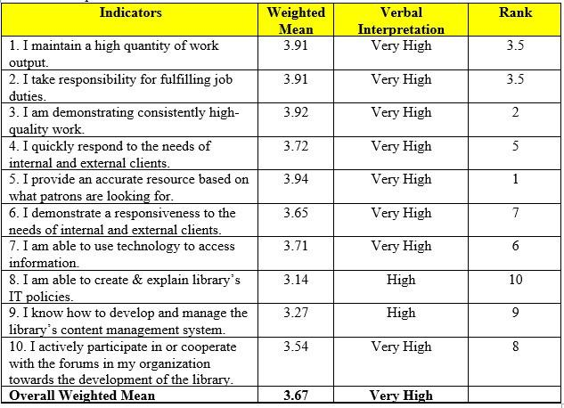
Presented by
Novie Claire Rambuyon
UniLibNSCD Conference| 2023
Respondents’ Level of
Job Performance

Slide 15
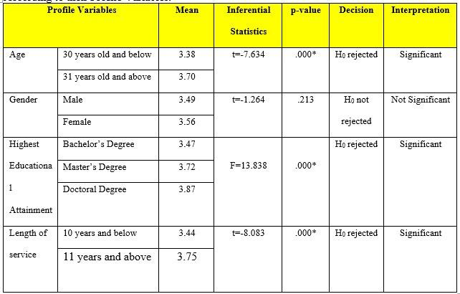
Presented by
Novie Claire Rambuyon
UniLibNSCD Conference| 2023
Difference in the
Respondents’ Level
of Professional
Competencies When
Grouped According to
their Profile Variables.

Slide 16
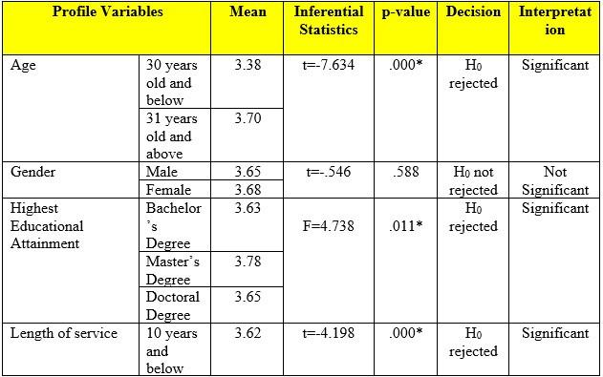
Presented by
Novie Claire Rambuyon
UniLibNSCD Conference| 2023
Difference in the
Respondents’ Level of Job
Performance When Grouped According to their Profile Variables

Slide 17
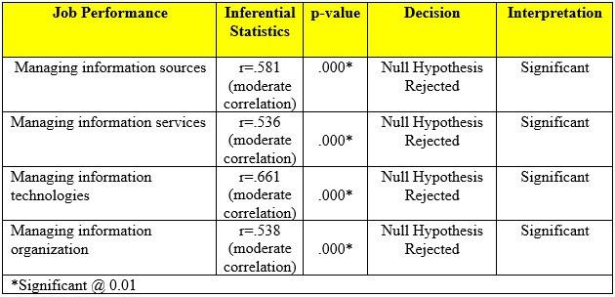
Presented by
Novie Claire Rambuyon
UniLibNSCD Conference| 2023
Relationship Between the Respondents’ Level of Professional Competencies and Level of Job Performance.

Slide 18
Presented by
Novie Claire Rambuyon
UniLibNSCD Conference| 2023
DISCUSSION
Self-determination is the idea that people are driven to engage in activities that need the fulfillment of competence, autonomy, and relatedness to achieve them. Having highly competent academic librarians can identify that they fulfill what is needed which leads them to attain a high level of job performance. As well-determined professionals, this will be having an impact on how people address the role of this kind of profession.
As they attain a high level of competencies and job performance, it is necessary for the head and chief librarian to determine the skills and knowledge of their employees including their profile for them to be assigned in an area that is aligned or matched to their ability to perform the tasks well. In that way, it will serve also to determine what area they should improve.

Slide 19
Presented by
Novie Claire Rambuyon
UniLibNSCD Conference| 2023
CONCLUSION
The academic librarians are highly competent in managing information technologies among four domains of professional competencies: managing information resources, managing information services, managing information organization, and managing information technology.
They achieved very high level of job performance maintaining high quantity of work, fulfilling job duties, consistent for high quality of work, respond to the needs of users, provide accurate resources, demonstrate responsiveness, able to use technology, and actively participate in forums.
The higher the respondents’ level of professional competencies in all its dimensions, the higher the level of respondents’ job performance

Slide 20
Presented by
Novie Claire Rambuyon
UniLibNSCD Conference| 2023
RECOMMENDATION
Administrators of higher education institution (HEIs) should encourage attendance of chief librarians to implement seminars to introduce financial management including its process and services for the development of the academic librarian's knowledge and skills.
Academic librarians should participate in forums and training about information technology especially to older librarians due they are not more engaged with the use of recent technology.
Newly licensed librarians and bachelors should pursue master's degree while continuing their service as academic librarians to obtain additional knowledge and experience for the development of their professional competencies and job performance.

Slide 21
Presented by
Novie Claire Rambuyon
UniLibNSCD Conference| 2023
REFERENCES
Budd, J. M. (1998). The academic library: Its context, its purpose, and its operation.
Libraries Unlimited
Vathanophas, V. (2007). Competency requirements for effective job performance in
the thai public sector. Contemporary Management Research. Vol. 3 no. 1.
https://doi.org/10.7903/cmr.49

Slide 22
Page
UniLibNSCD Conference| 2023
THANK YOU

