Slide 1
Library and information services for national minorities and indigenous peoples of Ukraine in the context of contemporary challenges
Iryna PETROVA,
(Mariupol State University, Kyiv, Ukraine)
Yevhen HORB,
(Mariupol State University, Kyiv, Ukraine / CEFRES, Prague, Czech Republic)

Slide 2
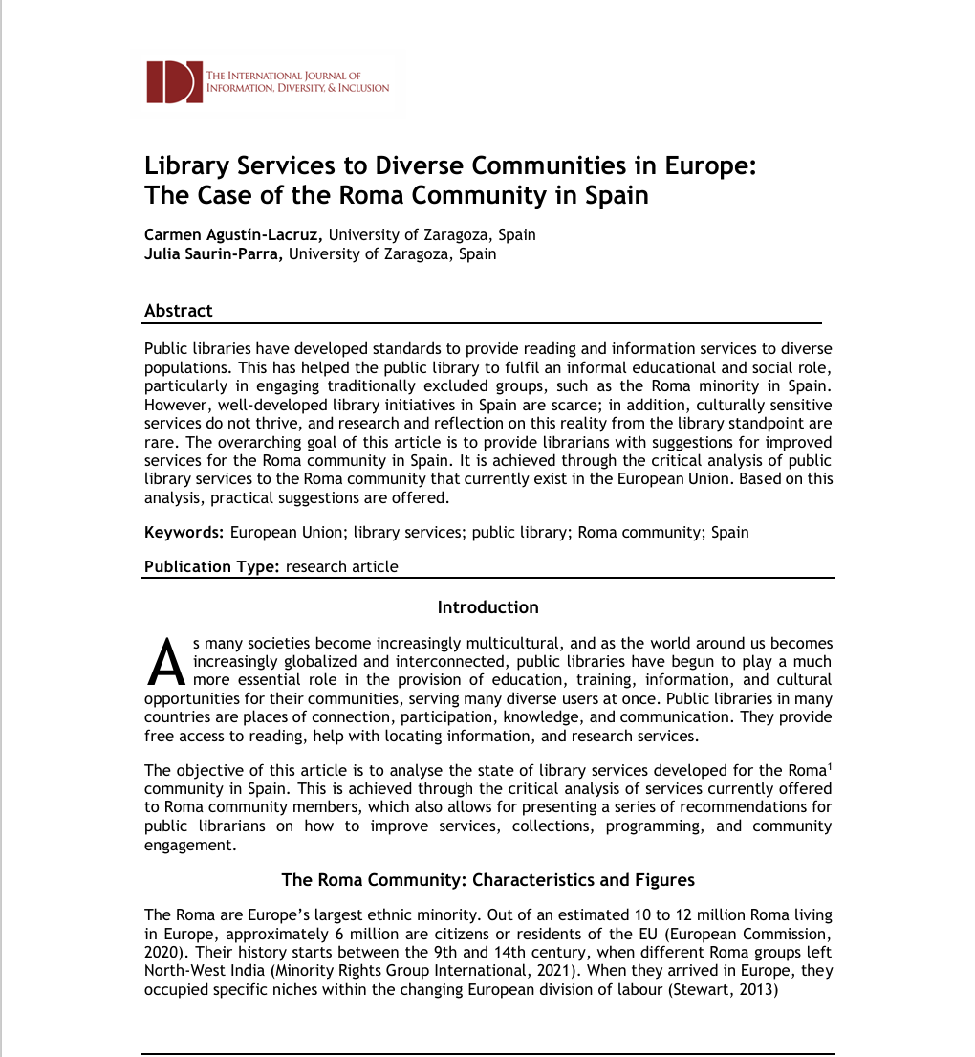
Problem area of research
conceptual studies;
case studies;
issues of library services for migrants;
practitioners' experience

Slide 3
Number of documents in the Ukrainian library collection (public libraries) by language (%), 2020

Slide 4
Number of documents in the Ukrainian library collection (public libraries) by language (%), 2023 and 2024

Slide 5
Number of documents in the Ukrainian library collection (public libraries) in the languages of national minorities and indigenous peoples (%), 2020, 2023 and 2024

Slide 6
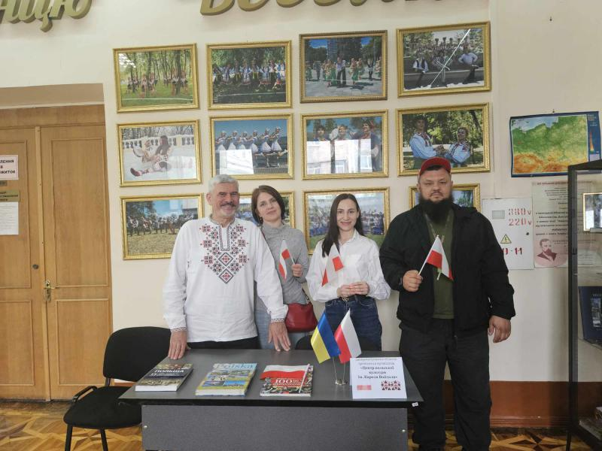
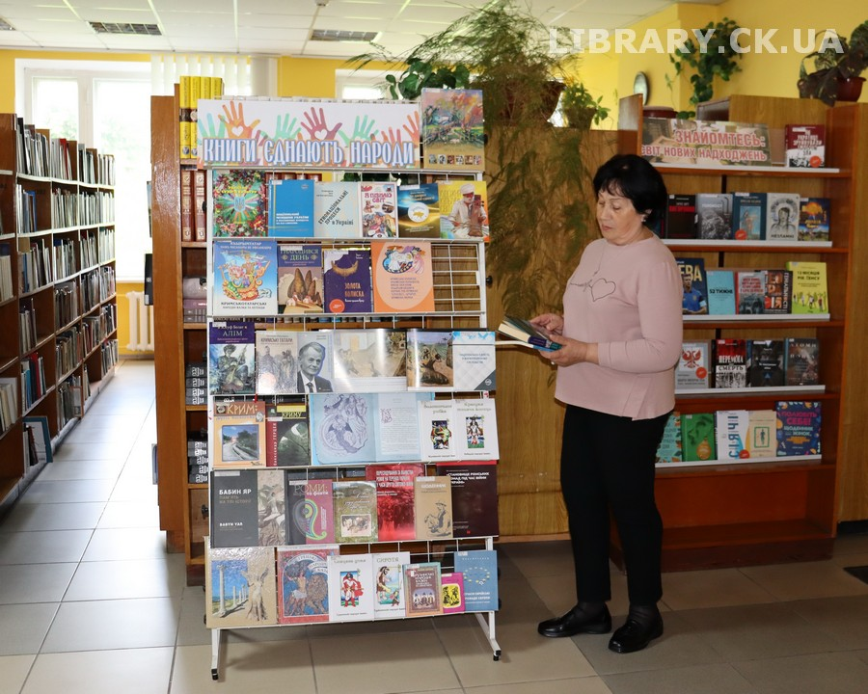
The Day of Interethnic Harmony and Cultural Diversity
Cherkasy Regional Universal Scientific Library named after Taras Shevchenko
Dnipropetrovsk Regional Universal Scientific Library named after Cyril and Methodius

Slide 7
Roadmap “Equal access of national minorities and indigenous peoples to library services in Ukraine”
Focus on electronic libraries and digital publications
Libraries as digital publishers
Launching the “Mobile Library” project for areas with compact settlements of national communities
National Resource Centre for Literature in the Languages of Ethnic Communities of Ukraine
Initiate the creation of the position of “consultant on national minorities and indigenous peoples” in regional public libraries

Slide 8
Many thanks for your attention!
Iryna PETROVA, e-mail: i.petrova@mu.edu.ua, ORCID: 0000-0002-9032-3203
Yevhen HORB, e-mail: e.gorb@mu.edu.ua, ORCID: 0000-0002-9782-919

