Slide 1
Libraries Civic Roles and Responsibilities:
Issues in Information Crises and Information Disorders
VIІІ International Conference
University Library at New Stage of Social Communications Development
Theme: Library and Knowledge Management in Times of Crisis
October 5-6, 2023
Joseph M. Yap
Ph.D. candidate
Eotvos Lorand University
Budapest, Hungary

Slide 2
Content of the Presentation
Introduction
Research Problems
Literature Review
Methodology
Findings
Conclusion
Reference

Slide 3

Introduction
Public libraries are strong advocates of civic engagement. Libraries that educate and inform society have a responsibility to rekindle civil society and must spread their role beyond physical and virtual space.
Notes:
https://unsplash.com/photos/Nwkh-n6l25w

Slide 4
Definition
Civic engagement are defined as the idea by which a set of knowledge, skills, values, motivation, and actions are developed to create change and make a better society (Singh, 2020; Coward, et al., 2018; Ehrlich, 2000).
[Public] libraries fully utilize their civic role by strengthening democratic movements by providing access and information freely available to all to develop a mature civil society (Kranich, 2012).

Slide 5

Civic Librarianship
Civic librarianship seeks to strengthen communities through developmental strategies that renew the public library’s mission of education for a democratic society (McCabe, 2001).
Public library exists because it has a moral responsibility of improving democracy by providing education to its community.

Slide 6
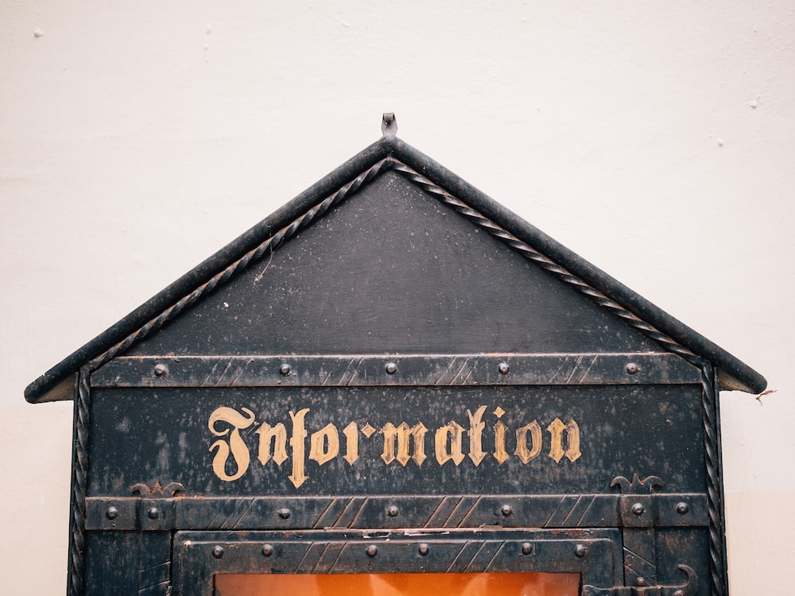
The challenge that libraries are facing: identifying accurate information
Notes:
https://unsplash.com/photos/WUvBROPOsuo

Slide 7
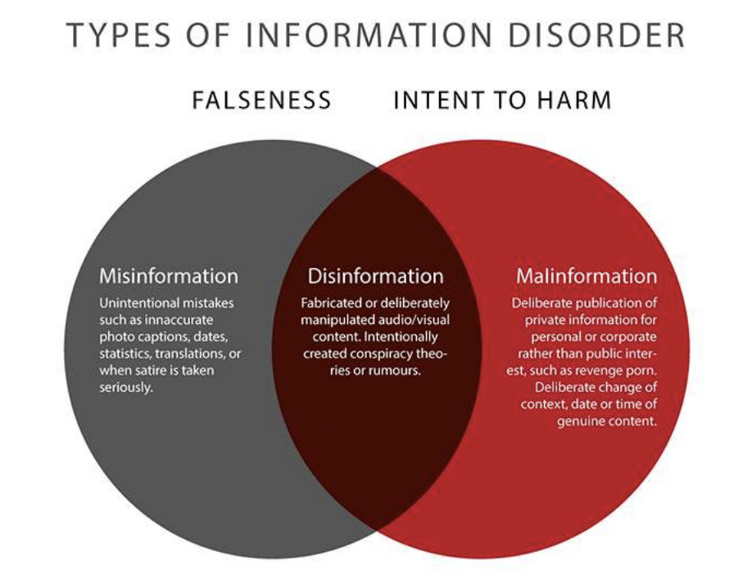
Information Crisis and Information Disorders
Cooper, 2021
Rumors online can easily trigger information crises and cause ﬁnancial costs (Jin & Austin, 2017).

Slide 8

Research Problems
How do librarians activate their civic roles in facing information disorders?
How do Filipino librarians define or construct the information disorder phenomenon?

Slide 9
Literature Review
Civic Initiatives | Description
Library as Civic Space | Libraries offer safe spaces
Library as Enabler of Civic Literacy | Libraries enable citizens to become smart seekers in producing content
Library as Conversation Catalyst | Libraries help citizens create a deep understanding of other’s opinions
Library as Civic Information Center | Libraries facilitate e-government services
Library as Partner in Public Service | Libraries collaborate to enhance services
Democratic nations are best exemplified when public participation is alive and citizens are part of the decision making and public policy process.
Some civic initiatives identified by Kranich (2012)

Slide 10
Civic engagement challenges in libraries
Lack of civic skills among librarians
Professional challenges
Political perception
Scope creep

Slide 11
Methodology
Discourse analysis investigates the process by which individuals create and shape reality through the attribution of meanings (Jager & Maier, 2016).
Discourse analysis is an approach embraced in LIS because it is a multidisciplinary method where the object of analysis comes from the serious speech acts of community experts where the context of speech distinguishes truth and falsity (Frohmann, 1994).
Buschmann (2007) thinks that the work of Foucault as adopted in LIS needs more reflection to reach a critical-theoretical LIS.

Slide 12
The Process
Pilot study considered public librarians from one of the multi-awarded public library in the Philippines.
Public librarians were selected based on their performance as identified by the head librarian.
An online anonymized interview was scheduled.
The transcripts were collected and transferred to an Excel file.
This file was uploaded to Nvivo 1.7.1 to analyze qualitative data and build thematic analysis.

Slide 13
Findings
ID | Age | Sex | Degree | Number of years in public library | When did you start your profession as librarian?
1 | 45 | f | MLIS | 10 | 2001
2 | 33 | m | BLIS | 4 | 2013
3 | 25 | f | BLIS | 5
4 | 55 | f | BLS | 7 | 2000
5 | 47 | m | MLIS | 6 | 2000

Slide 14
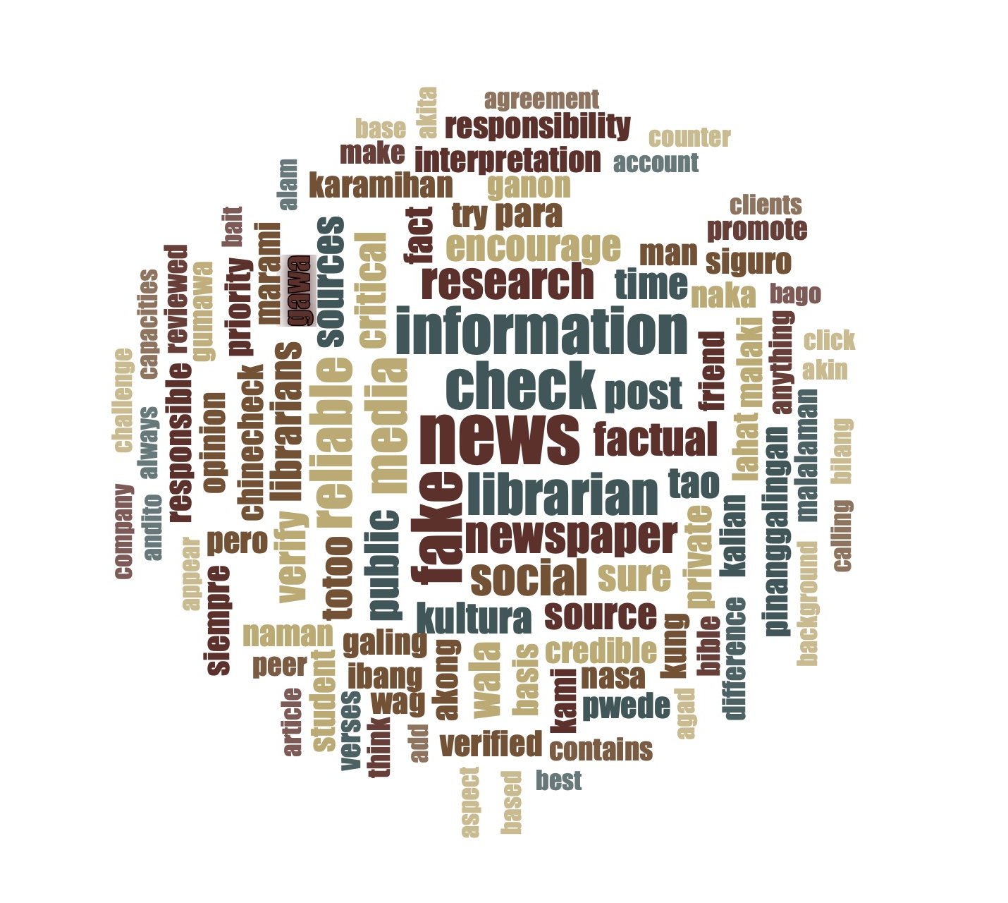
Common terms used in the interview

Slide 15
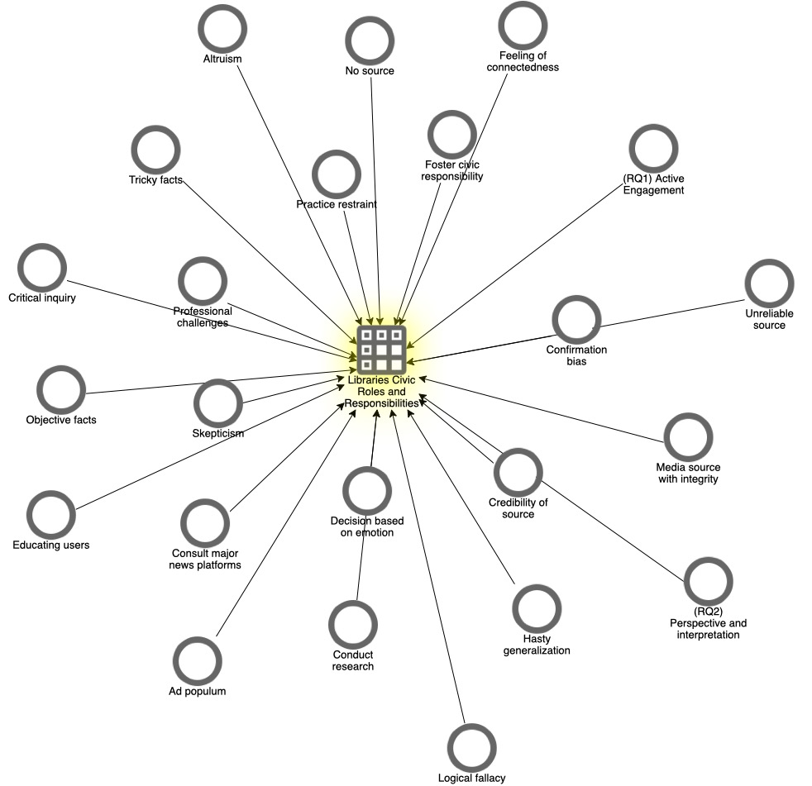
Themes
(Development stage)

Slide 16
RQ1
Name | Description
(RQ1) Active Engagement | How do librarians activate their civic roles in facing information disorders?
Altruism | The librarian builds trust and is willing to help clients in a friendly manner.
Consult major news platforms | Verifying news sources
Critical inquiry | Demonstration of behavior that we do not know everything that we thought we already know.
Conduct research | Reading, research, and meaning-making in literary research are deeply tied to an iterative process of inquiry: critical inquiry
Educating users | Performing their educational mission
Feeling of connectedness | According to Poynter Institute: We share to get credit and feedback for being a good sharer, to feel valuable in the eyes of others.
Foster civic responsibility | Maintains a balance between advocacy and neutrality
Practice restraint | Librarians know when to share content
Professional challenges | Librarians have to be trained and understand that they have civic roles to play.
How do librarians activate their civic roles in facing information disorders? (active engagement)

Slide 17
RQ2
(RQ2) Perspective and interpretation | How do Filipino librarians define or construct the information disorder phenomenon?
Confirmation bias | Select messages that only align with a person’s own opinion are accepted over other information.
Credibility of source | A criteria which is difficult to measure. Every information may be true or false and someone must decide on its credibility. Most of the time, when the receiver thinks he is satisfied with the information, then the person interprets on its credibility.
Decision based on emotion | What libraries want is to train users not to use emotions during emergency situations but to have a presence of mind when it comes to the accuracy of information.
Hasty generalization | This occurs when someone jumps to a conclusion based on biased or insufficient evidence.
Logical fallacy | problematic reasoning to argue on certain matters to persuade others and believe in them.
Ad populum | This fallacy appeals to positive ideals like religion or to negative fears like xenophobia to distract from the question being discussed.
Media source with integrity | Refers to the degree in which a piece of information is true or honest (Rügenhagen et al., 2020).
No source | Information with no attribution
Objective facts | Unbiased, balanced observation based on facts
Skepticism | Adding further steps before we accept or reject an information
Tricky facts | There are facts that are controversial, and the credibility of information is in question.
Unreliable source | Sources that maybe inaccurate, bias or false
How do Filipino librarians define or construct the information disorder phenomenon? (perspective and interpretation)

Slide 18

Discussion (Extracts)
Foster civic responsibility
  “Ang tingin ko talaga ay criticality. Nakita ko na malaki ang responsibility ng librarians pagdating sa information.”
  “I view a sense of critical thinking. Librarians have a huge responsibility when it comes to information.”

Slide 19

More questions than answers
What is the extent of a librarians’ responsibility?
How should librarians accept this role?
Can a Filipino public librarian practice civic librarianship?

Slide 20
Discussion (Extracts)
Skepticism
  “May friend ako na nag share ng quotes, chinecheck ko muna kung kanino galing. Pag may doubt, chinecheck. Pag familiar o reliable ang source, ok naman.”
  “I have a friend who shares quotations, I check the source. If there is doubt, I check it. If the source is familiar and reliable, I believe it is okay.”

Slide 21
Being an expert requires a lot of practice to determine which one is credible or not
One great advice is to practice skepticism. In processing the information we receive, we must add further steps before we accept or reject an information.

Slide 22
Conclusion
Active Engagement
Perspective
Public librarians are aware of the professional challenges brought by social media information disorders.
Civic responsibility is associated with fact checking and the value of librarianship as a profession.
Objects seen on social media are handled with skepticism.
Public librarians look for objective facts (verified and published information) to ensure the integrity of the source.

Slide 23
References
Buschman, J. (2007). Transgression or stasis? Challenging Foucault in LIS theory. The Library Quarterly, 77(1), 21-44.
Cooper, A. (2021). Information disorder: Are librarians able to counter the spread and effects of fake-news, misinformation and disinformation in a post-truth world. https://hcommons.org/deposits/objects/hc:37448/datastreams/CONTENT/content
Coward, C., McClay, C., Garrido, M. (2018). Public libraries as platforms for civic engagement. Seattle: Technology & Social Change Group, University of Washington Information School.
Ehrlich, T. (2000). Civic responsibility and higher education. Oryx Press.
Frohmann, B. (1994). Discourse analysis as a research method in library and information science. Library and information science research, 16(2), 119-38.
Jager, S., & Maier, F. (2016). Analyzing discourses and dispositives: A Foucauldian approach to theory and methodology. In In R. Wodak & M. Meyer, Methods of critical discourse studies (pp. 109-136), 3rd ed.. Sage.
Jin, Y., & Austin, L. L. (Eds.). (2017). Social media and crisis communication. Taylor & Francis.
Kranich, N. (2012). Libraries and civic engagement. Rutgers University Community Repository, DOI: http://dx.doi.org/doi:10.7282/T3VX0DWS.
Singh, R. (2020) Promoting civic engagement through cultivating culturally competent self-reflexive information professionals. Journal of the Australian Library and Information Association, 69(3): 302-315, DOI: 10.1080/24750158.2020.1777635

