Slide 1
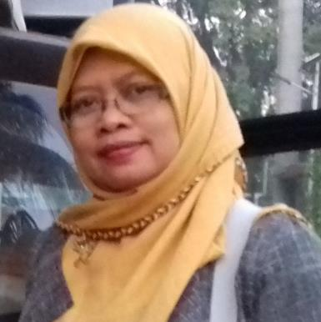
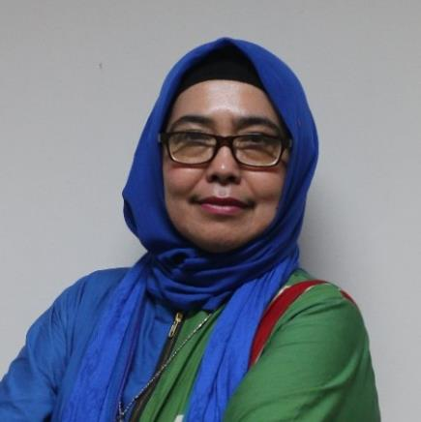
Reaching Users Through Social Media: A Case Study On The Use Of Instagram By Islamic Higher Education Libraries In Indonesia
UniLibNSD 2023
Marwiyah, MLIS
Lecturer, UIN Sunan Kalijaga Yogyakarta-Indonesia
marwiyah.mlis@uin-suka.ac.id
Dr. Labibah
Lecturer, UIN Sunan Kalijaga Yogyakarta-Indonesia
labibah@uin-suka.ac.id

Slide 2

Content
1
Background
2
The purposes of the research
3
Methodology
4
Finding and discussion
5
Conclusion

Slide 3

01
Background
The development of information technology → the most important tools to support daily activities
The rise of social media has changed the way people communicate → Information can be easily shared and accepted throughout the world

Slide 4
The use of social media
Education: to support learning
Business → promotion, selling product
Politic → campaign
Health → the intensive use of social media during covid 19 outbreak
Library

Slide 5

The use of social media in the library
China: use social media to promote library services and resources (Xin & Yingxi, 2022)
Indonesia:
  promoting library access and services
  promoting new sources and material, sharing information about the library, socializing the library programs, and sharing information about social and cultural activities
Social media even help students with up-to-date information which is not related to library services
This Photo by Unknown Author is licensed under CC BY-SA

Slide 6
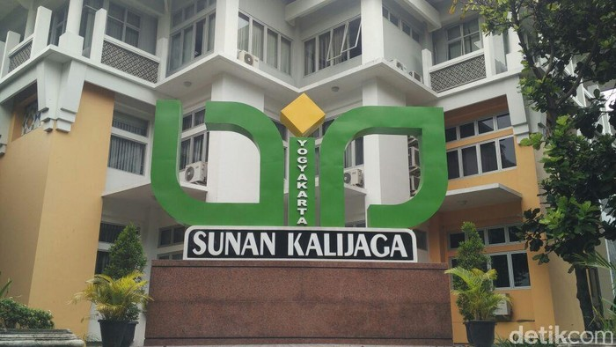
During Covid-19 pandemic era
Lockdown policies in most countries
The use of social media increases to support the learning process (online learning)
The increased use of social media in libraries → as a tool to deliver library services
Lesson learned:
  Social media is a solution for facing a “crisis moment”
  Social media also enable libraries to provide user-centric innovative services
  Social media also enable libraries to provide user-centric innovative services
  The use of social media to communicate with users: to promote library collections and services
  In short: social media can be used by libraries to reach their users

Slide 7
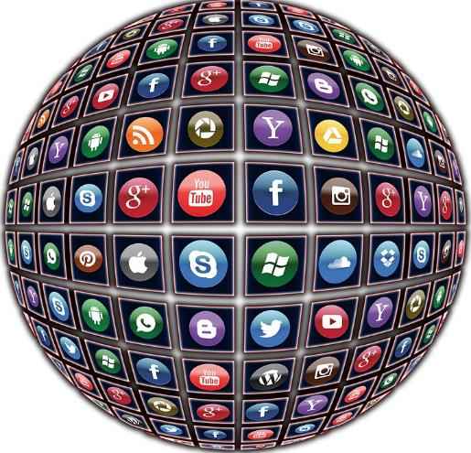
Libraries in Islamic Higher Education in Indonesia: The Islamic State University (UIN) libraries also use social media to communicate with users during the pandemic era → users’ responses were good
How about post-Covid-19 era?
Focus: Instagram

Slide 8
Questions:
Do libraries in Islamic Higher Education still use social media to reach their users?
Do users still use social media as a means to get information and access library services?

Slide 9

02
The purposes of the research

Slide 10

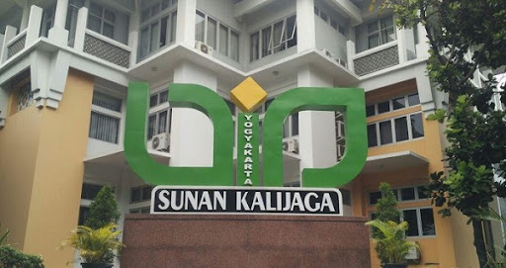
1.
2.
To identify the use of social media in Indonesian Islamic Higher Education Libraries to reach their users, assist users in finding information, and make users stay connected with the library
To uncover how users benefit from the information posted in the libraries’ Instagram accounts, by seeing the users’ responses to the Instagram posts

Slide 11


03
Methodology

Slide 12
Methodology for research on social media
Type of Research
Data Gathering
Data being observed
small samples of Instagram data paired with a qualitative approach using content analysis
The technique of data gathering: observation on Instagram posts and users’ responses to them: like, comment, share and save
Instagram posts made during one academic year (2022-2023) that start from July 2022 to June 2023

Slide 13



Sample: 3 Instagram of UIN library accounts with the greatest followers
Library of UIN Sunan Kalijaga Yogyakarta (UIN Yogyakarta) with 22.300 followers
Library of UIN Syarif Hidayatullah Jakarta (UIN Jakarta) with 13.500 followers
Library of UIN Syarifuddin Zuhri Purwokerto (UIN Purwokerto) with 10.200 followers

Slide 14
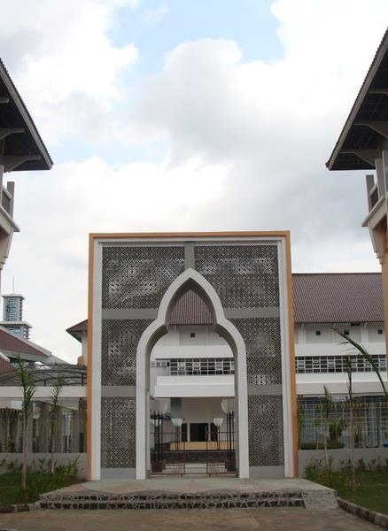
04
Finding and discussion
Users’ responses to the Instagram posts taken on a monthly basis
Users’ Responses based on Content

Slide 15

1. Users’ responses to the Instagram posts taken on a monthly basis
Each library has a different policy on how to use social media for sharing information
UIN Yogyakarta: Instagram post on a daily basis with information content as planned for each day using the academic calendar as a guideline
UIN Purwokerto: only post information related to announcements, while information on library activities, collections, and services is posted on the library website
UIN Jakarta: do not have a specific policy on posting on Instagram

Slide 16
Instagram Posts and Users’ Responses
Library of UIN Yogyakarta
 | Jul-22 | Aug-22 | Sep-22 | Oct-22 | Nov-22 | Dec-22 | Jan-23 | Feb-23 | Mar-23 | Apr-23 | May-23 | Jun-23 | Total
Post | 29 | 29 | 29 | 30 | 26 | 28 | 32 | 30 | 30 | 21 | 29 | 26 | 339
Like | 3.322 | 6.528 | 5.943 | 6.437 | 7.305 | 8.390 | 6.582 | 4.685 | 5.904 | 1.942 | 8.480 | 3.388 | 68.906
Comment | 9 | 73 | 30 | 35 | 63 | 120 | 108 | 55 | 88 | 56 | 135 | 32 | 804
Share | 108 | 336 | 175 | 150 | 152 | 542 | 178 | 155 | 232 | 55 | 282 | 125 | 2.490
Save | 397 | 1.410 | 336 | 460 | 313 | 952 | 145 | 316 | 703 | 133 | 369 | 458 | 5.992
Total | 3.836 | 8.347 | 6.484 | 7.082 | 7.833 | 10.004 | 7.013 | 5.211 | 6.927 | 2.186 | 9.266 | 4.003 | 78.192

Slide 17

Dec-January:
  Preparation for graduation: uploading their last assignments, which is a condition to fulfill before graduation
  Final exam
May: graduation preparation

Slide 18
Instagram Posts and Users’ Responses
Library of UIN Jakarta
 | Jul-22 | Aug-22 | Sep-22 | Oct-22 | Nov-22 | Dec-22 | Jan-23 | Feb-23 | Mar-23 | Apr-23 | May-23 | Jun-23 | Total
Post | 10 | 4 | 8 | 1 | 12 | 5 | 11 | 5 | 9 | 8 | 18 | 23 | 114
Like | 749 | 851 | 1.467 | 68 | 1.544 | 533 | 2.495 | 675 | 2.984 | 1.752 | 2.207 | 2.675 | 18.000
Comment | 0 | 0 | 0 | 0 | 0 | 0 | 0 | 0 | 0 | 1 | 1 | 1 | 3
Share | 23 | 88 | 9 | 0 | 21 | 2 | 62 | 12 | 56 | 13 | 45 | 25 | 356
Save | 14 | 43 | 17 | 0 | 27 | 2 | 216 | 1 | 39 | 16 | 29 | 24 | 428
Total | 786 | 982 | 1.493 | 68 | 1.592 | 537 | 2.773 | 688 | 3.079 | 1.782 | 2.282 | 2.725 | 18.787

Slide 19
Instagram Posts and Users’ Responses
Library of UIN Purwokerto
 | Jul-22 | Aug-22 | Sep-22 | Oct-22 | Nov-22 | Dec-22 | Jan-23 | Feb-23 | Mar-23 | Apr-23 | May-23 | Jun-23 | Total
Post | 4 | 5 | 4 | 2 | 6 | 0 | 0 | 0 | 0 | 0 | 2 | 6 | 29
Like | 749 | 504 | 1577 | 418 | 2070 | 0 | 0 | 0 | 0 | 0 | 734 | 762 | 6814
Comment | 3 | 1 | 13 | 1 | 2 | 0 | 0 | 0 | 0 | 0 | 1 | 5 | 26
Share | 5 | 6 | 45 | 4 | 11 | 0 | 0 | 0 | 0 | 0 | 9 | 13 | 93
Save | 13 | 12 | 117 | 0 | 44 | 0 | 0 | 0 | 0 | 0 | 16 | 9 | 211
Total | 774 | 528 | 1756 | 425 | 2133 | 0 | 0 | 0 | 0 | 0 | 762 | 795 | 7173

Slide 20


The number of posting and users’ response: 3 UINs
No |  | UIN Yogyakarta | UIN Jakarta | UIN Purwokerto
1 | Posting | 339 | 114 | 29
2 | Like | 68.906 | 18.000 | 6.814
3 | Comment | 804 | 3 | 26
4 | Share | 2.490 | 354 | 93
5 | Save | 5.992 | 428 | 211
 | Total Response | 78.192 | 18.785 | 7.144
 | Average | 230 | 164 | 246

Slide 21
2. Users’ Responses based on the Content: 8 categories
3) Library Promotion (library activities and collections);
4) Library visit → documentation made when another institution makes a library visit
Greeting (for example, greeting for big days, graduation, etc.);
Announcement, that is, short information about daily library activities, like service hours, library activities, etc.
5) Library activities (webinar, user education, etc.);
6) Book gift, that is, a documentation made when an academician or writer donates books for library collection
7) Quotes taken from inspiring figures;
8) Others: a post with content that does not fall into these seven categories

Slide 22
Library of UIN Yogyakarta
Types of Response | Content of the Post
 | Greeting | announcement | Promotion | Library Visit | Library Activities | Book Gift | Quote | Others | Total
Post | 59 | 51 | 100 | 44 | 48 | 27 | 8 | 2 | 339
Like | 9.938 | 14.460 | 25.809 | 6.915 | 7.949 | 4.281 | 1.301 | 163 | 70.816
Comment | 62 | 223 | 392 | 50 | 53 | 20 | 2 | 2 | 804
Share | 121 | 950 | 1.157 | 81 | 104 | 45 | 30 | 2 | 2.490
Save | 55 | 1.123 | 4.496 | 46 | 159 | 50 | 57 | 6 | 5.992
Total | 10.176 | 16.756 | 31.854 | 7.092 | 8.265 | 4.396 | 1.390 | 173 | 80.102

Slide 23
Library of UIN Jakarta
Types of Users’ Responses | Content of the Post
 | Greeting | Announcement | Promotion | Library Visit | Library Activities | Book Gift | Quote | Others | Total
Post | 26 | 16 | 16 | 20 | 33 | 4 | 0 | 0 | 115
Like | 5.389 | 2.384 | 2.380 | 3.014 | 4.496 | 344 | 0 | 0 | 18.007
Comment | 0 | 1 | 0 | 0 | 2 | 0 | 0 | 0 | 3
Share | 69 | 63 | 161 | 11 | 55 | 4 | 0 | 0 | 363
Save | 37 | 52 | 281 | 21 | 32 | 4 | 0 | 0 | 427
Total | 5.495 | 2.500 | 2.822 | 3.046 | 4.585 | 352 | 0 | 0 | 18.800

Slide 24
Library of UIN Purwokerto
Sort of Users’ Responses | Content of the Post
 | Greeting | Announcement | Promotion | Library visit | Library Activities | Book Gift | Quote | Others | Total
Post | 10 | 13 | 6 | 0 | 0 | 0 | 0 | 0 | 29
Like | 2.641 | 2.302 | 1.870 | 0 | 0 | 0 | 0 | 0 | 6.813
Comment | 6 | 7 | 13 | 0 | 0 | 0 | 0 | 0 | 26
Share | 12 | 36 | 45 | 0 | 0 | 0 | 0 | 0 | 93
Save | 8 | 58 | 145 | 0 | 0 | 0 | 0 | 0 | 211
Total | 2.667 | 2.403 | 2.073 | 0 | 0 | 0 | 0 | 0 | 7.143

Slide 25
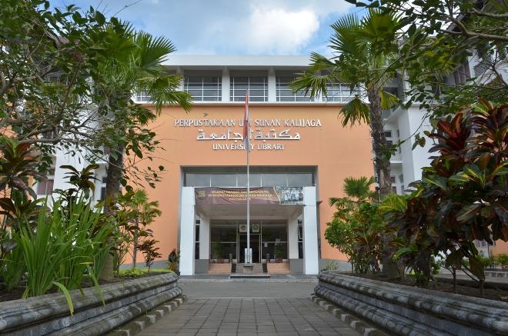
Lesson learned: UIN Yogyakarta
UIN Yogyakarta is the most active library in terms of posting information on Instagram compared to the other two libraries.
The highest number of posts makes the highest number of users’ responses
The library of UIN Yogyakarta has a policy on the use of social media to interact with users:
  post information related to library activities and library promotion.
  Provide a schedule to post information on Instagram based on content and time (when to post and what to post).
  Assigning two librarians to take responsibility for managing social media including making posts on Instagram regularly.

Slide 26

Lesson learned: UIN Jakarta
library staff will share information on Instagram only when they have library activities (such as user education) and on important days
do not have a certain pattern or plan to post information on Instagram (primarily during 2022)
The number of posts and users’ responses: the least among the three UIN libraries

Slide 27
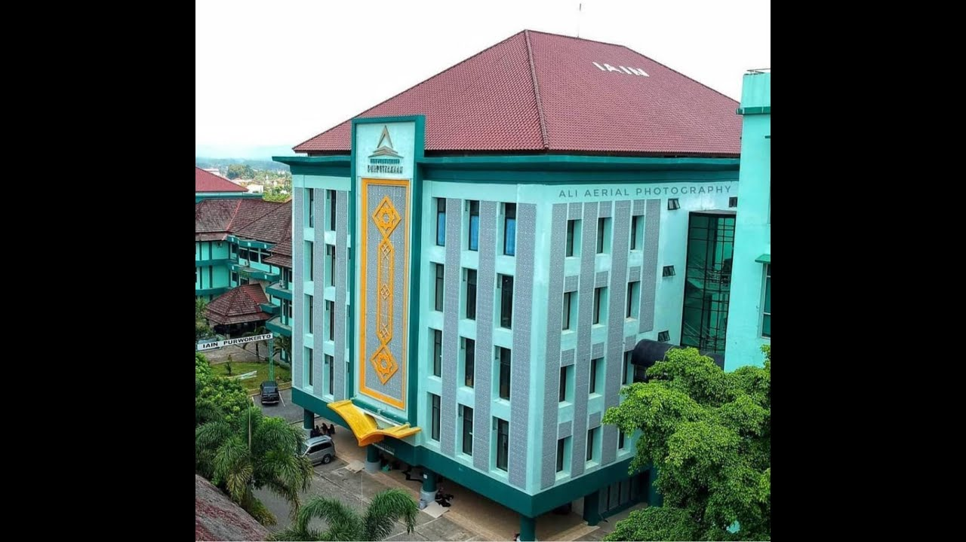
Lesson learned: UIN Purwokerto
The library has a policy concerning the use of social media by limiting posts only to announce important information to users
UIN Purwokerto has the least number of posts but has good responses from the users (the average response of users is higher than UIN Jakarta)

Slide 28


05
Conclusion

Slide 29



Instagram is still used as an important tools used by UIN libraries to reach their users through posting information for library users ranging from general information like greetings to information related to library promotion (library collections and services) and announcements
The positive responses from users through like, comment, share and save indicate that users still use social media to interact with the libraries
The availability of policy affects the number of responses by users

Slide 30


TERIMA KASIH
Thank You

