Slide 1
Documenting the Cataloging Practices and Policies among
Selected Libraries in Kazakhstan
April Manabat
Expert Librarian
Nazarbayev University
Nur-Sultan, Kazakhstan
University Library at a New Stage of Social Communications Development
(UniLibNSD) International Conference
7-8 October 2021

Slide 2
Outline
Results and Discussions
  Profile of Selected KZ Libraries
  The ILS and the Library Catalog
  Cataloging Standards
  Cataloging Practices and Future Plans
Conclusion and Recommendations
Introduction
Objectives
Some related cataloging practices studies
Cataloging Practices in the CIS countries
Methodology

Slide 3
Introduction
Cataloging and classifying material are performed to facilitate easy access and retrieval of library collections.
Kazakhstani librarians still posits a considerable interest in this task.
Most libraries in Kazakhstan based their cataloging practices on SIBID and Russian cataloging standards which needs to be updated and upgraded to reflect international changes and trends in creating bibliographic records (Bakhturina, 2016; Tukubayeva, 2018).
Technology as a tool to facilitate easy access and retrieval.

Slide 4
Objectives
To determine the existing cataloging practices and policies among selected libraries in Kazakhstan;
To identify the different ways on how Kazakhstani libraries are dealing with bibliographic records and metadata;
To know how are they coping with the changing user behaviors and the emerging trends in the field of metadata librarianship.
To examine the various ways on how to further improve the skills in cataloging and classification in the digital era.

Slide 5
Cataloging Practices and Policies
Embracing metadata librarianship with the evolution of digital collections and the changing user needs (Ma, 2009 / SPEC Kit 298: Metadata)
Embracing new trends in the field such as metadata librarianship and believed that new skills were still needed on creating bibliographic descriptions of materials (Virtual Resources Association, 2017)
Catalogers still find the need to create records of online resources despite a growing interest of creating and maintaining merged catalogues or bibliographic databases (Hider, 2014).

Slide 6
Cataloging Practices and Policies
Various similarities and differences of cataloging practices in universities from Pakistan, Malaysia, and Saudi Arabia; Overall uniformity with regards to cataloging tools can be used as a starting point for an international library cooperative cataloging activity (Muhammad Khalid, Mahmood, & Willson, 1997).
Aside from languages issues, poor bibliographic publication issues, name authority problems, problems with descriptive cataloging such as lack of chief sources of information, uniform titles, and copyright dates, inadequacy of subject headings and classification schedules, transliterations, as well as backlogs and cooperative cataloging should also be addressed (Joachim, 2010).

Slide 7
Cataloging Practices/Issues in CIS Countries
Linguistic turmoil on describing “exotic” languages such as Serbo-Croatian (Cyrillic) and Turkic languages (Husic, 2008; Jajko, 1993; Walter, 2010).
Catalogers were left with little guidance on how to describe materials in Cyrillic languages as the standards such as the Anglo-American Cataloging Rules (AACR) and USMARC were designed for English or other western languages especially with regards to authority control and title changes (Husic, 2008).
Identity problems about cataloger working as bibliographer especially in the Middle East to cater to these languages (Jajko, 1993).

Slide 8
Cataloging Practices/Issues in CIS Countries
Problems such as lack of vernacular reference and bibliographical sources for assigning the creator or authority files, shelflisting and assigning cutter numbers, and the application of uniform titles for literary works (Walter, 2010).
Lack of consistency and specificity in the subject headings in addition to the adoption of new language of choice of some countries due to the breakup of the Soviet Union (Walter, 2010).
The importance of a unified approach to standardized cataloging practices as well as determining various ways of improving bibliographic description based on current trends. Kazakh libraries should also be open to such trends by gaining more knowledge and sharing best practices with foreign colleagues in the field (Tukubayeva, 2018).

Slide 9
Methodology
Descriptive approach
9 out of 20 respondents from school, public, academic libraries
21-item structured online questionnaire from Hider’s (2014) study with some modifications to suit the needs of the study
Questions on ILS, OPAC, employing standards, experiences with cataloging online resources, perceptions on conducting cataloging-related trainings and seminars as well as the establishment of a union catalog
Online survey in EN, KZ, and RU languages

Slide 10
Results and Discussions
Library | Type of Library | Location
A | Academic | Almaty
B | Academic | Nur-Sultan
C | School | Nur-Sultan
D | School | Nur-Sultan
E | Public | Nur-Sultan
F | Academic | Nur-Sultan
G | Academic | Almaty
H | Academic | Nur-Sultan
I | Academic | Nur-Sultan
Profile of Selected Kazakhstani Libraries

Slide 11
Results and Discussions
Library | With ILS | ILS (X-in-house; √-commercial) | With OPAC
A | X | X | X
B | √ | √ | √
C | √ | √ | X
D | √ | √ | X
E | √ | √ | √
F | √ | √ | √
G | √ | √ | √
H | √ | √ | √
I | √ | √ | √
Profile of Selected Kazakhstani Libraries based on ILS and OPAC

Slide 12
Cataloging Standards
Cataloging Standards Currently Applied in Selected Kazakhstani Libraries

Slide 15
Cataloging Practices and Future Plans

Slide 16
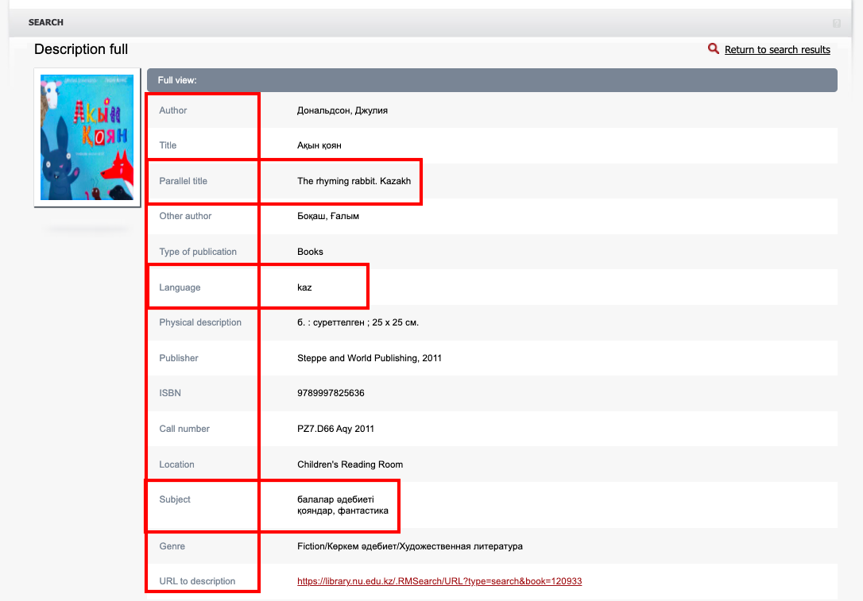
A sample catalog record

Slide 18
Future Plans
Acquiring a new automated library system and creating the online bibliographic records of their library collection to facilitate easy access and retrieval (e.g. consistency of the records; converting their classification scheme from DDC to LC);
Digitization plans;
Increasing the volume of their library collection;
Training their librarian catalogers with new trends;
Open to the possibility of conducting some cataloging-related trainings and workshops;
Interest on establishing a union catalog.

Slide 19
Conclusions
With the advent of technology as well as the introduction of various cataloging standards and other guidelines to ensure consistency of the bibliographic records and the cataloging work in general, librarian catalogers find themselves struggling and challenged on how to adopt these kind of standards and make them work from their respective ends.
Kazakhstani librarians were also faced by the same challenges not only on adopting a more Western approach to this work but also the use of native language.
Kazakhstani librarians remains open to various possibilities and opportunities to learn and improve their cataloging work.

Slide 20
Recommendations
A follow-up study be conducted covering a bigger number of Kazakhstani libraries and changes and trends that have been done;
A similar or related study on the metadata librarianship
A collaborative project/program for training of libraries in cataloging trends in Kazakhstan
Creation of a union catalog
Creation of a unified cataloging standard / guidelines for CIS countries

Slide 21
References
Bakhturina, T. (2016). SIBID standards at the beginning of the XXI century: updating and expanding information. Scientific and Technical Libraries.,
(5), 59–76. Retrieved from https://doi.org/10.33186/1027-3689-2016-5-59-76
Hider, P. (2014). Contemporary Cataloging Policy and Practice in Australian Libraries. Australian Academic & Research Libraries, 45(3), 193–204.
https://doi.org/10.1080/00048623.2014.920568
Husic, G. (2008). Orthographic reforms in the former Soviet Union: some implications for serials and internet resource catalogers. Slavic East
European Information Resources ISSN: 1522-8886, 2(2), 35–46. https://doi.org/10.1300/J167v02n02
Jajko, E. A. (1993). Cataloging of Middle Eastern materials (Arabic, Persian, and Turkish). Cataloging & Classification Quarterly, 17(1–2), 133–148.
Joachim, M. (2010). Issues and problems in cataloging the languages of the world. Cataloging & Classification Quarterly, 17(1–2), 1–14.
Ma, J. (2009). Metadata in ARL libraries: A survey of metadata practices. Journal of Library Metadata, 9(1–2), 1–14.
https://doi.org/10.1080/19386380903094977
Muhammad Khalid, H., Mahmood, K., & Willson, J. (1997). Cataloging practice in university libraries:A comparison of three developing countries
(Pakistan, Malaysia, Saudi Arabia). Library Review, 46(5), 328–338. https://doi.org/10.1108/00242539710178461
Tukubayeva, K. (2018). Bibliographic description of documents in the historical context. Proceedings of the 7th International Conference on
Emerging Global Trends in University Library Development (Library Connect 2018), 107–114.
Walter, M. (2010). Central Asian cataloging. Cataloging & Classification Quarterly, 17(1–2), 149–158.
Virtual Resources Association. (2017). ﻿Cataloging and metadata practices survey report. http://vraweb.org/wp-
content/uploads/2018/02/VRACatalogingandMetadataSurveyAnalysis_final.pdf

Slide 22
Thank you for listening!
April Manabat
Expert Librarian
Nazarbayev University
Nur-Sultan, Kazakhstan april.manabat@nu.edu.kz
University Library at a New Stage of Social Communications Development
(UniLibNSD) International Conference
7-8 October 2021

