Slide 1







PAGE 01
Digital Knowledge, Skills and Application among Librarians and Library Staff of MUNPARLAS Library Association, Incorporated
MELCHOR T. MANTILLA, RL, MLIS
University of Perpetual Help System Laguna
Philippines

Slide 2


Overview
PAGE 02
Introduction
Result
Objectives
Conclusion
Theoretical Framework
Recommendation
Methodology

Slide 3

Introduction
PAGE 03
Acceptance to the fact that this pandemic came in the least most unexpected event in everyone’s lives around the globe. School’s face to face classes and all offices whether public or private changed most of their everyday routine on how to serve their clients. Abrupt use of digital platforms became mandatory, particularly in the field of Education. Libraries on the other hand need to focus in delivering services thru online to support their communities, to deliver effectively, Librarians including the Library staff should have the knowledge and skills in using digital technology where communication and access to information thru internet platforms, social media, and mobile devices is needed.

Slide 4

Objectives
PAGE 04
To identify and assess Librarians and Library staff digital knowledge, skills and application who are working in Muntinlupa, Parañaque and Las Piñas Libraries and are members of MLAI ( Muntinlupa, Parañaque, Las Piñas Library Association, Incorporated)

Slide 5
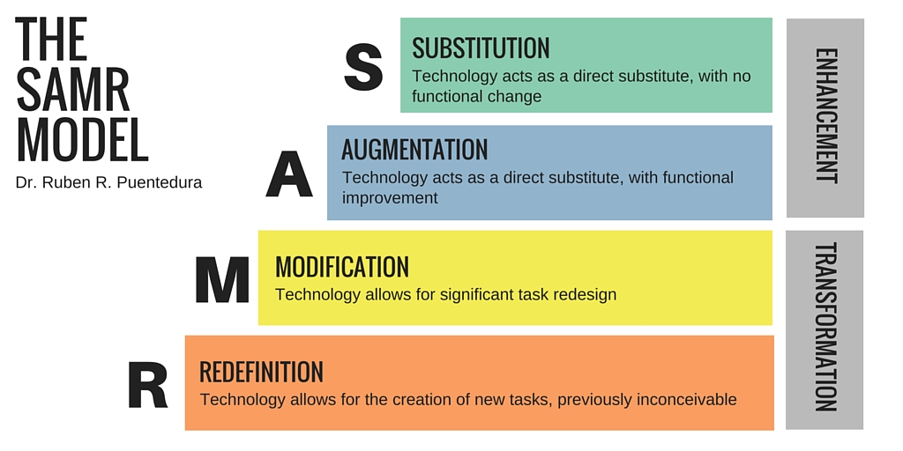
Theoretical Framework
PAGE 05

Slide 6


Methodology
PAGE 06
Descriptive Correlation
Respondents of the Study
60 Librarians and Library Personnel who are members of MUNPARLAS Library Association, Inc.

Slide 7

RESULTS
PAGE 07
Digital Knowledge
Digital Skills
Librarians/library staff level of digital knowledge is very high with an average weighted mean of 3.39
Librarians/library staff level of digital skills is very high with an average weighted mean of 3.25.

Slide 8
RESULTS
PAGE 08
Digital Application
Significant Relationship
Librarians/library staff level of digital application is very high with an average of 3.52
There was a significant relationship between the respondent’s digital knowledge and digital skills since the p value of 0.000 is lower than the Pearson r value of 0.812.

Slide 9
RESULTS
PAGE 09
Significant Relationship
Significant Relationship
There was a significant relationship between the respondent’s digital skills and digital application since the p value of 0.000 is lower than the Pearson r value of 0.712.
There was a significant relationship between the respondent’s digital knowledge and digital application since the p value of 0.000 is lower than the Pearson r value of 0.649.

Slide 10
Conclusion
PAGE 10
The study revealed that the librarians and library staff demonstrated a very high level of digital knowledge, digital skills, and digital application. The results also demonstrated significant positive relationships between these three aspects, highlighting the interconnectedness of digital competencies in the library profession.

Slide 11
Conclusion
PAGE 11
The findings emphasize the critical role of digital literacy within the realm of librarianship. In today's rapidly evolving information landscape, libraries and their staff must be well-equipped to harness digital tools and technologies to meet the changing needs of library users.

Slide 12
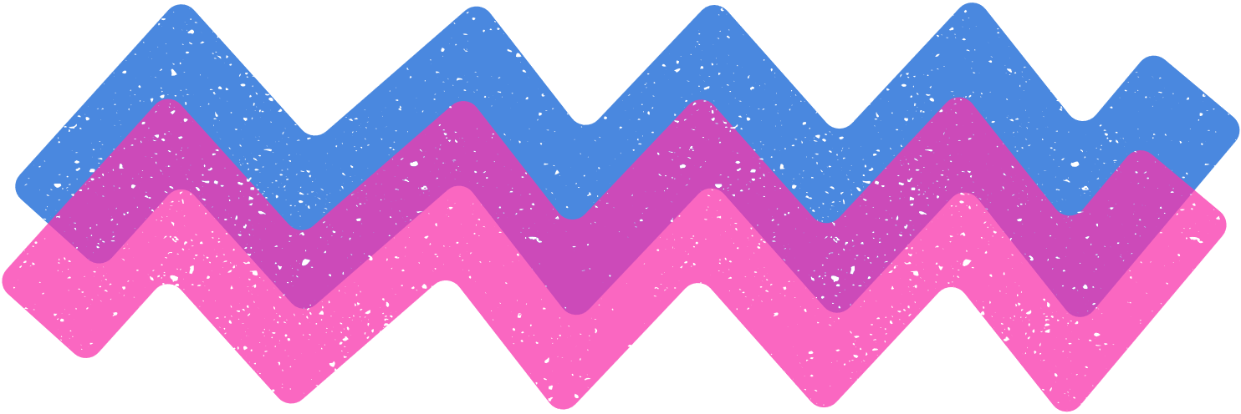
Recommendations
PAGE 12
01
02
03
Conduct Seminars and Online Training
Prioritize Digital Skills Development
Comprehensive Digital Skills Training

Slide 13
Recommendations
PAGE 13
04
05
06
Strengthen Digital Applications
Foster Knowledge Sharing
Evaluate Competency Growth

Slide 14
REFERENCES
PAGE 14
A., S.,Sinha, P.andUgwulebo, J.E.E.(2022). Digital literacy skills among African library and information science professionals –an exploratory study. Global Knowledge, Memory and Communication.
Ali, M. Y., Naeem, S. B., & Bhatti, R.(2020). DigitalTechnologies Applications in the Provision of Library and Information Services in Health Crises,Journal of Hospital Librarianship,20:4,342-351.
Antley, T. (2020, July, 16). Why is professional development and why is it important? WebCE. https://www.webce.com/news/2020/07/16/professional development#:~:text=Professional%20development%20refers%20to%20continuing,trends%2C %20and%20advance%20their%20career.
Baro, E.E.,Obaro, O.G., &Aduba, E.D.(2019). An assessment of digital literacy skills and knowledge- based competencies among librarians working in university libraries in Africa",Digital Library Perspectives, Vol. 35 No. 3/4, pp. 172-192.
Chewe, P., & Zulu, Z. (2020). A Survey of Digital Literacy Skills among Librarians in Zambia.Zambia Journal Of Library & Information Science (ZAJLIS ), ISSN: 2708-2695, 4(1).

Slide 15
THANK YOU
SO MUCH

