Slide 1

Artificial intelligence and machine learning algorithms to assess the reliability of a scientific paper in Scopus: the experience of a translator
Vitalii Osadchyi
Director, Language Service Provider
Translation.in.ua
expert@translation.in.ua

Slide 2
According to paragraph 4, Article 42, the Law of Ukraine "On Education",
violation of academic integrity is considered to be:
- academic plagiarism;
- self-plagiarism;
- fabrication;
- falsification;
- cheating;
- deception;
- bribery;
- biased assessment.
Vitalii Osadchyi
expert@translation.in.ua

Slide 3
Vitalii Osadchyi
expert@translation.in.ua

Slide 4
The endless theorizing about academic integrity, unfortunately, is practically not illustrated by real examples of identified violations that can create the impression of absolute transparency of Ukrainian science.
A rudimentary Google search for the keywords "example of academic integrity", "violation of academic integrity", "academic dishonesty" does not give a single local example!
I believe that the corporate ethics of Ukrainian science encourages unscrupulous practice, in particular, of scientific publications. It is this aspect of scientific activity that is considered in my report.
О
Vitalii Osadchyi
expert@translation.in.ua

Slide 5
The hypothesis of my research is based on personal practical experience of translating 4,000 peer-reviewed articles by Ukrainian, Kazakh, Azerbaijani scientists into English for confirmed publications in journals indexed by Scopus in the period from 2016 to 2022.
Given the specificity of the activity, I have read all the papers from beginning to end, including abstracts, references, and assurances of the full reliability of the results.
Taking into account the working conditions of lecturers at Ukrainian universities, who are forced to report annually on the number of papers, both articles written "for a report on science" (endless repetitions, scientific stamps, a precisely adjusted number of pages) and commissioned articles (lengthy fictions about concepts that often simply do not exist) are excluded from this study.
О
Vitalii Osadchyi
expert@translation.in.ua

Slide 6
The following hypothesis is being considered:
when writing a paper using Internet search engines, it is tempting to include, for example, in a literature review not just a primary source but a phrase (sentence, paragraph) of another author, while passing it off as your own. The situation is extremely simplified if the original is written in Russian or Ukrainian, and the article is translated into English, or vice versa.
With the help of such a simple manipulation, it is possible to compose a text of any length, which is almost impossible to check by anti-plagiarism software(especially in relation to the Russian-Ukrainian-English languages, and vice versa). Indirectly, this is confirmed when the author's usual style of presentation suddenly changes to exquisite academic English.
Until August 2022, I did not have the opportunity to confirm my hypothesis, even after repeatedly contacting the relevant services Microsoft Translator and Google Translate.
О
Vitalii Osadchyi
expert@translation.in.ua

Slide 7
The newest operating system Windows 11 (2022), combined with the Ukrainian version of the Office 365 cloud application package, has finally included multilingual text authentication in the standard Word text editor.
Now you can test my assumptions on real examples of those papers that I translate in September-October 2022. The new standard function "Correction" in parallel with the translation shows how many sources in the text coincide with publications on the Internet and provides a direct active link to the journal, article, original page.
On the one hand, the public results of such a check can adversely affect the reputation of the author, on the other hand, hypothetically, Scopus specialists will now be able to check even the Russian and Ukrainian versions of the paper, making appropriate conclusions about the author, reviewer, journal, educational institution, and this country as a whole.
О
Vitalii Osadchyi
expert@translation.in.ua

Slide 8
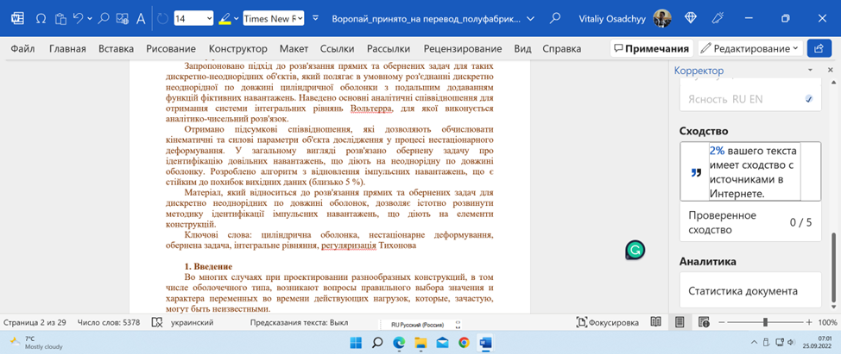
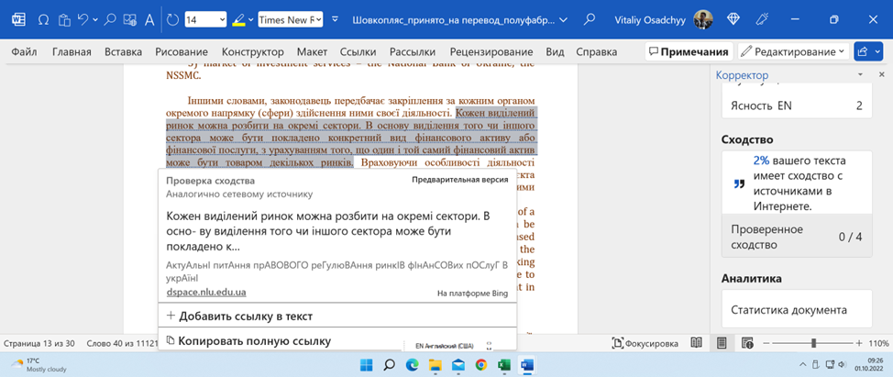
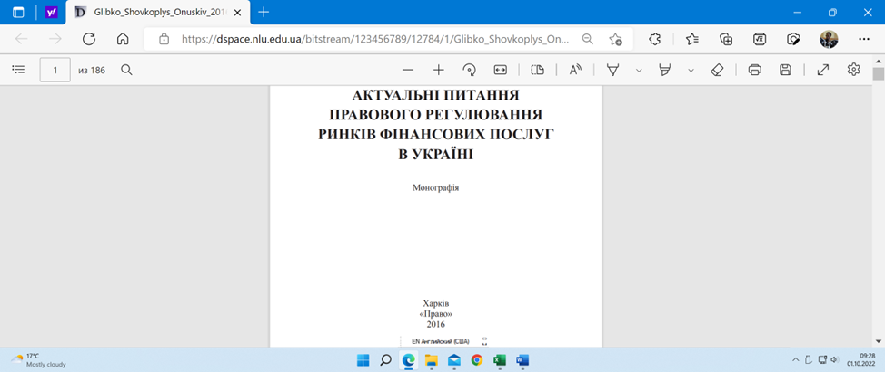

О
Vitalii Osadchyi
expert@translation.in.ua

Slide 9
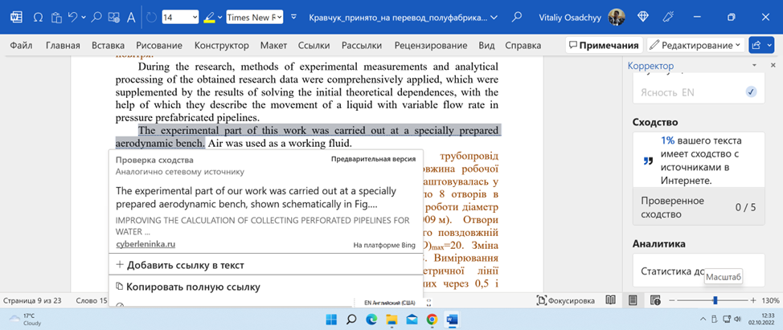
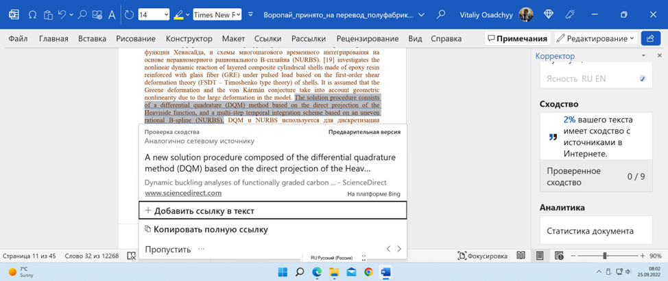
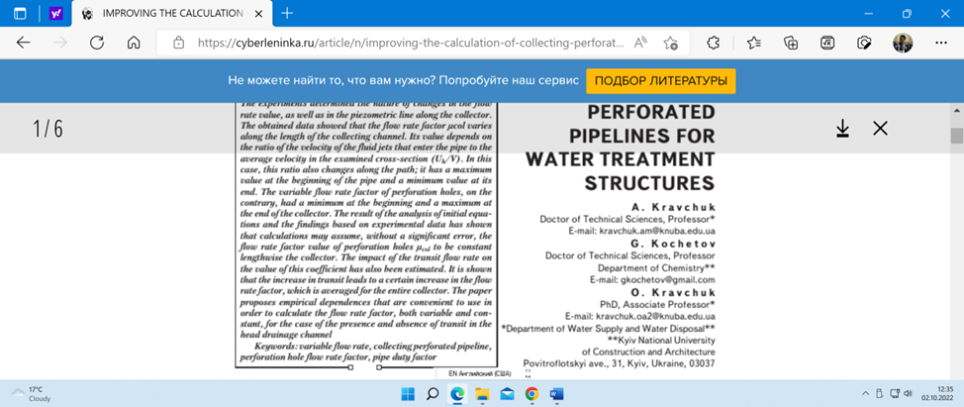
О
Vitalii Osadchyi
expert@translation.in.ua

Slide 10
Artificial intelligence and machine learning algorithms to assess the reliability of a scientific paper in Scopus: the experience of a translator
Vitalii Osadchyi
Director, Language Service Provider
Translation.in.ua
expert@translation.in.ua

