Slide 1


Information Behavior and
Access to Online Live Streaming:
A Pilot Study of Avid Viewers
in the Philippines
Joseph Yap, RL
(PhD Candidate)
School of Library and
Information Studies (SLIS),
University of the Philippines
Diliman, Quezon City
Ernani A. Agulto, RL, LPT
Quezon City Public Library (QCPL)
Quezon City
2025 October 09-10

Slide 2
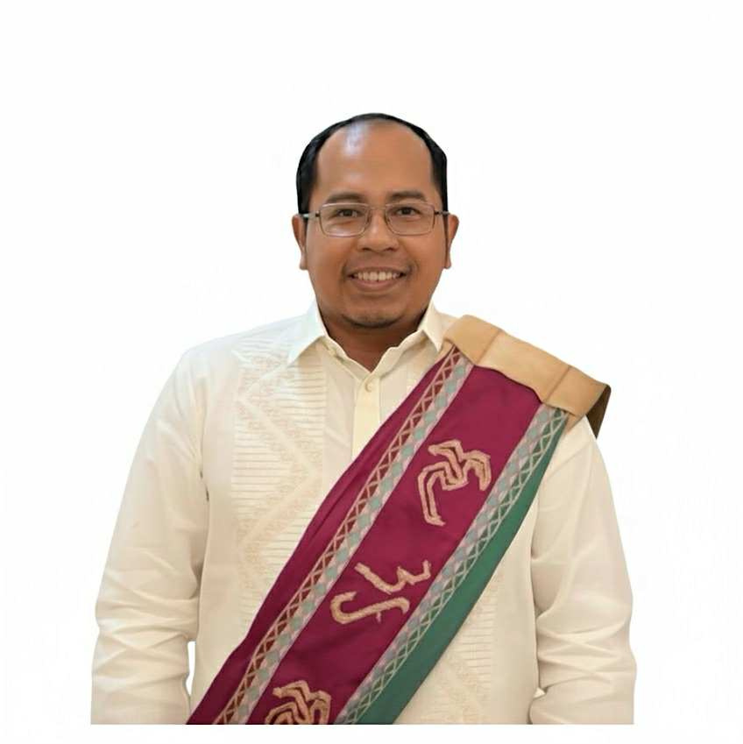

Researchers
Joseph Yap, RL
(PhD Candidate)
Ernani A. Agulto, RL, LPT
Librarian III, QCPL
Faculty, UP Diliman
1

Slide 3


Introduction
As social media progresses in the Philippines, access to entertainment and online content has become convenient for today’s digital users. Given that consumption often involves purchasing services, and online user behavior is influenced by freely available content, this study investigates how avid beauty pageant fans search for live online content.
The study asks the question:
How do Filipino beauty pageant fans consume online live streaming content amidst the evolving landscape of social media and digital access?
2

Slide 4
Objectives
  To explore the willingness of viewers to pay for online content during live streaming occasions;
  To understand if viewers are willing to share the online content they possess;
  To determine the expanding role of libraries as sources of information and entertainment.
3

Slide 5


Methods
  Semi-structured online interview, responses were organized according to demographics and interview questions.
  Convenience sampling was used to gather initial data for this pilot study and improve the study design.
4

Slide 6

Results
  A diverse group of 14 participants took part in the online survey, with age ranging from 26 to 52 years old, belonging to different professions.
Figure 1. Profession of participants
5

Slide 7
Results
  93% avid fans of beauty pageants can identify local and international pageants.
  Participants were able to search the information they need by searching for the official website or social media pages and by reading the comments section of social media pages for tips and links.
  Participants are willing to share free access with others.
Fig 2. Watching beauty pageants online
6

Slide 8
Results
  Most of the participants were not willing to pay for this kind of entertainment.
  Since libraries have the unique ability to expand their media services and collections based on their specific missions and target audiences, libraries have to address the needs of their enthusiastic online entertainment seekers.
  As the data provided, 66.67% strongly agree that access to digital entertainment content should be part of the services offered by public libraries to engage users and that the same number of participants strongly agree that streaming media should be a constant service of public libraries.
Fig 3. Public libraries and online streaming services
7

Slide 9
Conclusions
This study explored the previously unexamined information seeking behavior of individuals seeking free items when engaging with online beauty pageant content. As a call to action, libraries, as sources of media and content, may provide video streaming services to diverse users, provided they are aligned with their mission and objectives.
“By developing services and collections that recognize and respond to the rise of online entertainment, libraries can strengthen their importance in the digital age. This ensures they stay relevant and vital resources for all members of their communities. The aim is not just to provide content, but to empower users to engage with online entertainment thoughtfully, critically, and responsibly.”
8

Slide 10
Conclusions
“By developing services and collections that recognize and respond to the rise of online entertainment, libraries can strengthen their importance in the digital age. This ensures they stay relevant and vital resources for all members of their communities. The aim is not just to provide content, but to empower users to engage with online entertainment thoughtfully, critically, and responsibly.”
9

Slide 11

Thank you
for listening

