Slide 1

Integration of Information Literacy Training Across University
dr. Gintarė Tautkevičienė, dr. Aldona Augustinienė
Kaunas University of Technology
https://biblioteka.ktu.edu/
X International Scientific Conference ‘University Library at the New Stage of Social Communications Development’, 9-10 October, 2025

Slide 2
Outline
Definition of information literacy;
The relevance of information literacy education;
The need for information literacy education according to the level of study
Information literacy integration practice at Kaunas University of Technology

Slide 3
Definition of information literacy
“the set of integrated abilities encompassing the reflective discovery of information, the understanding of how information is produced and valued, and the use of information in creating new knowledge and participating ethically in communities of learning” (ACRL, 2015)
A person who is information literate:
Determines the nature and extent of the information needed.
Accesses needed information effectively and efficiently.
Evaluates information and its sources critically and incorporates selected information into his or her knowledge base and value system.
Individually or as a member of a group, uses information effectively to accomplish a specific purpose.
Understands many of the economic, legal, and social issues surrounding the use of information and accesses and uses information ethically and legally.
HUMAN SIDE OF TECHNOLOGY
(Information literacy competency standards for Higher Education, 2000)

Slide 4
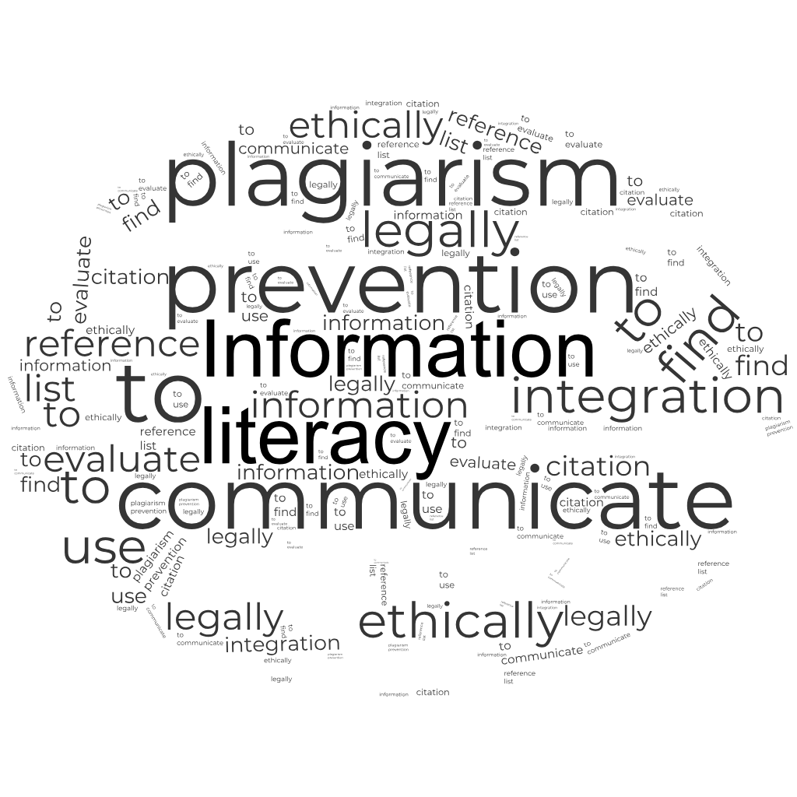
The relevance of information literacy development
Align information literacy skills development with curriculum requirements.
Incorporate information literacy training when needed, ensuring its relevance and the ability to apply knowledge immediately.
Provide assignments that require the application of information literacy skills to be completed successfully.
Transform the librarian from a guest lecturer to a co-teacher, integrating information literacy directly into the teaching and learning structure of the discipline.
HUMAN SIDE OF TECHNOLOGY

Slide 5
Undergraduate level: building the foundation
Orientation to Scholarly Ecosystems
Information Search Strategies
Critical Source Evaluation
Library Information System
Citation and Ethics
HUMAN SIDE OF TECHNOLOGY

Slide 6
Master’s level: developing specialized research competencies
Advanced Search Techniques
Synthesis and Argumentation
Reference Management Tools
Ethics and Plagiarism Prevention
Academic Integrity
HUMAN SIDE OF TECHNOLOGY

Slide 7
Postgraduate level: mastering the research lifecycle
Comprehensive Literature Search
Scholarly Publishing and Open Science
Selecting Journals for Publishing
Research Data Management
Research Assessment Indicatos and Tools
Research Impact and Visibility
HUMAN SIDE OF TECHNOLOGY

Slide 8
Information literacy courses at the University
Target group | 1st cycle students | 2nd cycle students | 3rd cycle students | Researchers | Librarians & other research support staff | Research managers | High school students
Type of training | Built-in (since 2019, as part of and “Introduction to Studies”) and stand-alone | Built-in (since 2016, mandate of min. 6 hours) stand-alone | Stand-alone & built-in (since 2018, course “Research Data Management”, 1 ECTS) | Stand-alone | Stand-alone | Stand alone | Stand alone
HUMAN SIDE OF TECHNOLOGY
Trainers:
- subject librarians,
- other librarians, e.g., institutional repository managers, information managers, research data managers, etc.,
- external trainers (publishers, open science experts, etc.)

Slide 9
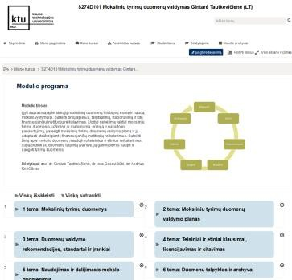
PhD course “Research Data Management”
June 26, 2017: approval at the committee of the joint Doctoral Programme in Educational Science October 2017: registration at Kaunas University of Technology
2018 – 2019 Moodle-based course was offered for PhD students as an elective (6 ECTS)
Since 2021 the course has been taught as an elective of 1 ECTS
Topics:
Research Data.
Research Data Management Plan.
Research Data Management Guidelines,
Standards and Tools.
Legal and Ethical Issues. Data Licensing and Data Citations.
Using and Sharing Data.
Data Repositories and Archives.
Open Science Initiatives.

Slide 10
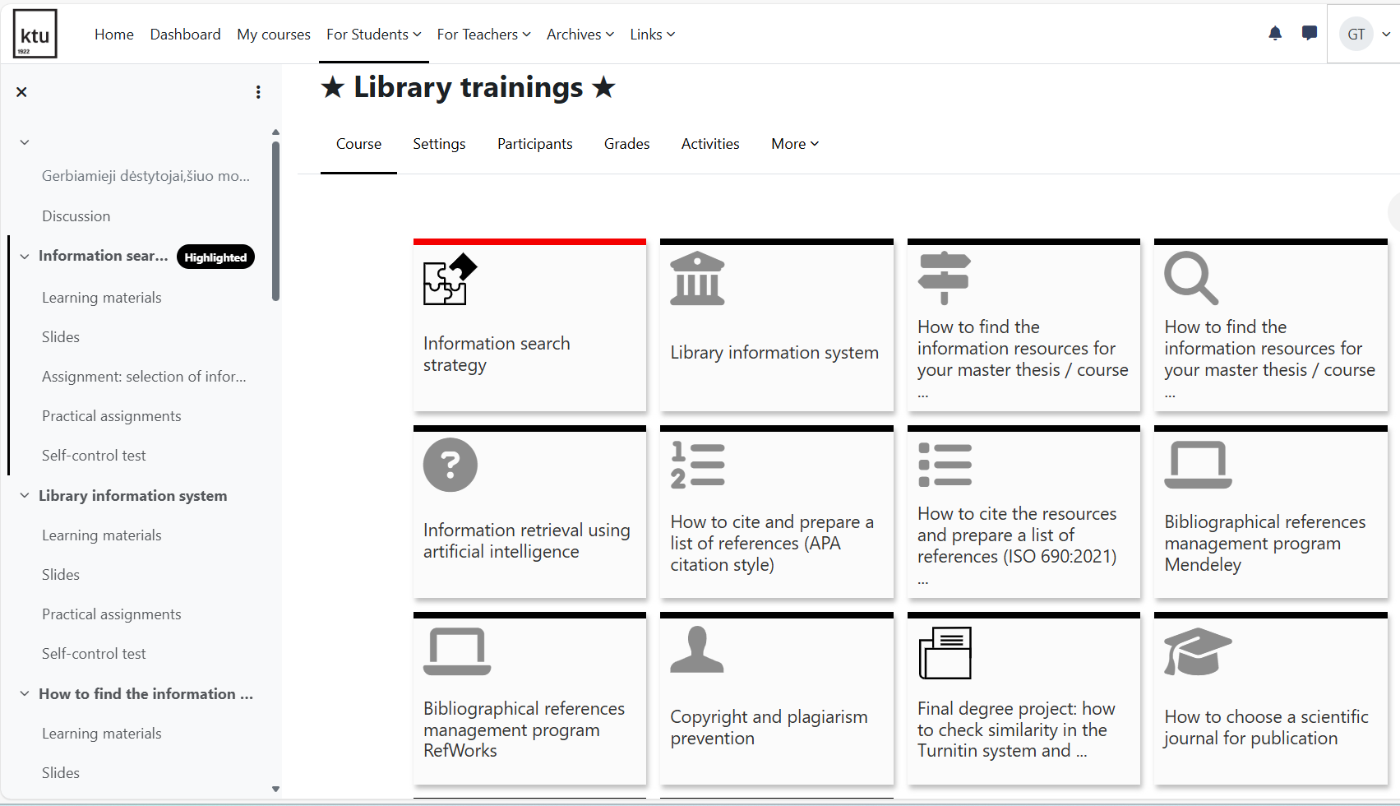
Moodle-based modules of self-paced library courses

Slide 11
Information literacy training participants
HUMAN SIDE OF TECHNOLOGY
Annual Library Report, 2025

Slide 12
Which topics in the field of information literacy are most popular among students?
Annual Library Survey, 2025

Slide 13
How do students evaluate librarians’ training and support?
Question | Bachelor students | Master's students | Doctoral students
The competence of the staff delivering library training is appropriate | 3.94 | 4.14 | 4.42
I can use the knowledge I have acquired in IL training | 3.88 | 4.10 | 4.45
The duration of the training sessions organized by the library is appropriate | 3.91 | 3.96 | 4.39
The training sessions organized by the library are useful | 3.81 | 4.01 | 4.33
The number and frequency of library training courses organized are sufficient | 3.67 | 3.95 | 4.29
I prefer remote library training sessions to traditional ones because they are convenient for me to attend | 3.59 | 4.04 | 4.23
HUMAN SIDE OF TECHNOLOGY
Annual Library Survey, 2025

Slide 14
Lessons learnt
Libraries play a key role as educators, facilitators, partners, and resource providers in information literacy training.
The integration of information literacy training across all levels of university study programs is essential to prepare students for academic and professional success.
The library should offer various forms of teaching and opportunities for students of all levels: courses integrated into study curriculum, stand alone training courses, distance training sessions, workshops, seminars, and self-paced Moodle courses.
A disciplinary and developmental approach ensures that information literacy skills are relevant, meaningful, and effectively embedded in the curriculum.
By adopting strategic, collaborative, and innovative practices, universities can cultivate a culture of information competence that benefits students throughout their academic journey and beyond.

Slide 15
Integration of Information Literacy Training Across University
dr. Gintarė Tautkevičienė, dr. Aldona Augustinienė
Kaunas University of Technology
https://biblioteka.ktu.edu/
IX International Scientific Conference ‘University Library at the New Stage of Social Communications Development’, 9-10 October, 2025

