Slide 1


Impractical Practicum? Analyzing the Impact of Online Work Immersion among the Bachelor of Library and Information Science (BLIS) Students amidst the Pandemic
Catherine Joy B. Calvo¹, Valiant Andrew P. Marcelo¹, Paolo D. Pariñas¹, Michal Rose G. Regala¹, Cj M. Telemban¹, Mickey D. Villaflor¹, April Manabat, MLIS ^{1,2,a}, Vivian Lirio, MLIS ^{1,3} and Rhodora Julian, DPA¹
¹Polytechnic University of the Philippines, Manila, Philippines, ²Nazarbayev University, Astana, Kazakhstan, ³University of Rizal System, Binangonan, Rizal
UNIVERSITY LIBRARY AT A NEW STAGE OF SOCIAL COMMUNICATIONS DEVELOPMENT 2023 “LIBRARY AND KNOWLEDGE MANAGEMENT IN TIMES OF CRISIS”
5-6 October 2023
Dnipro, Ukraine

Slide 2
Introduction
Connecting theories and knowledge learned inside the four walls of the classroom to the actual real world scenario is the most quintessential way to see the effectiveness of the learning process.
Experiential learning allows learners to apply their knowledge and skills to the actual workplace, giving them the glimpse of professional life after completing a degree.
One such way to have such experiential learning is through work immersion. Work immersion has been integrated into the curriculum to allow the learners to be familiar with the work environment and apply their skills and competencies in their specific professions (Penaredonda, 2023).

Slide 3
Distance and Connectivity Issues
The success of online immersion heavily depends on the internet use.
Stable internet connection was essential for trainees in an online work immersion since it impedes productivity and better work performance which further contributes to stress.
Connection instability added stress to the students as it would delay the tasks due to unstable internet connection (Asio et al., 2021; Del Rosario, 2021).

Slide 4
Self-Assessments and Applications
Given that distance and connectivity issues were considered an integral part in the realization of online work immersion during the pandemic, it is understandable and valid if students would feel unsatisfied, unsure, or unconfident with what their were doing.
This was also seen as a barrier to ensure productivity during online work immersion. Having the sense of self-awareness through self-assessment appears to be a good strategy to address such issue.

Slide 5
Coping Mechanism during Online Work Immersion
Covita and Torres (2017) noted students' coping strategies were problem and emotion focused. This includes assertiveness and help seeking, skills enhancements through observation, interaction and practice, and conflict mediation to address problems; while seeking for emotional and social support, cognitive reappraisal, having leisure activities, and venting, ignoring, and postponing to address emotion-focused challenges to name a few.

Slide 6
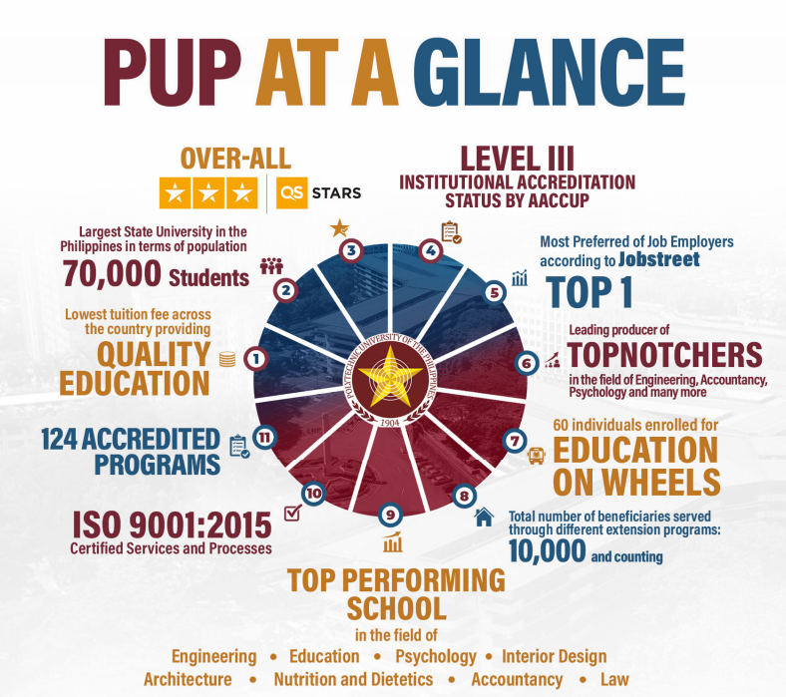
State-funded university
Humble beginnings as a Business School (1904-1951)
On becoming a college (1952-1971)
Transforming into a university (1972-1985)
Centennial Celebration (2004)
Continuously provide quality education

Slide 7
Polytechnic University of the Philippines - BLIS Work Immersion Subjects
Commission on Higher Education (CHED) Memorandum Order (CMO) No. 24, Series of 2015 Section 8, all students taking up Bachelor in Library and Information Science should undergo a minimum of 400 hours immersion to different types of libraries through the supervision of practicum coordinator.
These required number of hours is divided into Library Practice 1 and Library Practice 2 courses which should be taken into two semesters. This guideline is applicable to all state universities and colleges (SUCs) offering the same program. In addition, students are also required to submit journals, portfolios and proposals based on their observation to the assigned area.

Slide 8
Objectives
To document the impact of online work immersion among 4th year Bachelor of Library and Information Science (BLIS) students at the Polytechnic University of the Philippines who were enrolled in the Library Practice subjects from school year 2022-2023.
To determine the challenges they encountered as well as their coping mechanisms relevant to the completion of the online work immersion.
To identify the students’ level of readiness to perform in a professional library.
To suggest improvements in the work immersion subject of the Department of Library and Information Science of the Polytechnic University of the Philippines.

Slide 9
Methodology
descriptive quantitative approach
63 students (4th year BLIS students, 2 sections) enrolled in Library Practice subjects
Self-made tool
40 statements
Likert Scale (1- strongly disagree and 5 - strongly agree)
Statistical methods: frequency distribution, percentage, and weighted means

Slide 10
Results and Discussions
Profile of the Respondents
The respondents of the study were the two sections of 4th year BLIS students and were enrolled in the subject Library Practice subjects during the pandemic. A total of 63 respondents participated in the study with age ranges from 21 to 25 years old and with females (74.6%) dominating the group.

Slide 11
Connectivity and Distance Issues During Online Work Immersion
Statements | Weighted Mean | Standard Deviation | Rank | Interpretation
I was able to finish tasks without interruptions due to bad internet connections. | 3.75 | 0.84 | 6 | Agree
I was able to go to work on time without getting late. | 3.97 | 0.86 | 2 | Agree
I am worth connecting with others in online discussion forums and meetings. | 4.05 | 0.81 | 1 | Agree
I was able to perform the task well without any inconvenience. | 3.63 | 0.87 | 7 | Agree
I was able to set adjustments to distance learning. | 3.86 | 0.80 | 4 | Agree
I found flexibility in doing online-based task. | 3.86 | 0.86 | 3 | Agree
Online work immersion became effective because I used to enhance my computer skills. | 3.76 | 1.00 | 5 | Agree
Distance learning works better than a typical mode of learning. | 3.11 | 1.25 | 8 | Neutral
Composite mean | 3.75 |  |  | Agree
Legend: 4.21 – 5.00 (Strongly Agree); 3.41 – 4.20 (Agree); 2.61 – 3.40 (Neutral); 1.81 – 2.60 (Disagree); 1.00 – 1.80 (Strongly Disagree) (n=63)

Slide 12
Self-Assessment on Performing Online Work Immersion Tasks
Statements | Weighted Mean | Standard Deviation | Rank | Interpretation
I demonstrated different abilities/skills to do tasks or operate materials/equipment/applications needed for the job. | 3.98 | 0.77 | 4 | Agree
I could handle the details of the work assigned to me without difficulty. | 3.83 | 0.85 | 7 | Agree
I learned and showed professional attitude in dealing with different people that I came in contact with. | 4.29 | 0.73 | 1 | Strongly Agree
I was able to give sound suggestions to problems. | 3.76 | 0.82 | 8 | Agree
The work immersion program motivated me to pursue high level of learning and career. | 3.92 | 0.85 | 6 | Agree
I could adapt to the changes in my work environment and overcome problems in the work immersion. | 3.95 | 0.79 | 5 | Agree
The work immersion program allowed me to explore new ideas about the existing knowledge in the field of library science. | 4.10 | 0.80 | 2 | Agree
I was attentive and productive throughout my work immersion. | 4.02 | 0.81 | 3 | Agree
Composite mean | 3.97 |  |  | Agree
Legend: 4.21 – 5.00 (Strongly Agree); 3.41 – 4.20 (Agree); 2.61 – 3.40 (Neutral); 1.81 – 2.60 (Disagree); 1.00 – 1.80 (Strongly Disagree) (n=63)

Slide 13
Self-Application of Tasks After Online Work Immersion
Statements | Weighted Mean | Standard Deviation | Rank | Interpretation
I was able to accomplish all assigned tasks on time. | 4.24 | 0.89 | 1 | Strongly Agree
I was able to communicate well with my superiors. | 4.10 | 0.82 | 3 | Agree
I am more efficient in doing tasks online than working inside the library. | 3.41 | 1.16 | 8 | Agree
I was able to manage my time and stay motivated. | 3.79 | 1.06 | 6 | Agree
I am committed to doing more in online working. | 3.57 | 1.07 | 7 | Agree
I was able to focus on achieving goals in work, results in higher productivity | 3.86 | 1.00 | 5 | Agree
I am well organized and competent to complete and get stuff done. | 4.14 | 0.90 | 2 | Agree
I was able to prioritize the tasks wisely. | 4.00 | 0.92 | 4 | Agree
Composite mean | 3.89 |  |  | Agree
Legend: 4.21 – 5.00 (Strongly Agree); 3.41 – 4.20 (Agree); 2.61 – 3.40 (Neutral); 1.81 – 2.60 (Disagree); 1.00 – 1.80 (Strongly Disagree) (n=63)

Slide 14
Coping Mechanisms to Overcome Difficulties During Online Work Immersion
Statements | Weighted Mean | Standard Deviation | Rank | Interpretation
I was able to ease the stress from work immersion through entertainment materials/medium such as watching television and listening to music. | 3.97 | 0.86 | 6 | Agree
I use social media to relieve work fatigue. | 4.02 | 0.89 | 5 | Agree
Learning and researching advance sustained the gap in my abilities. | 4.10 | 0.78 | 3 | Agree
Asking questions to my instructor right after the work immersion hours will help me to understand the task more. | 4.06 | 0.80 | 4 | Agree
I sleep throughout the working hours whenever it is possible in order to regain my strength. | 3.29 | 1.17 | 7 | Neutral
Being friend with workmates help me to overcome difficulties in work immersion. | 4.30 | 0.75 | 1 | Strongly agree
The work institution helped me overcome difficulties by adjusting deadlines and being lenient on workloads. | 4.11 | 0.88 | 2 | Agree
Composite mean | 3.98 |  |  | Agree
Legend: 4.21 – 5.00 (Strongly Agree); 3.41 – 4.20 (Agree); 2.61 – 3.40 (Neutral); 1.81 – 2.60 (Disagree); 1.00 – 1.80 (Strongly Disagree) (n=63)

Slide 15
Level of Readiness to Professional Library Work
Statements | Weighted Mean | Standard Deviation | Rank | Interpretation
This work immersion taught me to be more resourceful and productive. | 3.58 | 1.17 | 7 | Agree
In my career, I applied all the knowledge I learned in work immersion. | 3.89 | 0.93 | 5 | Agree
Work immersion made me gain additional knowledge that we didn’t discussed in classroom. | 4.03 | 0.94 | 2 | Agree
Work immersion allowed me to experience different library works. | 3.80 | 1.01 | 6 | Agree
I learned and improved my skills during work immersion. | 4.13 | 0.93 | 1 | Agree
I am confident that the work immersion prepared me for my future career. | 3.91 | 0.83 | 4 | Agree
I understood the connection between tasks given to me in the work immersion to my career. | 3.95 | 1.00 | 3 | Agree
Composite Mean | 3.89 |  |  | Agree
Legend: 4.21 – 5.00 (Strongly Agree); 3.41 – 4.20 (Agree); 2.61 – 3.40 (Neutral); 1.81 – 2.60 (Disagree); 1.00 – 1.80 (Strongly Disagree) (n=63)

Slide 16
Conclusions
Work immersion regardless of mode of delivery or learning still plays a vital role to ensure that the teachings inside the walls of classroom is indeed relevant to the actual work environment.
This study revealed that distance and connectivity issues impacted the productivity and performance of the students during the online work immersion as the fulfillment of the task heavily depends on the stable internet connection.
It is also essential to understand how students perceived their overall online work experience and assess how they performed to accomplished the given task.
Students still prefers to have the work immersion done in a physical setting.
Lastly, the outcome of the study can be used to improve any online work immersion in the future which may include virtual library tours, online seminars and information sessions, hybrid work immersions, and virtual team building to name a few.

Slide 17
References
Acut, D., Curaraton, E., Latonio, G., & Latonio, R. (2021). Work immersion performance appraisal and evaluation of Grade 12 STEM students in science and technology-based industries. Journal of Physics: Conference Series 1835. Retrieved Febuary 1, 2023 from https://iopscience.iop.org/article/10.1088/1742-6596/1835/1/012013
AlGhamdi, R. A. (2020). Virtual internship during the COVID-19 pandemic: Exploring IT students satisfaction. Education + Training 64(3). pp. pp. 329-346. https://doi.org/10.1108/ET-12-2020-0363
Asio, J. M. R., Gadia, E. D., Abarintos, E.C. , Paguio, D. P., and Balce, M. (2021). Internet connection and learning device availability of college students: Basis for institutional flexible learning. Studies in Humanities and Education 2(1). ERIC Database. https://files.eric.ed.gov/fulltext/ED613639.pdf
Covita, M., & Torres, B. G. (2017). Problems and coping strategies of SMU-HTM students during their US cultural exchange immersion: Basis for an enhanced preparation of students for international internship program. National Business and Management Conference. Retrieved July 12, 2022 from: https://nbmconference.files.wordpress.com/2017/03/92-100.pdf
Del Rosario, L. A. (2021). Effects of having slow internet connection to the trainees during work immersion. STUdocu. Retrieved November 29, 2022 from https://www.studocu.com/ph/document/gordon-college-philippines/science-technology-and-society/effects-of-having-slow-internet-connection-to-the-trainee-during-work-immersion/15429693
Guidelines on K to 12 Partnership, DepEd Order 4, Series 2015. (2015). https://www.deped.gov.ph/wp-content/uploads/2015/08/DO_s2015_40.pdf
Insorio, A. O., Manaloto, C. C. & Larena, J. J. (2021). Exploring work immersion at home: Humanities and social sciences students’ compliance, difficulties, and evaluation. Puissant 2, pp. 197-220. https://puissant.stepacademic.net/puissant/article/view/54/18
Penaredonda, L. (2023). Work immersion skills of grade 12 TVL students during the pandemic in Santa Cruz North Cluster, Division Of Marinduque: Basis for intervention program. Psychology and Education: A Multidisciplinary journal 8(5). https://DOI:
10.5281/zenodo.7885160
Polyetchnic University of the Philippines. (2021)/ About the PUP. https://www.pup.edu.ph/about/
Rodríguez-Ardura, I. and Meseguer-Artola, A. (2018), "Immersive Experiences in Online Higher Education: Virtual Presence and Flow", Visvizi, A., Lytras, M.D. and Daniela, L. (Ed.) The Future of Innovation and Technology in Education: Policies and Practices for Teaching and Learning Excellence (Emerald Studies in Higher Education, Innovation and Technology), Emerald Publishing Limited, Bingley, pp. 187-202. https://doi.org/10.1108/978-1-78756-555-520181014
Shaketange, L., Kanyimba, A., and Brown E. (2017). The challenges and measures for internship among fourth-year students in the department of lifelong learning and community education at the University of Namibia. Creative Education 8(14). Retrieved July 13, 2022 from https://doi.10.4236/ce.2017.814155
Tanaleon, A., Abang, D., Alarcon, J. A., Camino, W. R., Versoza, A., Bernales, G. (2020). Impacts of work immersion subject on knowledge and skills development of Grade 12 general academic strand students of Bestlink College of the Philippines. Ascendents Asia Singapore - Bestlink College of the Philippines Journal of Multidisciplinary Research 2(1) Retrieve June 26, 2022 from https://ojs.aaresearchindex.com/index.php/aasgbcpjmra/article/view/1709
Walczyk, C., & Schultz-Jones B. (2017). Immersion librarianship: An assessment of transforming LIS students’ professional worldview through a service learning project at an international school library. IFLA WLIC Paper. Retrieved June 20, 2022 from https://digital.library.unt.edu/ark:/67531/metadc1042601/m1/1/

Slide 18
Thank you for listening!

