Slide 1

Ethical Component of Library Competences Design: Professional View
Tetiana Hranchak,
Leading Researcher,
V.I. Vernadsky National Library of Ukraine
2022

Slide 2

What makes
a librarian
a librarian?
What are core competencies for a modern librarian?

Slide 3
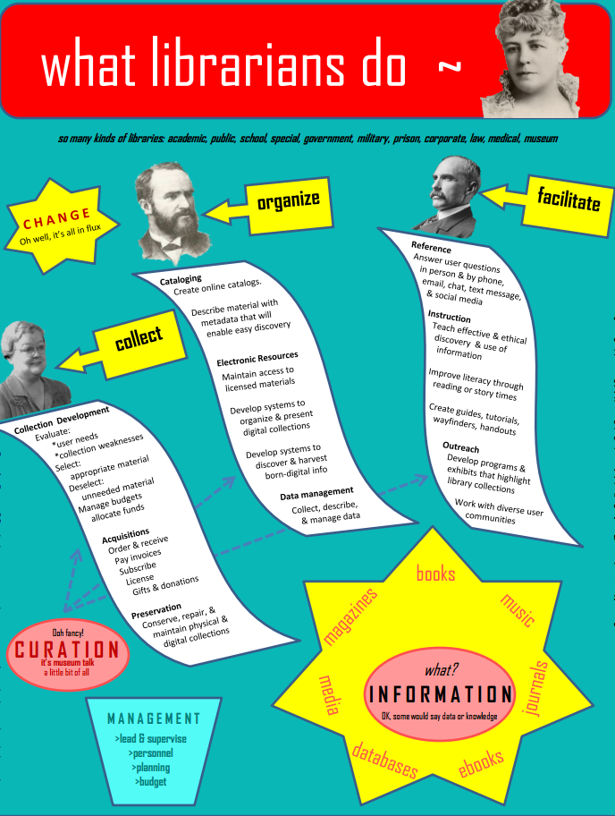
changes in the social role of the librarian, who transforms from an information specialist to
a knowledge "facilitator"

Slide 4

Hard skills
Soft skills
In between?

Slide 5
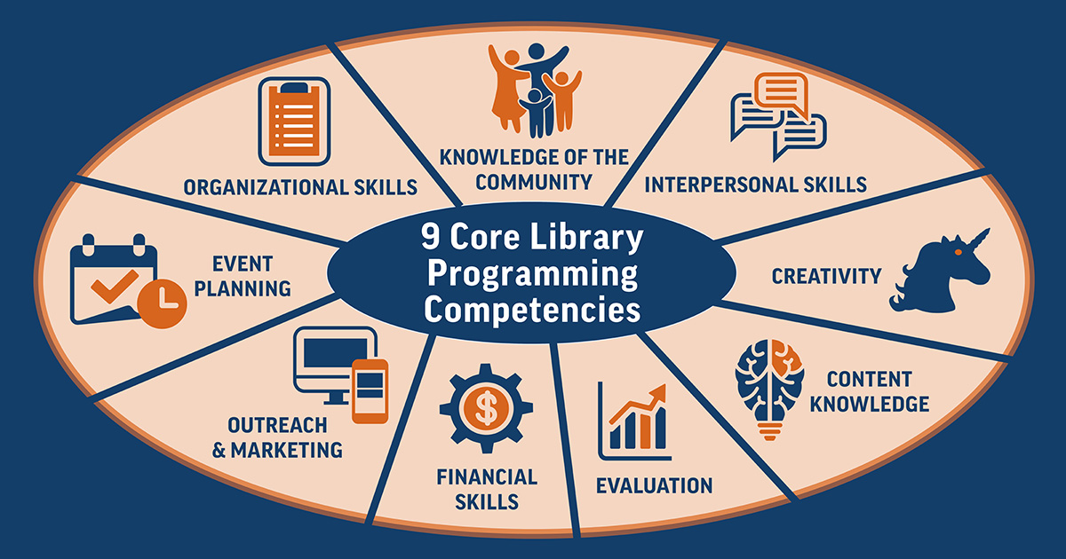
Revolution of Dignity

Slide 6

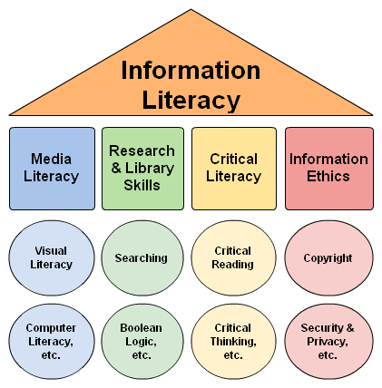

Slide 7

Standard
at the level
of Doctor of Philosophy
an ability to solve complex problems in information, library and archival affairs on the basis of a systematic scientific worldview and general cultural outlook in compliance with the principles of professional ethics and academic integrity

Slide 8
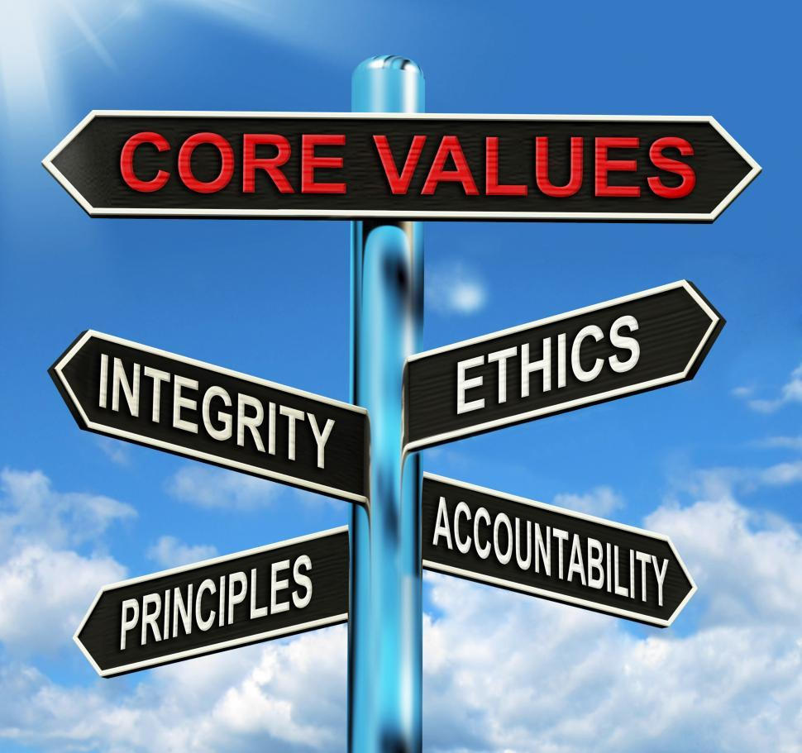
Professional ethics and academic integrity
Devotion to professional ethical norms and the spread of a culture of academic integrity are
the foundation for the request
for all further professional competencies of a librarian, because it provides the value of knowledge and personal theoretical and applied achievements

Slide 9

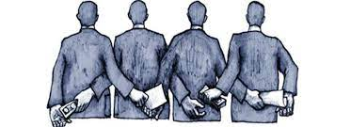
If who you know beats what you know
Corrupt traditions devalue professional knowledge, cause imitation practices. So, students no longer try to find the necessary information (lose of relevance of information retrieval activities, information evaluation), create an information product based on it (creativity, research skills, ability to analyze, synthesize information, use methodological tools) and etc.

Slide 10
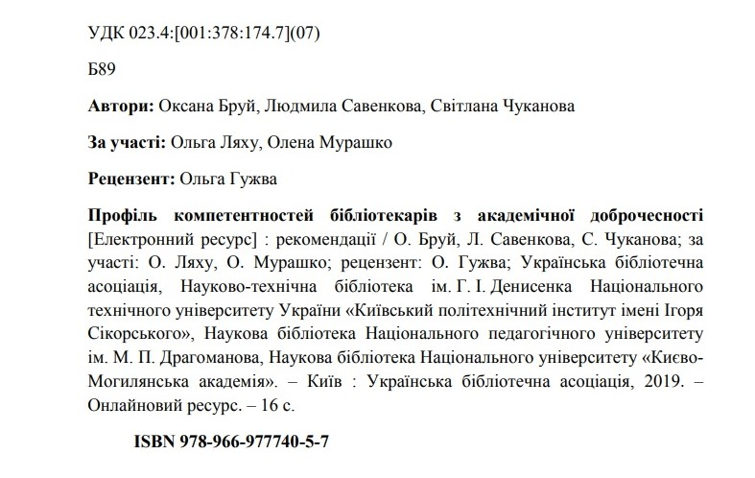
Brui, O., Savenkova, L. & Chukanova, S. (2019). Profil kompetentnostei bibliotekariv z akademichnoi dobrochesnosti [Profile of competencies of librarians on academic integrity] : rekomendatsii. Ukrainska bibliotechna asotsiatsiia, Kyiv.

Slide 11

Thank you!
#Stand_with_Ukraine!

