Slide 1
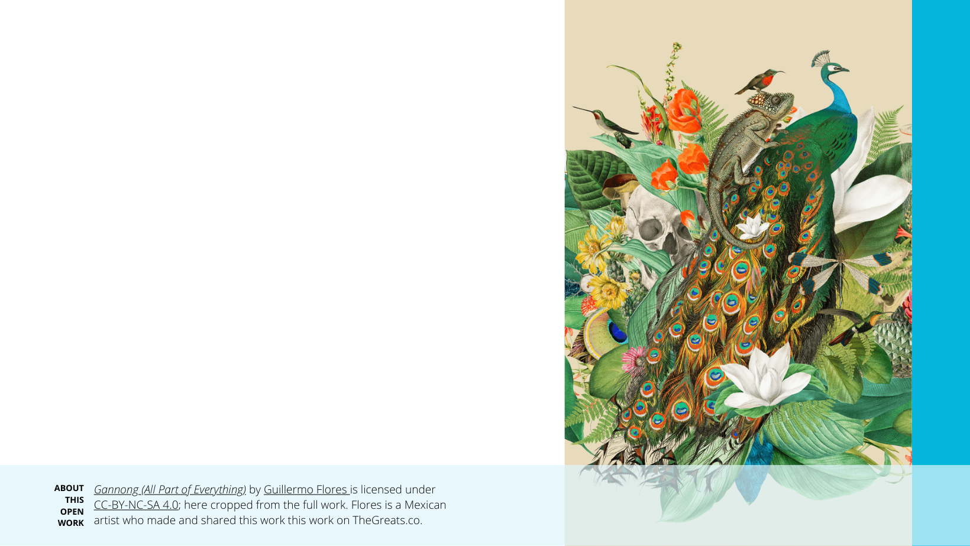
CC licenses: Helping form the Ecosystem of Open Educational Resources (OER) in Ukraine
Jennryn Wetzler, Director of Learning and Training, Creative Commons
9 January, 2024

Slide 2
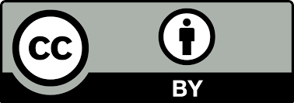
Created by Jennryn Wetzler. © Creative Commons. Unless otherwise noted, this presentation is licensed under a Creative Commons Attribution 4.0 International License.

Slide 3
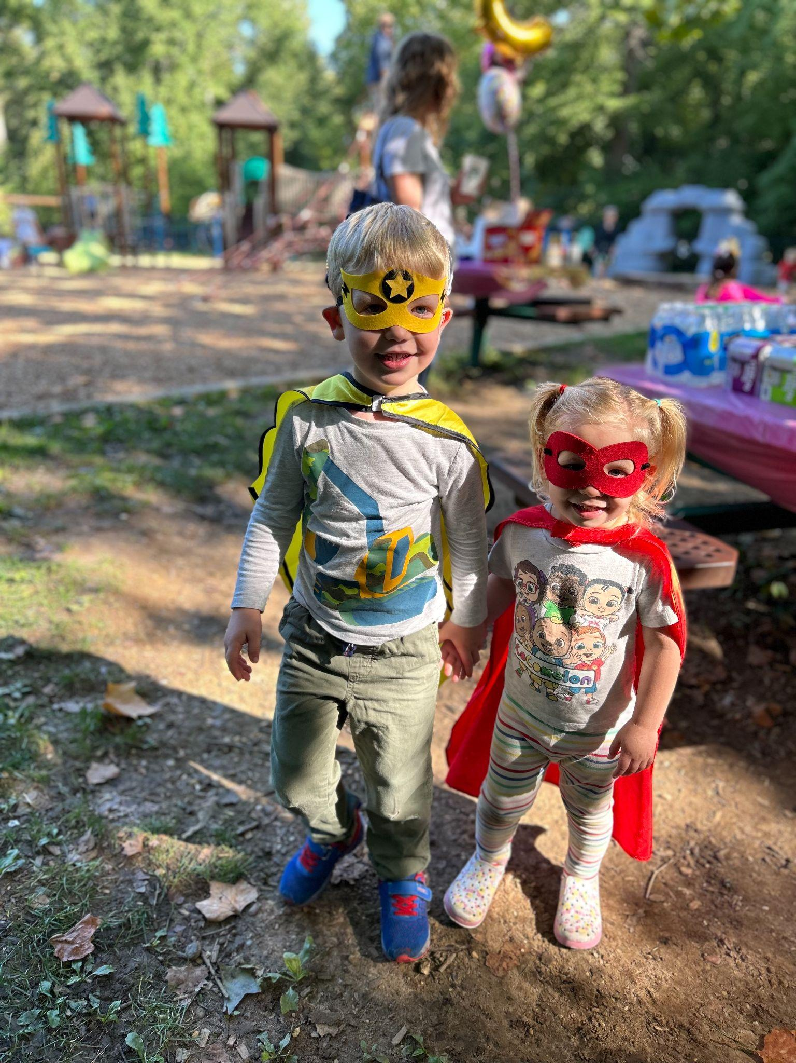

Slide 4
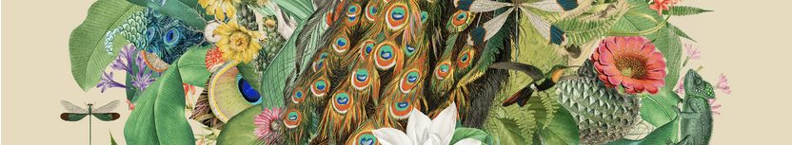
Creative Commons
Notes:
CC is a global nonprofit organization that helps address the world’s most pressing challenges through advancing open access to culture and knowledge. We are best known for our open licenses, which enable open, legal access to culture, research, information, education and more. There are over 2.5 billion CC licenses being used across 9 million websites, to date.
Beyond our licenses, we work on policy, advocacy and capacity building projects to help institutions and creators share knowledge and culture in the public interest.

Slide 5
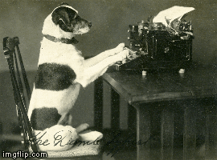
COPYRIGHT
Lillie Le Dorre, from Wellington, New Zealand, wins this category with her precocious typing dog. Source material courtesy Archives New Zealand Te Rua Mahara o te Kāwanatanga.
Notes:
CC licenses are foundational legal tools underlying efforts to open access to research, scientific data, digitized collections of cultural heritage, as well as educational resources.
CC licenses work within copyright, or the type of intellectual property law that intends to incentivize creators by restricting others from using their original creative expressions.
Copyright grants a set of exclusive rights to copyright owners, which means that no one else can copy, distribute, perform, adapt or otherwise use the work without permission of the copyright holder.
Copyright is automatic: as soon as one creates an original work of creative expression, they have copyright. In Ukraine, it lasts the lifetime of the author/creator plus an additional 70 years after their death.
CC licenses and public domain tools enable creators to offer more legal permissions than traditional copyright, given the increased flexibility and freedom of the internet. These are legal tools to better support creators. They allow creators to choose:
The rights they want to reserve
The rights they waive, or permit to the public.
It is important to understand who controls the exclusive rights granted by copyright in order to understand who has authority to grant permissions to others to reuse the work (e.g., adding a CC license to the work)

Slide 6
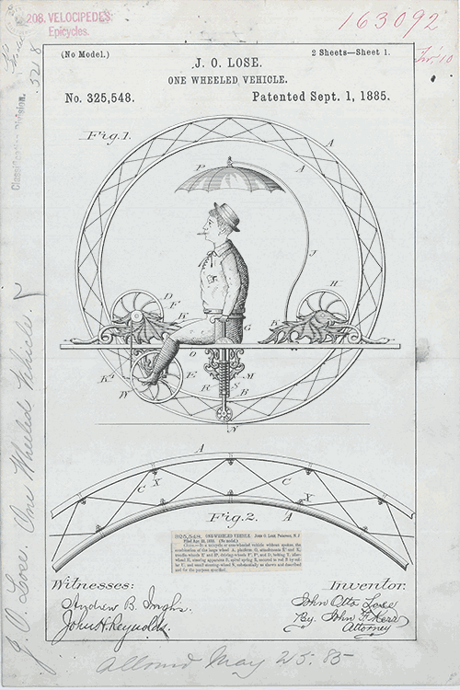
CC LICENSES
Notes:
Darren Cole, from the United States, wins this category with his moving (and smoking!) monowheel patent. Source material courtesy the National Archives and Records Administration.

Slide 7
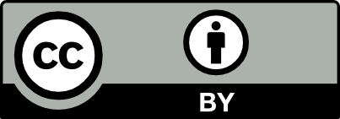


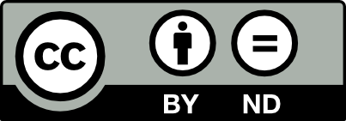
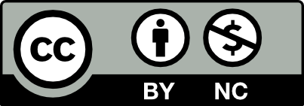
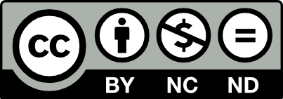


CC Open Licenses
CC Public Domain Tools
Non- ND Licenses allow for translations and other adaptations.
Notes:
Overview of CC licenses and public domain tools
CC has 6 different licenses and two public domain tools.
The licenses are comprised of one or more of four distinct elements
These elements allow permissions to downstream users…another way to think about it is, they restrict specific forms of reuse of your work by others.
Attribution (BY): attribution is, a specific form of giving credit to the original creator must be followed when using or adapting the work.
Share-Alike (SA): All derivative work(s) must be shared with the same license
Non-Commercial (NC): Permission for commercial usage rights are withheld
Based on use not user (ex. can’t be sold on a t-shirt by a non-profit, CAN be used without commercial gain by a for-profit entity)
No-Derivatives (ND): The work can be shared, but only if it remains unchanged

Slide 8
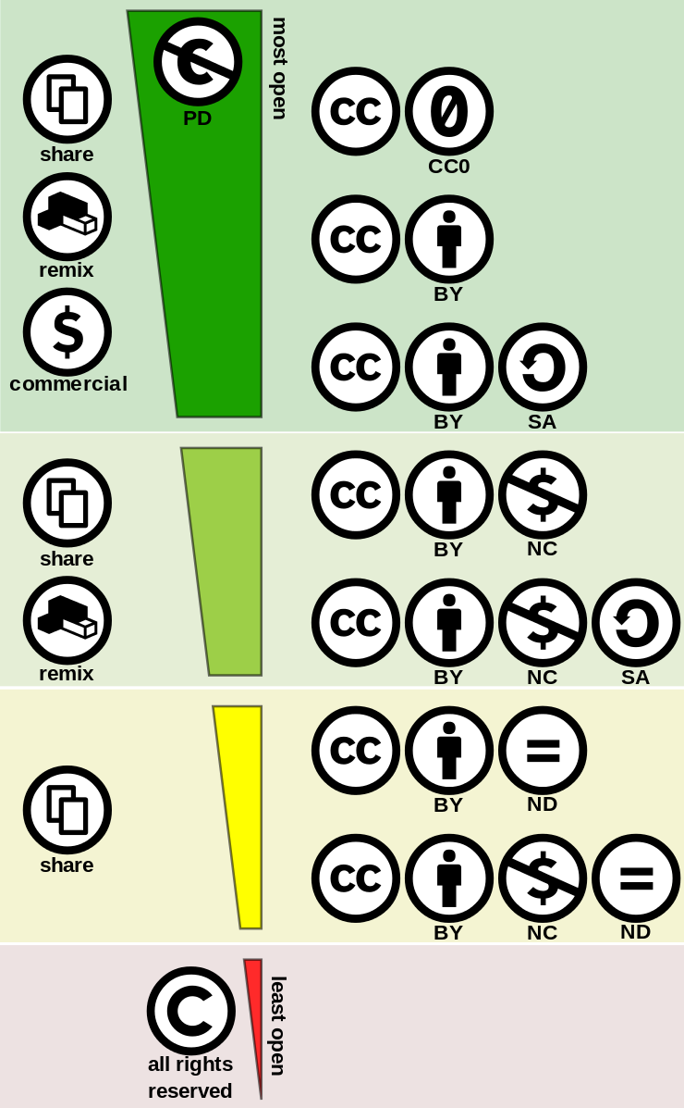
Least restrictive
to
Most restrictive
Notes:
There are also 2 public domain tools (CC0 or PD)
CC0 means that no rights are reserved. Creators waive all their rights (in as far as they are able) and place their work directly and immediately in the public domain.
The public domain mark is a label or tag used to communicate the public domain status of works worldwide. It does not have the same legal value as other CC licenses because it is not accompanied by a legal code.

Slide 9
https://creativecommons.org/choose/
https://creativecommons.org/faq/
https://certificates.creativecommons.org/
https://creativecommons.org/about/training-and-consulting/training/
Notes:
The easiest way to open license your work is to visit our CC License chooser, and answer the questions you see: https://chooser-beta.creativecommons.org/
The chooser will help you determine the best license to meet your needs. Then, all you need to do is copy and paste the license language into your resource--or the code into your web editor.
Beyond the chooser--we have a lot of resources for your great work!
Certificate courses
CC FAQ
Office Hours
Webinars

Slide 10
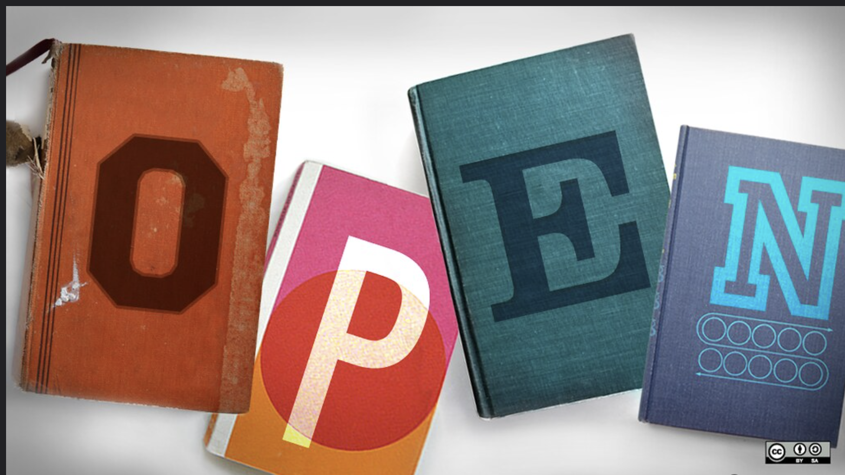
Opensource.com. Brigham Young University faculty survey seeks to advance open education through academic libraries. CC BY-SA 2.0
Notes:
Open education is so much more than the licenses on the resources. We work with incredible communities around the world, seeking to expand access/ further open access to education through:
Low and low bandwidth access options
Translations
Curriculum alignment across national borders
And more
Opening access to knowledge takes so many different forms!
If an introduction to any of our community members would be useful, we are happy to introduce you.

Slide 11
THANK YOU!
JENNRYN@CREATIVECOMMONS.ORG

