Slide 1

Is our Collection Enough or Underutilized? A Citation Analysis of Master’s Theses in the Field of Education
Joseph Yap | Altynay Kozhayeva
IV International Scientific and Practical Conference
“University Library at a New Stage of Social Communications Development”
Scientific and Technical Library
Dnipro National University of Railway Transport named after Academician V. Lazaryan, Dnipro, Ukraine
3-4 October 2019
Notes:
Good afternoon everyone. It is nice to be here in Dnipro. I thank Tatiana and the conference organizers for inviting NU Library as the partner of this conference. I am so excited to be here.
Most of the libraries prioritize what they want to purchase. Print or electronic? Mainly because of budget restrictions. What’s more difficult to decide upon is when we purchase something but is never used or has a low usage, resulting to poor ROI. Our paper will discuss the….

Slide 2
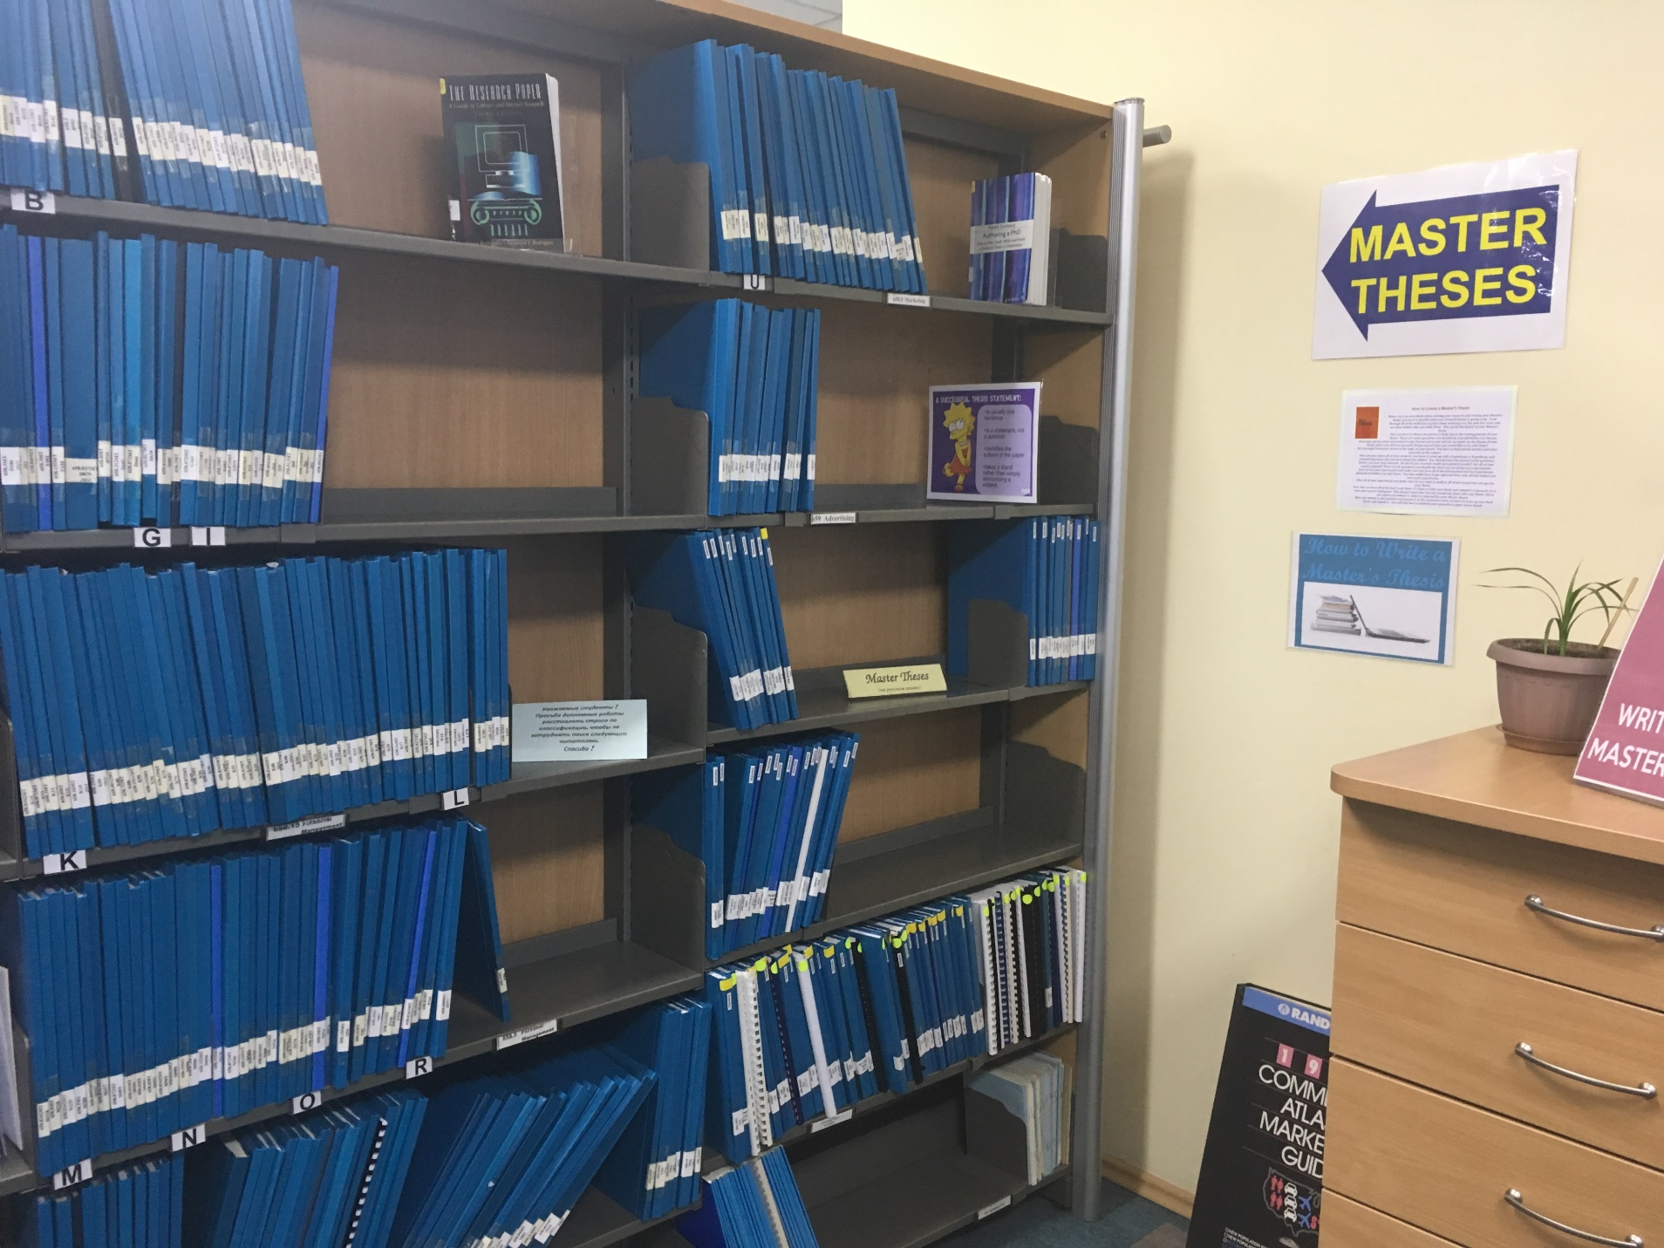
Introduction
Who’s in-charge of the theses collection?
As a librarian, do you scan the reference list of their thesis? Do students consult you during thesis writing?
Do you check if they cite items found in your collection (ie book holdings, e-journals, thesis, etc.)?
KIMEP Library, Almaty, 2018
Notes:
As a librarian, are you curious about the works of your students particularly if they did use the collection of the library?

Slide 3

Objectives (1/2)
To categorize the types of sources graduate students use in their thesis.
To compare the actual count of e-journal titles available in our collection versus the number of e-journal titles used in the reference list.
Background image: https://pixabay.com/illustrations/question-mark-pile-questions-symbol-2492009/

Slide 4
Background image: https://pixabay.com/illustrations/question-mark-pile-questions-symbol-2492009/
To identify the common journal titles used by the students and its overall journal ranking credibility based on prestige.
To further develop the e-resources collection based on the citation analysis.
Objectives (2/2)

Slide 5

Citation Analysis
Basis for collection development and retain journals that are important in a specific field of research (Beile, Boote, & Killingsworth, 2003).
Gaining some expertise in the field, authors and journals cited in a research gives them prestige.
A bibliometric technique in which works cited in publications are examined to determine patterns of scholarly communication, for example, the comparative importance of books versus journals, or of current versus retrospective sources, in one or more academic disciplines (Reitz, 2014) .
Notes:
In simplest terms, citation analysis is measuring the usage of library collection. There are many ways to evaluate, benchmarking, usage statistics, list checking.
Citation analysis will give you an idea what kinds of sources your patron uses.

Slide 6
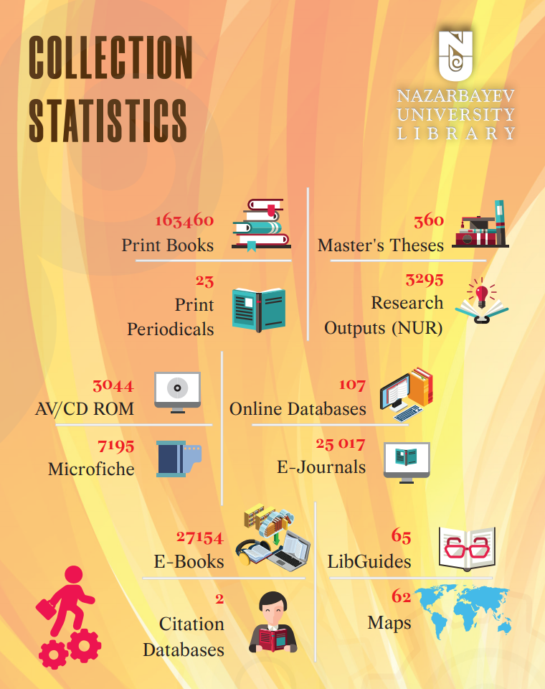

Slide 7
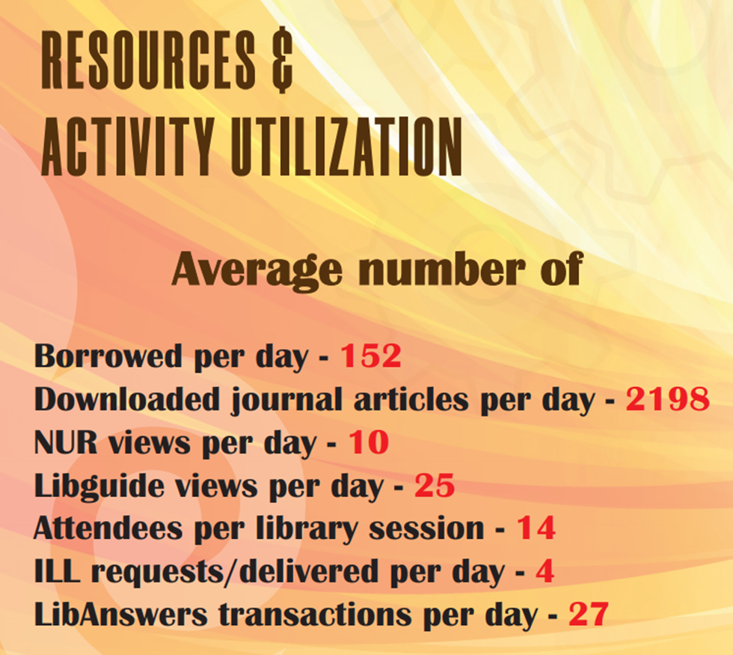

Slide 8
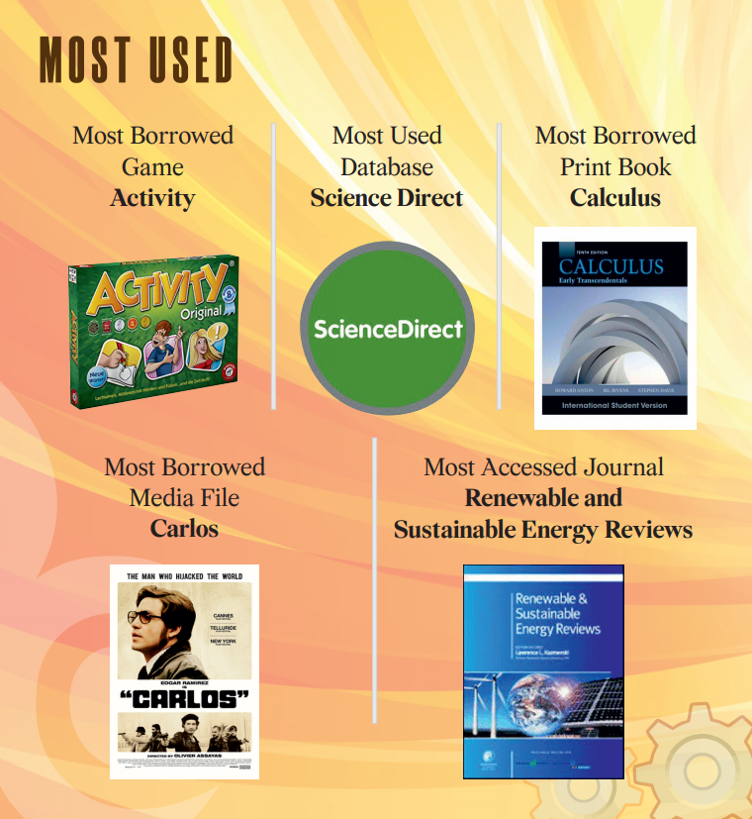

Slide 9
Author | Discipline | Main Findings
Brush (2015) | engineering master’s theses | number of unique journal titles cited and the journals that the university subscribe to
Timms (2018) | marine biology master’s theses | evidence of how the library collection is being used by the graduate students
Aliyu (2018) | doctoral theses in education | Textbooks and monographs were cited more than journal articles

Slide 10


Quick Facts
Established in 2012
More than 300 alumni
56 e-theses submitted
20 e-theses in 2019
Background image: https://pixabay.com/photos/books-bookstore-book-reading-1204029/
Notes:
The Graduate School of Education (GSE) of Nazarbayev University has produced about 56 master’s theses since its inception in 2012. More than 300 master’s and PhD students have graduated from the GSE but due to a competitive environment, only some of the best thesis are uploaded in the NU Repository. With this in mind, only 20 master’s theses were qualified to be uploaded in 2018 and for the purpose of this study, only 10 were examined as sample to generate some partial results.

Slide 11
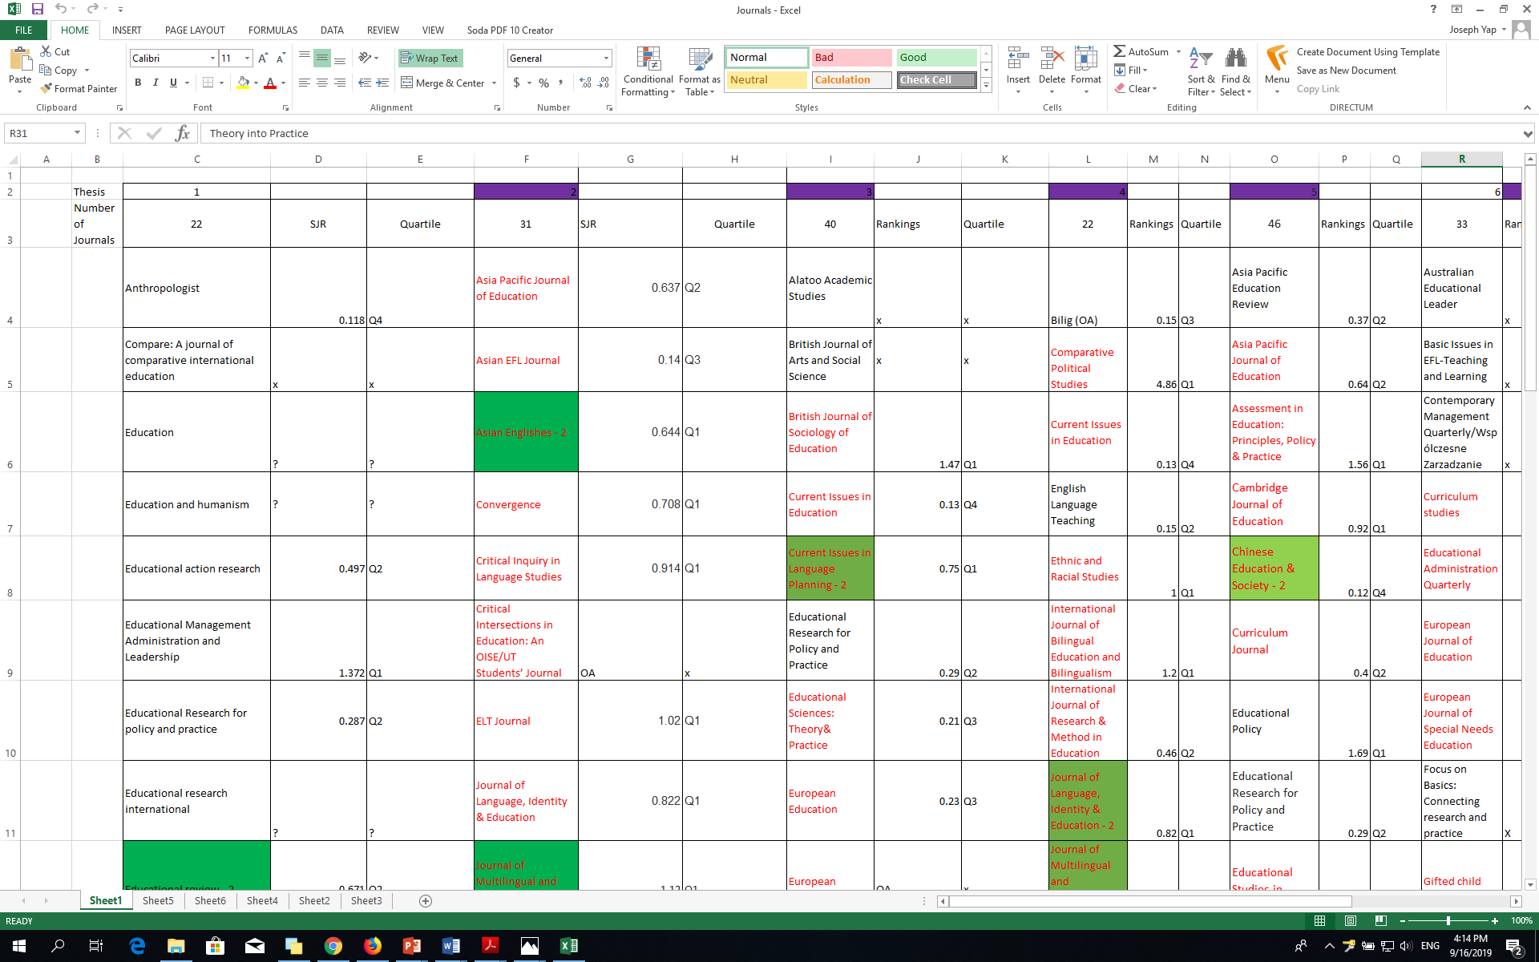
Methodology
Citation analysis was used to measure which materials are currently available in the library.
A sample of 10 theses (50%) was analyzed in this study.

Slide 12
Results

Slide 13
Table shows the number of references found in each thesis
Thesis Number | Number of References Used
1 | 55
2 | 55
3 | 76
4 | 56
5 | 62
6 | 54
7 | 45
8 | 55
9 | 64
10 | 68
Total | 590
Notes:
The smallest number of references used is 45 and the highest number of citations is 76. The cited reference mean is 59, median is 55.5 and mode is 55. The range is 31.
From this amount, 324 (55%) are citations coming from journals. There are 199 unique journal titles identified.

Slide 14
Journal Title | Number of Student Thesis Where the Journal Appeared | Total Number of Citations
Asia Pacific Education Review | 4 | 4
Asia Pacific Journal of Education | 2 | 2
Current Issues in Education | 2 | 2
Education | 2 | 2
Educational Administration Quarterly | 3 | 3
Educational Policy | 2 | 2
Educational Research for Policy and Practice | 3 | 3
Educational Sciences: Theory and Practice | 2 | 2
Gifted Child Quarterly | 2 | 14
Higher Education | 2 | 3
International Journal of Bilingual Education and Bilingualism | 2 | 3
Journal of Advanced Academics | 2 | 4
Journal of Educational Change | 2 | 4
Journal of Language, Identity & Education | 2 | 3
Journal of Multilingual and Multicultural Development | 3 | 7
Language Teaching | 2 | 3
Oxford Review of Education | 2 | 3
Phi Delta Kappan | 3 | 3
Procedia – Social and Behavioral Sciences | 4 | 6
Qualitative Research Journal | 2 | 2
RELC Journal | 2 | 3
Remedial and Special Education | 2 | 2
Research Papers in Education | 2 | 2
Review of Educational Research | 2 | 3
Studies in Educational Evaluation | 2 | 2
Studies in Higher Education | 2 | 2
System | 3 | 4
Teaching and Teacher Education | 3 | 11
Theory into Practice | 2 | 2
Notes:
29 of these journal titles (Table 2) appeared in several theses and 39 are unavailable in the collection.
Table 2 shows that the journal Gifted Child Quarterly appeared in two student theses but was cited 14 times. Teaching and Teacher Education which appeared in three studies received 11 citations. The Journal of Multilingual and Multicultural Development appeared in three student theses and was cited 7 times. The Asia Pacific Education Review and Procedia-Social and Behavioral Sciences which appeared in four different studies received four and six citations respectively. It is noticeable that journal titles appear in two or three studies but they were only cited either once in each study.

Slide 15
Title | Publisher | SJR Quartile
Asia Pacific Education Review | Springer | Q2
Educational Research for policy and practice | Springer | Q2
Higher Education Studies | Carfax Publishing | Q1
International Journal of Educational Advancement | Palgrave Macmillan | Not yet assigned
Tertiary Education and Management | Taylor & Francis | Q3
Notes:
Students also cite journal articles that are not existing in our subscription. They were able to access these sources from their own referral systems or from Inter-Library Loan service. It is recommended to add these titles in the future acquisition plan of the library.

Slide 16
SJR Quartile Distribution of Journal Titles Used in Theses
Thesis Number | Q1 | Q2 | Q3 | Q4
1 | 4 | 5 | 1 | 1
2 | 14 | 4 | 1 | 6
3 | 13 | 6 | 3 | 1
4 | 6 | 5 | 2 | 4
5 | 17 | 7 | 1 | 2
6 | 8 | 10 | 1 | 1
7 | 4 | 7 | 1 | 4
8 | 7 | 8 | 4 | 2
9 | 2 | 11 | 3 | 1
10 | 9 | 3 | 2 | 1
Notes:
Scholars are critical on what sources to cite. Given the ease of access for online resources, it is advisable to consider those items with high impact and just use the electronic databases of the library. Five theses cited more Q1 ranking journal titles. These are theses 2, 3, 4, 5 and 10. Theses 1, 6, 7, 8, and 9 cited more Q2 journals. In any case, they were able to choose good quality resources rather than choosing the predatory ones.

Slide 17
Conclusions
Citation analysis will provide us evidence-based record that our journal subscriptions are being used and accessed by our patrons.
It is apparent that master’s students from the graduate school of education cite more journal articles than books. At least 50% of the students get their references from Q1-ranked journals based from the SJR ranking.

Slide 18
Conclusions
The NU Library has a promising and huge collection of e-journal titles as it has almost 80% of the titles available in the library subscription. The sample revealed that the library is capable of providing a good quality of journal collection that can be used by the students and faculty members as well. We can proudly say that our collection is above the average.

Slide 19
Q&A
Are there any questions?

Slide 20
References
Aliyu, Y. (2018). Citation analysis of doctoral theses in education, University of Maiduguri, Nigeria. Library Philosophy and Practice. Retrieved from https://digitalcommons.unl.edu/cgi/viewcontent.cgi?article=4908&context=libphilprac
Becker, D. A., & Chiware, E. R. T. (n.d.). Citation analysis of masters’ theses and doctoral dissertations: Balancing library collections with students’ research information needs. Journal of Academic Librarianship, 41(5), 613–620. https://doi.org/10.1016/j.acalib.2015.06.022
Beile, P., Boote, D., & Killingsworth, E. (2003). Characteristics of education doctoral dissertation references: an inter-institutional analysis of review of literature citations. In American Educational Research Association, Chicago, IL (US), April 21, 2003. Retrieved from http://eprints.rclis.org/15870/
Borgemenke, A., & Brown, C. G. (2013). Examining the educational leadership knowledge base: A 5-year citation analysis. Education Leadership Review, 14(1), 1–3. Retrieved from https://search.ebscohost.com/login.aspx?direct=true&db=eric&AN=EJ1105273&site=eds-live
Brush, D. A. (2015). Engineering Master of Science theses at Rowan University: A citation analysis of the first nine years. Science & Technology Libraries, 34(2), 109–121. https://doi.org/10.1080/0194262X.2015.1031927
Miller, L. N. (2011). Local citation analysis of graduate biology theses: Collection development implications. Issues in Science and Technology Librarianship, (64). Retrieved from http://www.istl.org/11-winter/refereed3.html
Reitz, J. (2014). Citation analysis. Retrieved from https://www.abc-clio.com/ODLIS/odlis_c.aspx
Sherriff, G. (2010). Information use in history research: A citation analysis of master’s level theses. Portal: Libraries and the Academy, 10(2), 165–183. Retrieved from http://muse.jhu.edu/article/378046
Timms, G. P. (2018). Citations and citation metrics in a serial assessment using master’s theses. Collection Management, 43(3), 177–197. https://doi.org/10.1080/01462679.2018.1451794

Slide 21

THANK YOU FOR LISTENING
Joseph Yap
joseph.yap@nu.edu.kz

