Slide 1

Reusing and remixing
resources in openly licensed
MOOCs
(...and other multimedia resources as well)
Paola Corti

Slide 2
MOOCs
Massive
Open
Online
Courses

Slide 3
The meaning
of the MOOC acronym
MASSIVE
They are designed to be used by a very high number of people.
OPEN
They are accessible to all, meaning as they do not demand prerequisites that restrict participation.
ONLINE
They can be accessed via an online platform.
COURSES
They come with clearly stated learning objectives and a corresponding syllabus, materials and learning support activities and an assessment system.

Slide 4
The meaning
of OPEN in the MOOC acronym
OPEN
They are accessible to all, meaning as they do not demand prerequisites that restrict participation.
AND WHAT ABOUT OPEN LICENCES?

Slide 5
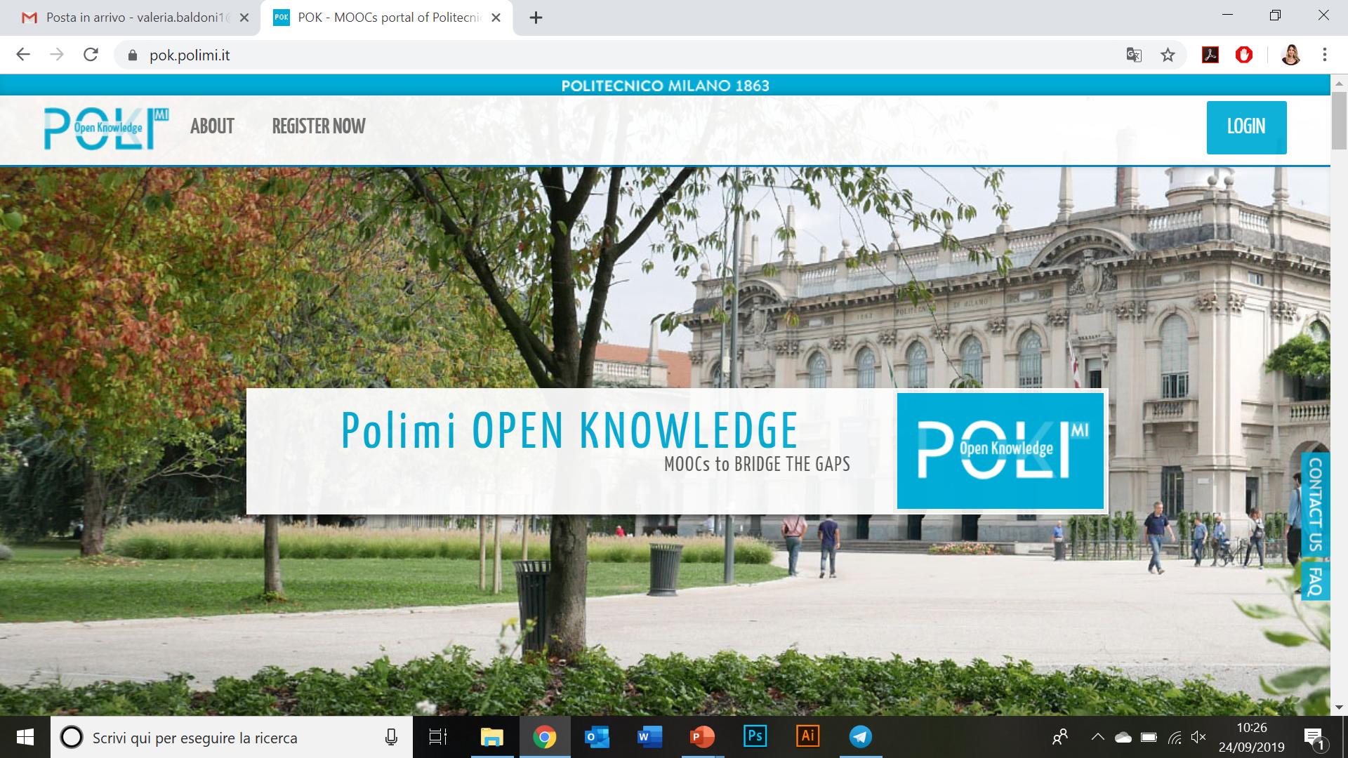
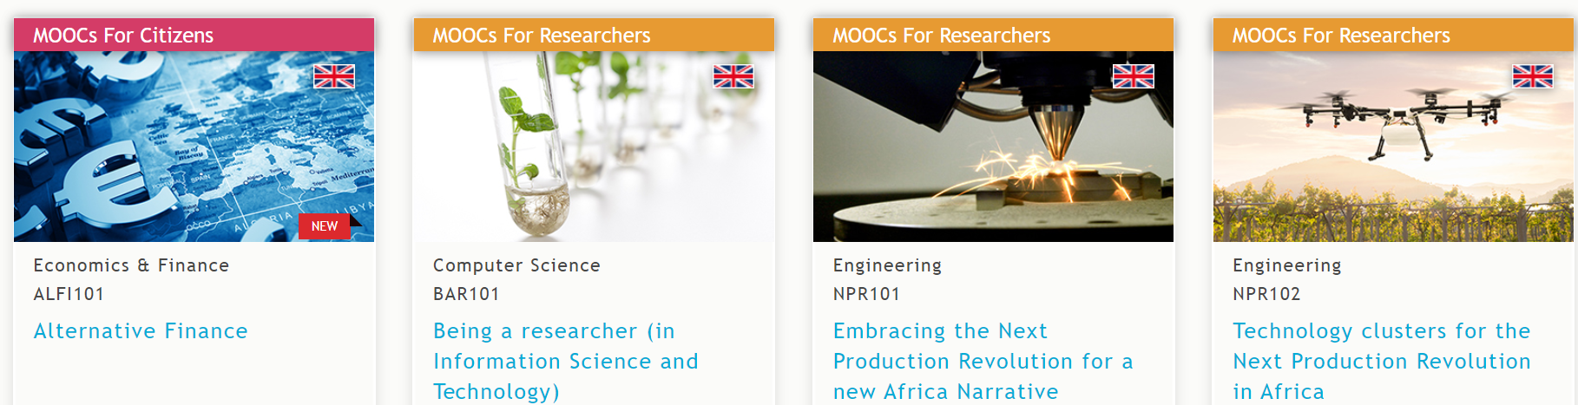

Slide 6
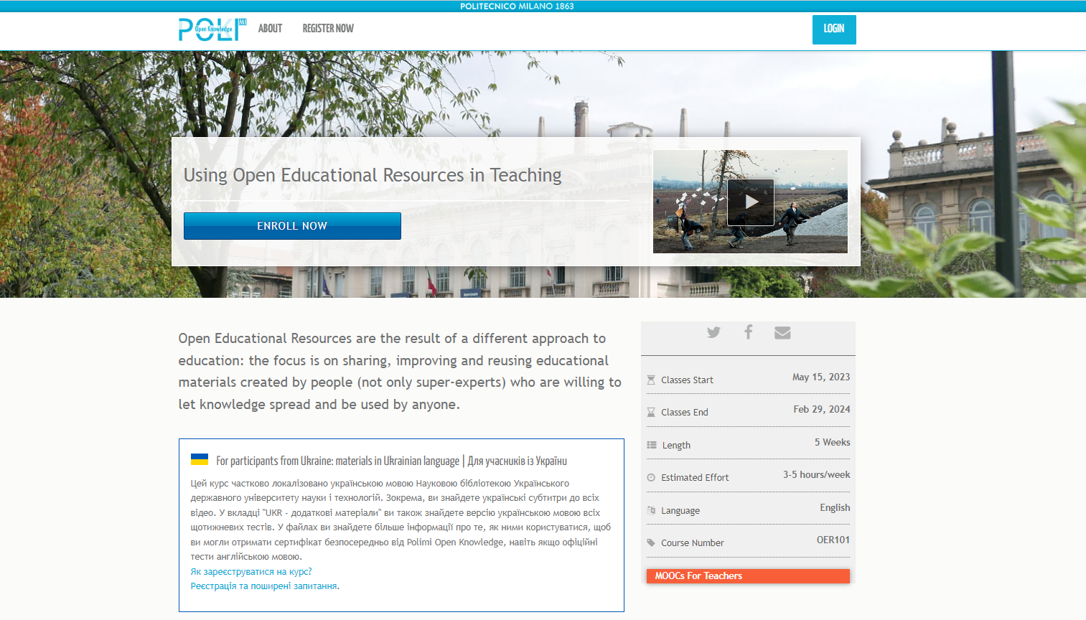

Slide 7
When do OPEN LICENCES come into play?
BEFORE YOU EVEN START
“Small steps tactic” require all of us to be flexible and patient, but experience shows “the sooner, the better.”
institution’s mission
platform choices (“pilot”)
availability of resources (what is doable?)

Slide 8
1
The process to build a CC licensed MOOC
the design phase
Platform examples to learn from: MIT OCW, MITx and TUDelft
The pilot design with Unit internal staff and responsibility
The CC licences explained smoothly to faculty through relevant examples
The choice of the CC licence with all the production and distribution phases in mind (content matters!)

Slide 9
2
The process to build a CC licensed MOOC
the production phase
The MOOC index contains all contents and their format, and notes related to licences issues
The video recording comes with a release form including the licence choice for each resource
The content production includes notes on each reused material and its licence for conscious remix
Deal with licences compatibility and find alternatives or ask for permission in advance when needed

Slide 10





Video only? Different content formats
                Texts
                Infographics
                Additional materials
                Activities
                Quizzes

Slide 11
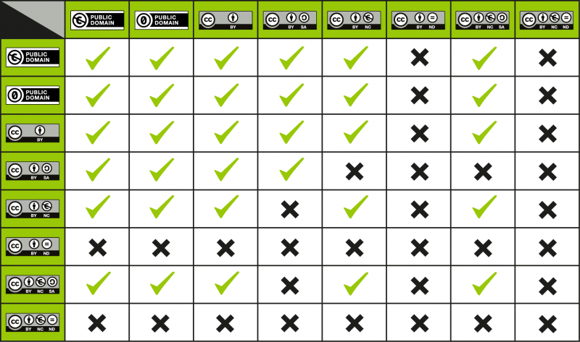
https://wiki.creativecommons.org/wiki/Wiki/cc_license_compatibility

Slide 12
3
The process to build a CC licensed MOOC
the post-production phase
Finalise critical licensing work and check proper attribution statements: Title, Author, Source, Licence (TASL)
MOOC index final check of the notes related to reused and remixed materials and record of specific permissions
The availability of content in the MOOC for the larger audience with their reuse in mind
The sustainability of the process and the virtual space: for a large scale or for specific projects?

Slide 13
Tips for reusing and remixing OER
Understand licensing terms before reusing OER
Choose OER with licenses that align with your MOOC's licensing terms
Provide clear attribution to original OER creators; follow specified attribution requirements (TASL)
Check that OER licenses permit remixing and modification; document changes made along the way (sooner is critically better than later!)
Maintain consistency in licensing throughout the MOOC as far as possible; communicate licensing terms clearly (“except where otherwise noted…”)
Encourage the sharing of derived works by licensing MOOC content for openness without being restrictive, whenever doable
Document licensing information for each component used in the MOOC (you might need them at a later stage!)
Utilise tools (like the Creative Commons search engine) to find suitable OER
Engage with open education communities for advice and collaboration.
Prioritise accessibility in both original OER and modifications made during remixing.

