Slide 1

Принципи відкритого доступу та відкритої науки в Україні: що думають дослідники і як можуть допомогти бібліотекарі?
Open Access and Open Science Principles in Ukraine: What Researchers Think and How Librarians Can Help
(Based on Selected Results from a 2025 Sociological Survey)
Ярошенко Тетяна, ДНТБ України
t.yaroshenko@dntb.gov.ua

Slide 2
OA & OS: Ukrainian landscape
Ukrainian universities and research institutions joined the open access movement in the early 2000s, with libraries serving as the primary drivers in most cases
140+ institutional repositories
National Repository of Academic Texts
3 pilot projects of Open research Data Repository
90% of all Ukrainian scholarly journals (1700+) are open access
Following the adoption of the National Open Science Plan in 2022, many universities and research institutions have developed and adopted their own OA and OS institutional policies
OS centers at many Universities

Slide 3

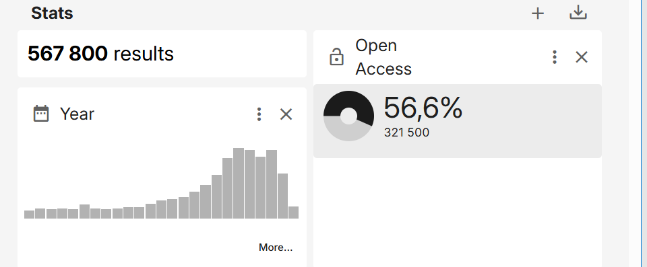

Slide 4
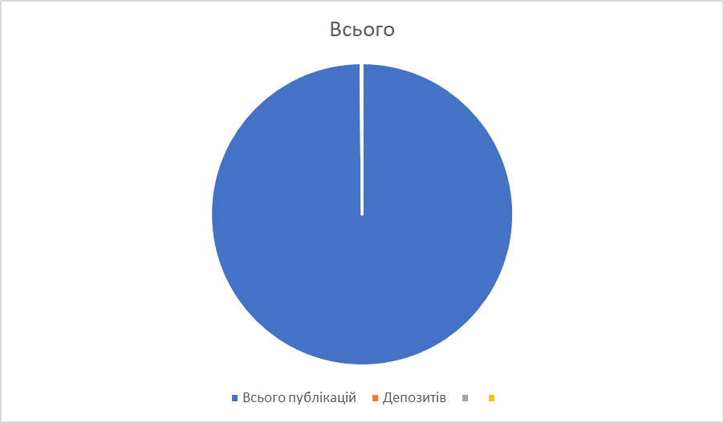
739
But
567800
Дані досліджень (датасети) – 0,13%

Slide 5
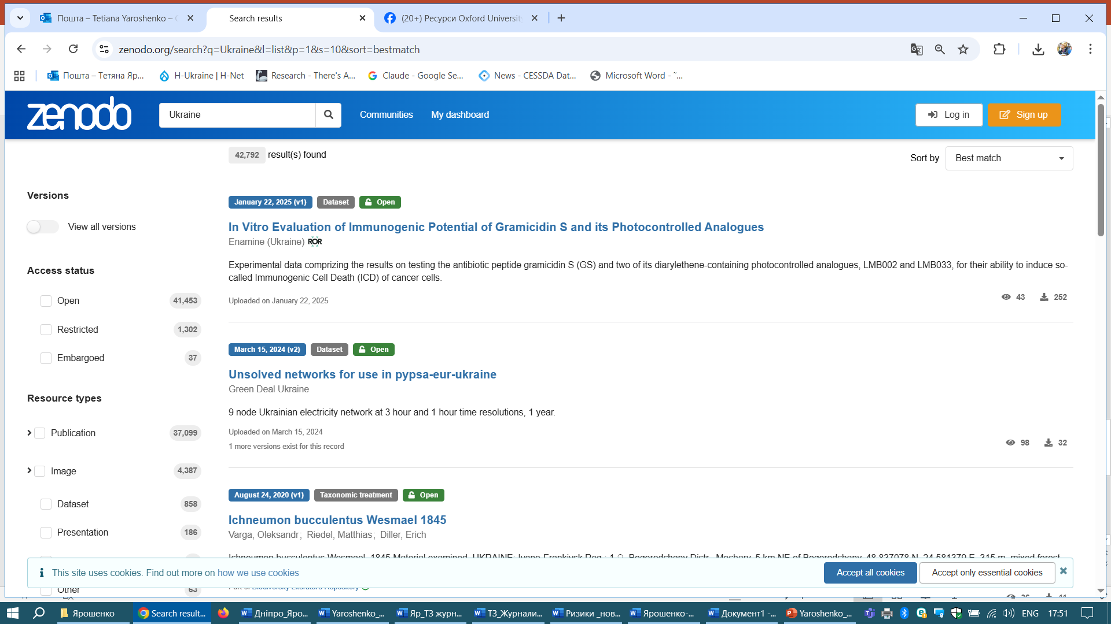
2%

Slide 6

2025 Sociological Survey
To examine the attitudes of Ukrainian researchers toward open access principles, open science, and research data management, as well as the role of libraries in promoting open science principles and practices, based on selected results from a sociological survey conducted by the State Scientific and Technical Library of Ukraine in April-August 2025.
The study involved 702 respondents from various scientific disciplines and academic institutions, with librarians comprising nearly 10% of participants.
The survey aimed to assess awareness levels, current practices, and readiness to implement open science approaches
Survey questions were developed based on literature review, expert discussions and feedback, and partial use of questions from the LEARN project study (LEARN, 2017).
The resulting survey instrument included 21 questions in 2 main sections: "Open Access and Research Data" and "Institutional Policies and Infrastructure for Open Science, Open Access, Research Data Management at the Institution."

Slide 7
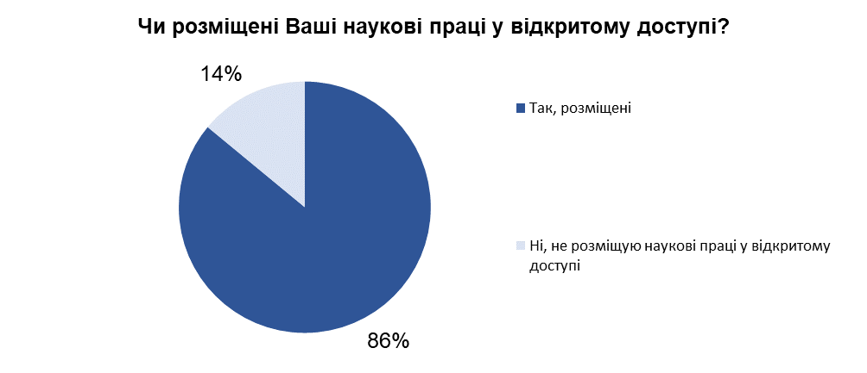

Slide 8
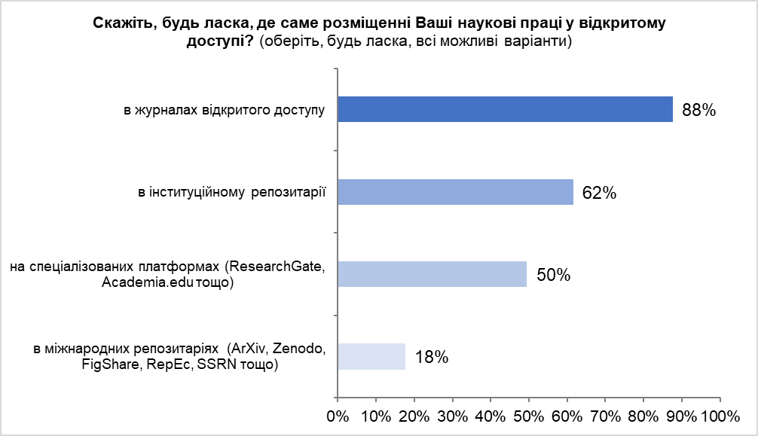

Slide 9
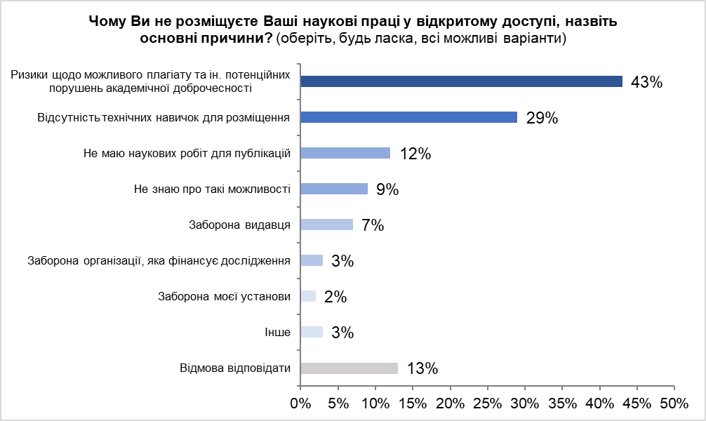

Slide 10
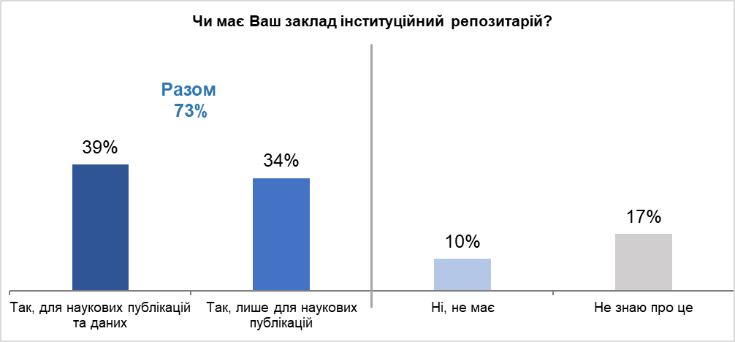

Slide 11
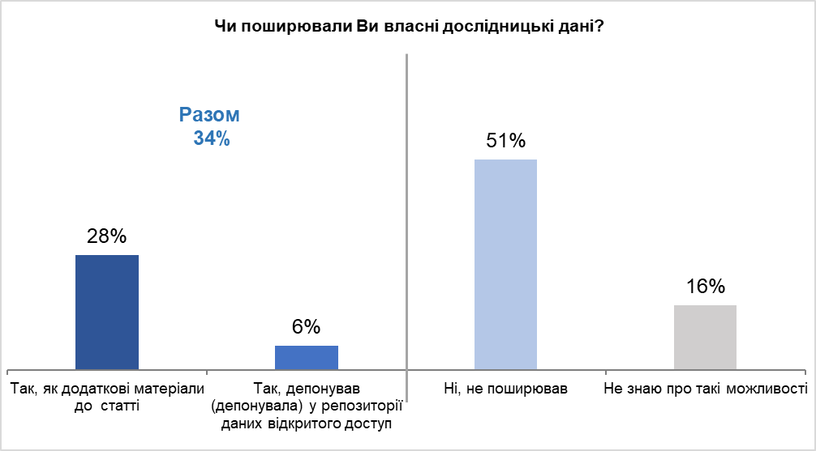

Slide 12
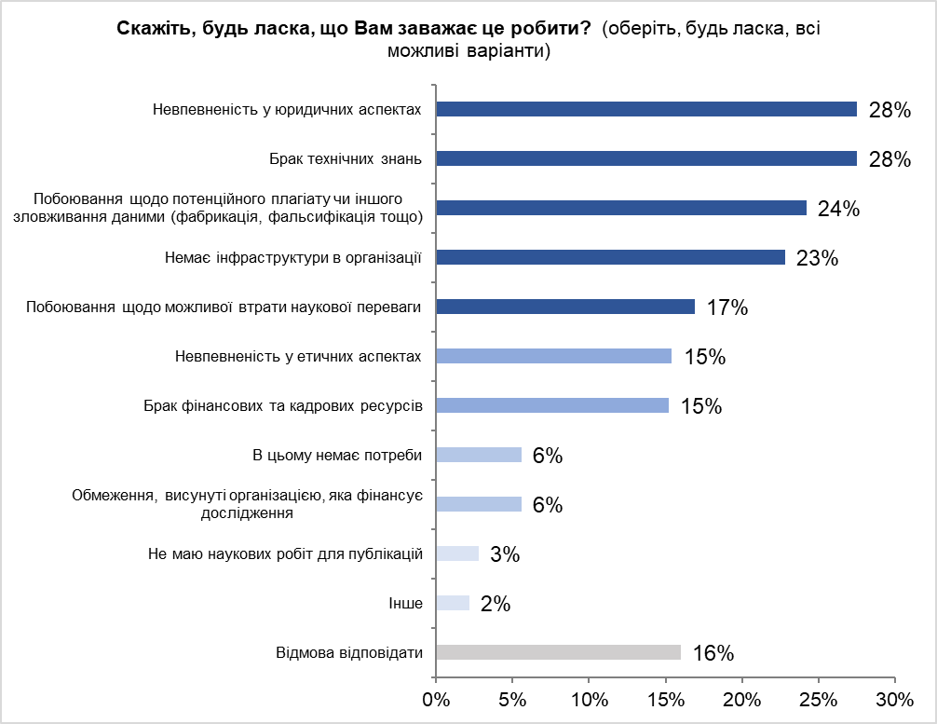

Slide 13
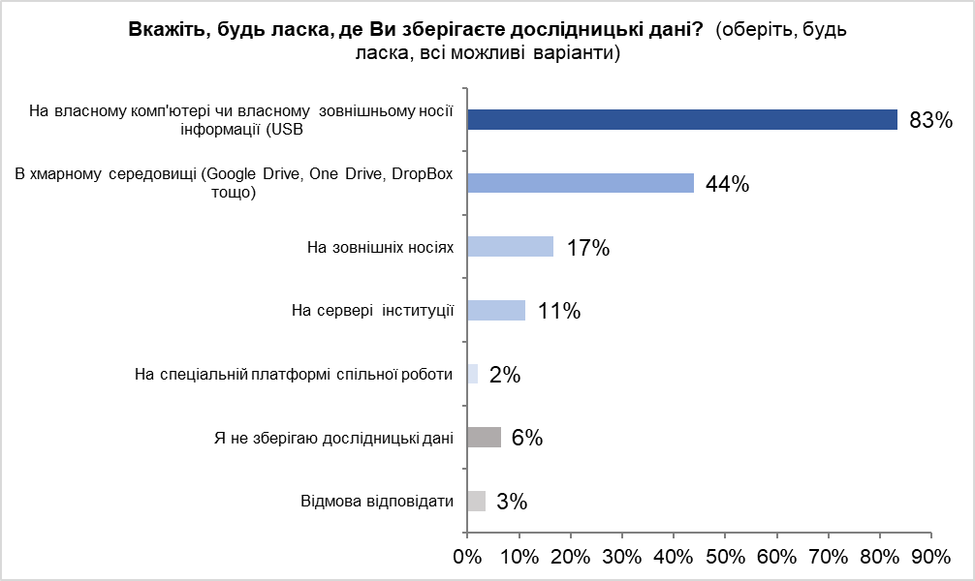

Slide 14
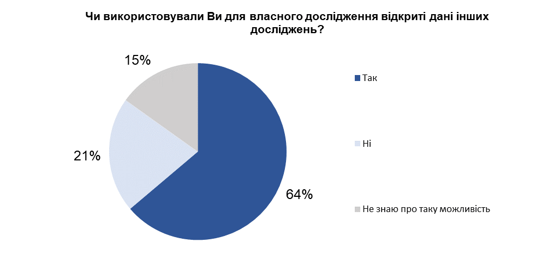

Slide 15
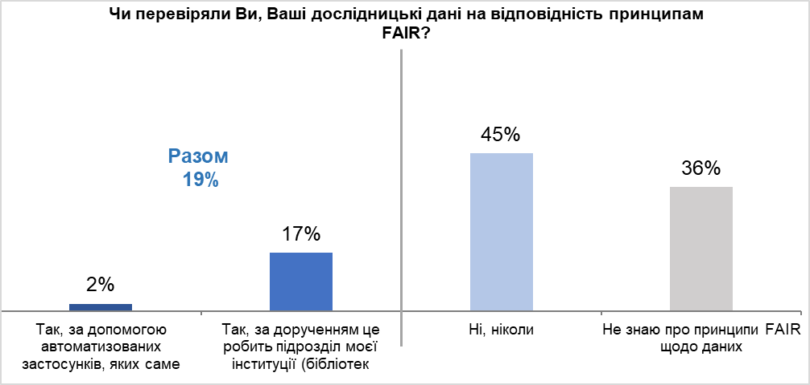

Slide 16
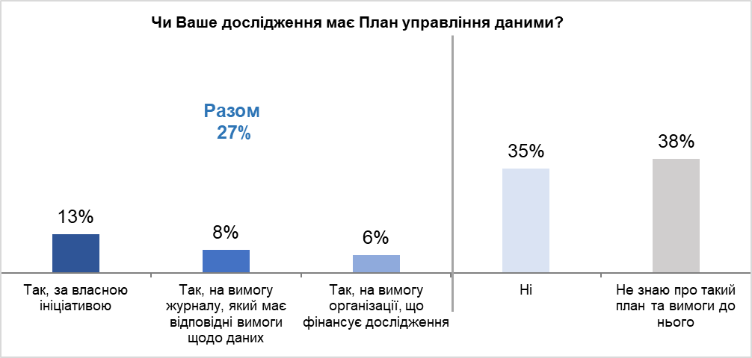

Slide 17
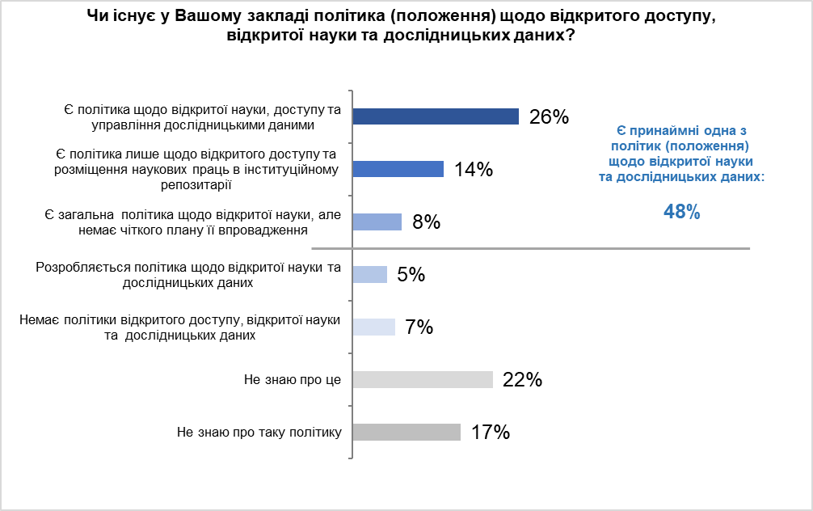

Slide 18
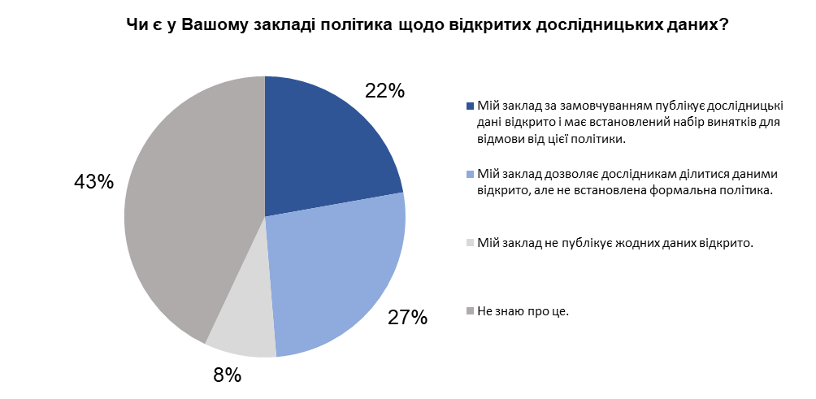

Slide 19
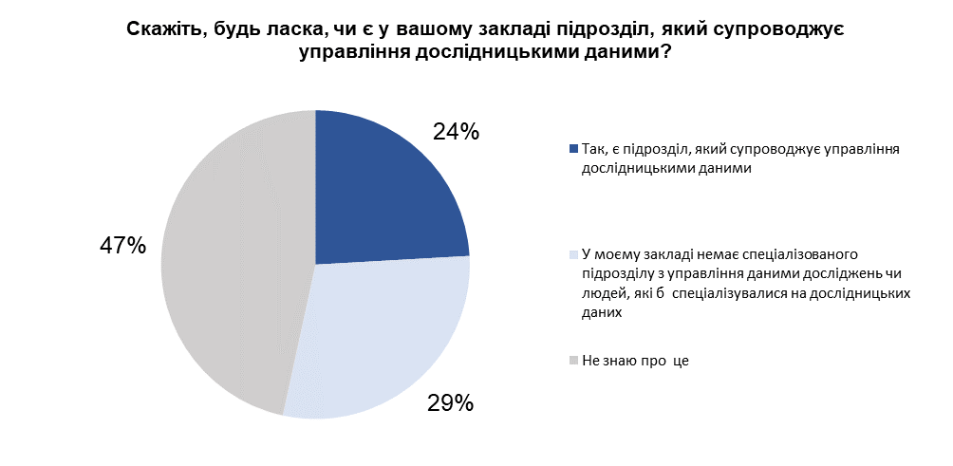

Slide 20
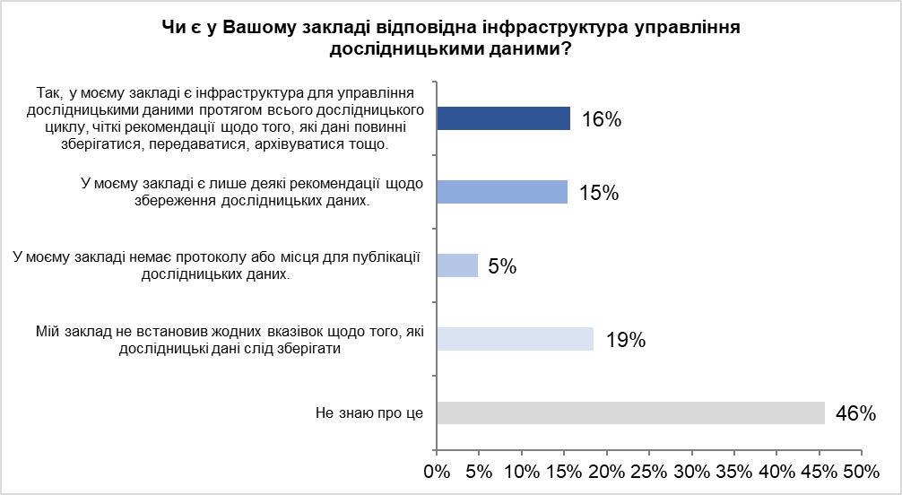

Slide 21
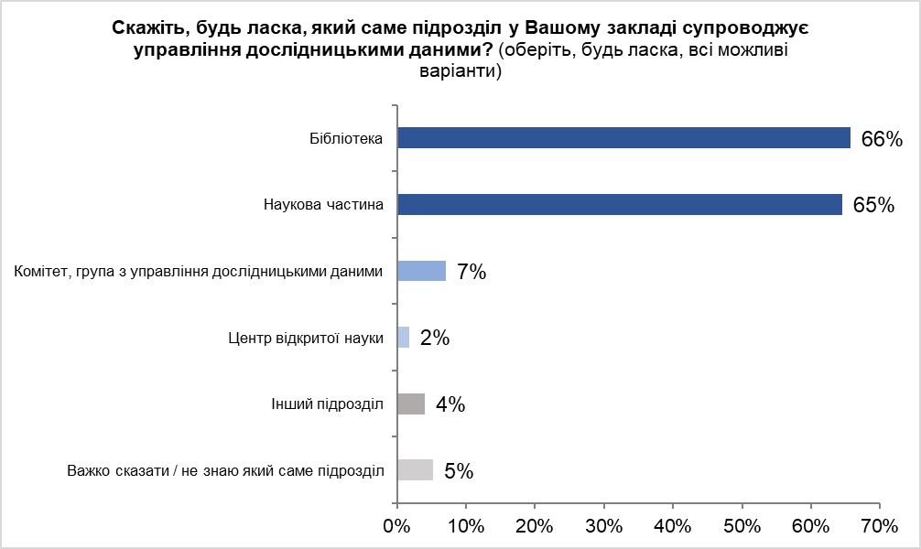

Slide 22
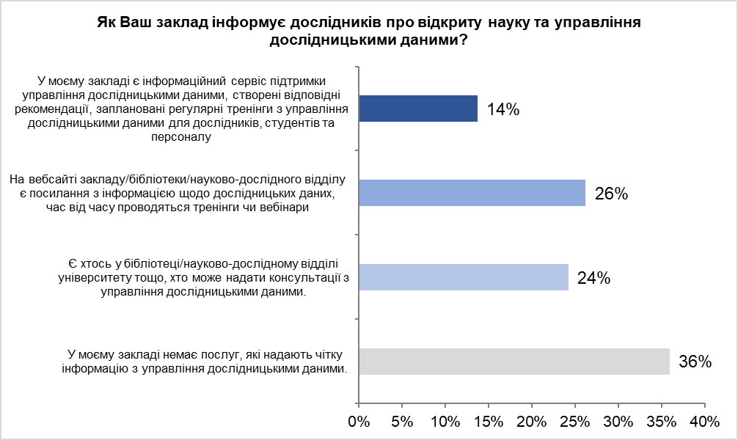

Slide 23
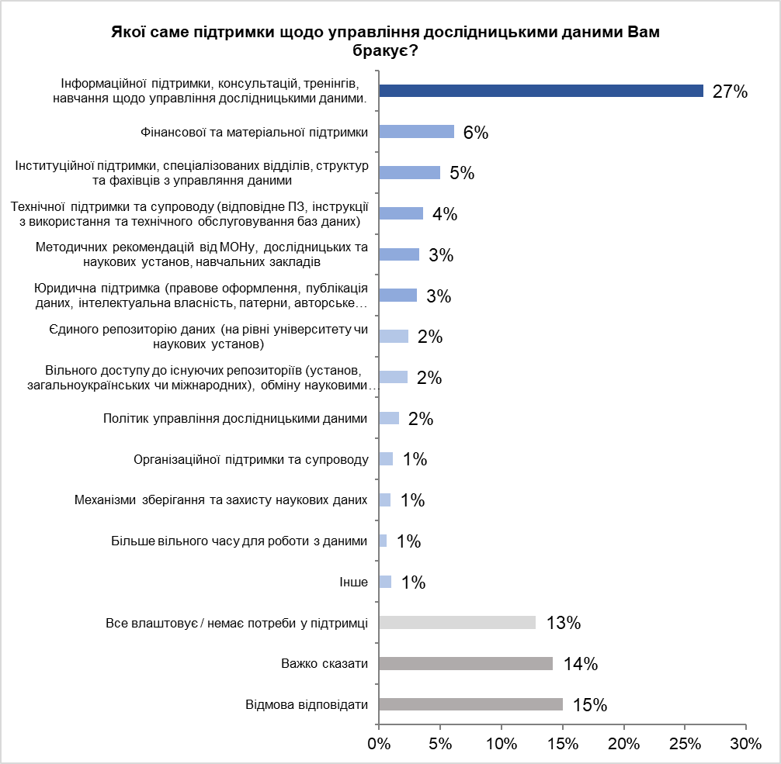

Slide 24

Academic libraries in Ukraine, which historically served as drivers of the open access movement, continue to play a key role in overcoming these challenges
Strengthen educational and advisory functions through developing systematic training programs on research data management, FAIR principles, data management plan creation, and metadata standards usage.
Intensify advocacy activities to promote development and implementation of institutional open science policies at university and research institution levels.
Expand technical infrastructure by creating and developing publication and data repositories, ensuring their interoperability and long-term preservation.
Develop specialized competencies of library staff in research data management and digital curation.
Provide comprehensive researcher support at all stages of the research lifecycle – from planning and data collection to publication and long-term preservation.

Slide 25
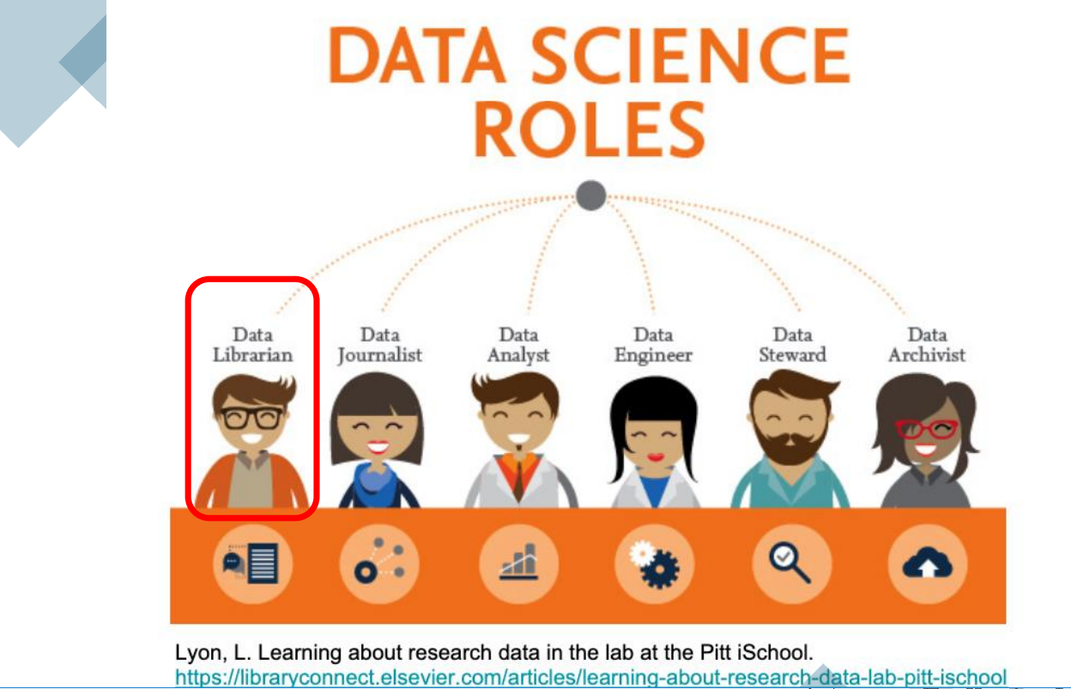

Slide 26

Дякую! Питання?
t.yaroshenko@dntb.gov.ua

