Slide 1



KNOWLEDGE, PREPAREDNESS AND CHALLENGES IN HYFLEX LIBRARY OPERATIONS AMONG HIGHER EDUCATION INSTITUTIONS (HEIs) LIBRARIANS IN CALABARZON PHILIPPINES
Mary Rose V. Navarro, Elizabeth D. Malabanan, Leomar S. Galicia, Ma. Lindie D. Masalinto
UNIVERSITY OF PERPETUAL HELP SYSTEM LAGUNA
PHILIPPINES
UniLibNSD Conference 2023|

Slide 2

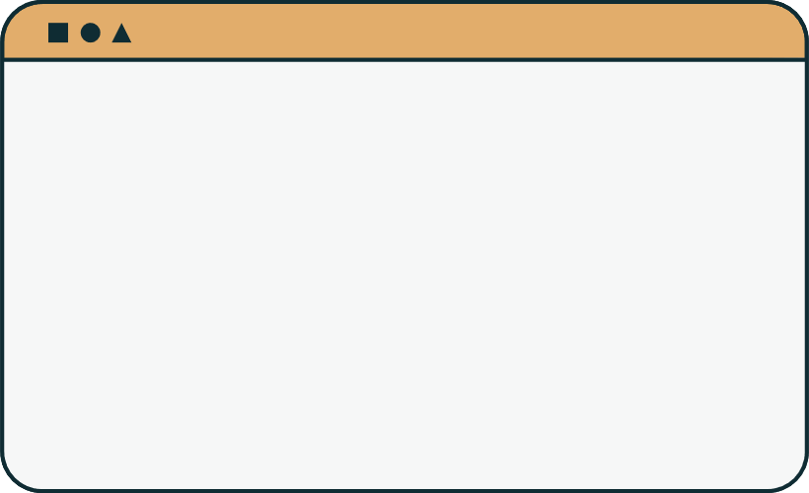


INTRODUCTION
METHODOLOGY
PRESENTATION OUTLINE
BACKGROUND
RESULTS
OBJECTIVES
CONCLUSION
UniLibNSD Conference 2023|

Slide 3





INTRODUCTION
LIBRARY
BACKGROUND
OBJECTIVES
METHODOLOGY
RESULTS
Traditional Library Operations
Hybrid Library Operations
COVID-19 Pandemic
HYFLEX Library Operations
CONCLUSION
UniLibNSD Conference 2023|

Slide 4
INTRODUCTION
Conventional methods and practices followed in libraries.
BACKGROUND
  cataloging and classifying physical books and materials;
  managing circulation and checkouts;
  providing reference services through in-person interactions;
  maintainingphysical collections
OBJECTIVES
METHODOLOGY
RESULTS
Traditional Library Operations
CONCLUSION
UniLibNSD Conference 2023|

Slide 5

INTRODUCTION
  Combine traditional library practices with digital technologies.
BACKGROUND
BACKGROUND
OBJECTIVES
  Physical collections are complemented by digital resources such as e-books, online databases, and digital catalogs.
METHODOLOGY
Hybrid Library Operations
RESULTS
CONCLUSION
UniLibNSD Conference 2023|

Slide 6

INTRODUCTION
BACKGROUND
  Closure or Limited Access to Physical Spaces
OBJECTIVES
  Increased Emphasis on Digital Resources
METHODOLOGY
  Remote Work for Library Staff
  Safe and Contactless Services
RESULTS
COVID-19 Pandemic
CONCLUSION
UniLibNSD Conference 2023|

Slide 7

INTRODUCTION
BACKGROUND
Flexible Learning Support
OBJECTIVES
  Personalized Services;
  Multiple Modes of Access;
  In-person access
  Synchronous online access
  Asynchronous online access
METHODOLOGY
RESULTS
Hybrid and Flexible (HyFlex) Library Operations
CONCLUSION
UniLibNSD Conference 2023|

Slide 8



INTRODUCTION
Ascertain the extent of knowledge, preparedness, and challenges associated with HyFlex library operations among librarians at Higher Education Institutions (HEIs) in the CALABARZON Philippines.
BACKGROUND
OBJECTIVES
METHODOLOGY
Examined the demographic profile of HEIs librarians, in terms of age, gender, position/designation, and years of service within the institution.
Determine the level of knowledge of HEIs librarians on HyFlex library operations.
Determine the level of preparedness of HEIs librarians on HyFlex library operations.
RESULTS
CONCLUSION
UniLibNSD Conference 2023|

Slide 9


INTRODUCTION
Ascertain the extent of knowledge, preparedness, and challenges associated with HyFlex library operations among librarians at Higher Education Institutions (HEIs) in the CALABARZON Philippines.
BACKGROUND
OBJECTIVES
METHODOLOGY
Test the relationship between the respondents' levels of knowledge and preparedness on HyFlex library operations when grouped according to their demographic profiles.
Explored the challenges faced by HEIs librarians in implementing HyFlex library operations.
RESULTS
CONCLUSION
UniLibNSD Conference 2023|

Slide 10





INTRODUCTION
BACKGROUND
OBJECTIVES
METHODOLOGY
Descriptive Method
148 HEIs Librarians in CALABARZON
Survey Questionnaire
RESULTS
CONCLUSION
UniLibNSD Conference 2023|

Slide 11





INTRODUCTION
BACKGROUND
OBJECTIVES
METHODOLOGY
Demographic Profile
Level of Knowledge
Significant Difference
Level of Preparedness
Challenges
RESULTS
CONCLUSION
UniLibNSD Conference 2023|

Slide 12


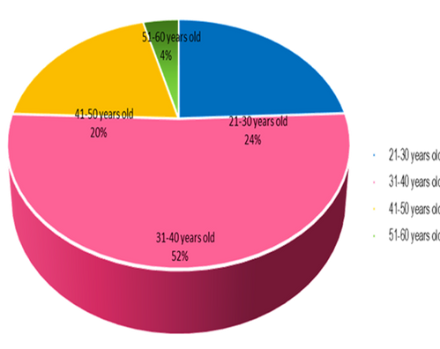
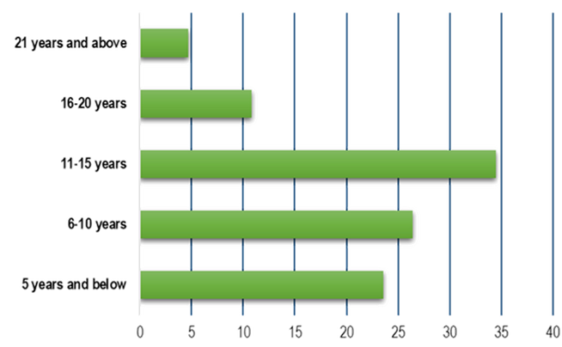
INTRODUCTION
DEMOGRAPHIC PROFILE
BACKGROUND
OBJECTIVES
METHODOLOGY
RESULTS
Female
31-40 Years Old
11-15 Years in Service
CONCLUSION
UniLibNSD Conference 2023|

Slide 13


INTRODUCTION
LEVEL OF KNOWLEDGE
BACKGROUND
OBJECTIVES
Respondents had a very high level of knowledge in Hyflex library operations with the overall weighted mean of 3.44.
METHODOLOGY
RESULTS
CONCLUSION
UniLibNSD Conference 2023|

Slide 14


INTRODUCTION
LEVEL OF PREPAREDNESS
BACKGROUND
OBJECTIVES
Respondents had a very high level of preparedness in Hyflex library operations as evident of the weighted mean of 3.46.
METHODOLOGY
RESULTS
CONCLUSION
UniLibNSD Conference 2023|

Slide 15

INTRODUCTION
SIGNIFICANT DIFFERENCE
BACKGROUND
p-values of .875, .193, .084
No significant difference on the respondents’ level of knowledge on Hyflex library operations when grouped according to their age, gender, position and years in service.
OBJECTIVES
METHODOLOGY
No significant difference in the respondents’ level of preparedness for Hyflex library operations when grouped according to their age, position and years in service.
RESULTS
CONCLUSION
p-values of .345, .808, .482 and .991
UniLibNSD Conference 2023|

Slide 16





INTRODUCTION
CHALLENGES
BACKGROUND
OBJECTIVES
lack of funds
METHODOLOGY
slow internet connectivity
limited number of users
RESULTS
CONCLUSION
UniLibNSD Conference 2023|

Slide 17
INTRODUCTION
  Higher Education Institutions (HEIs) libraries in the Philippines have transitioned from traditional to hybrid and flexible (HyFlex) operations due to technological advancements, evolving patron needs, and the ongoing COVID-19 crisis.
  HyFlex library operations extend the concept to education, emphasizing flexibility and adaptability in how students and faculty access library services and resources to support their learning and research needs.
BACKGROUND
OBJECTIVES
METHODOLOGY
RESULTS
CONCLUSION
UniLibNSD Conference 2023|

Slide 18





RECOMMENDATIONS
work with their colleagues
attend professional development trainings, workshops, and conferences
UniLibNSD Conference 2023|

Slide 19


RECOMMENDATIONS
stay updated on current trends and best practices
establish partnerships with other libraries and organizations
UniLibNSD Conference 2023|

Slide 20

RECOMMENDATIONS
Academic Administrators Support
UniLibNSD Conference 2023|

Slide 21


REFERENCES
Allen, L. (2021). Hybrid Librarians in the 21st Century Library: A Collaborative Service-Staffing Model. Retrieved from https://www.ala.org/acrl/sites/ala.org.acrl/files/content/conferences/pdf/allen05.pdf.
Amaechi, N.M., Enweani, U.V., & Eke, C.C. (2021). Challenges to Library and Information Services (LIS) Delivery in the 21st Century: The Situation in three Academic Libraries in Imo State, Nigeria. Library Philosophy and Practice (e-journal), 2075. Retrieved from http://digitalcommons.unl.edu/libphilprac/2075.
Beatty, B. J. (2019). Hybrid-Flexible Course Bibliometric Analysis and Information Mapping. Indonesian Journal of Librarianship, 2(1).
Bhardwaj, R.K., & Kanjilal, U. (2020). Assessing the preparedness of academic librarians in developing countries for hybrid library services: The Indian experience. The Electronic Library, 32(5), 719-733. doi:10.1108/EL-03-2020-0049.
Broopy, P. (2020). Digital Library Research Review: Final Report, Library & Information Commission, London. Retrieved from http://www.cerlim.ac.uk/consult/dlrr.rtf.
CHED. (2020). Guidelines on the Implementation of Flexible Learning. CHED Memorandum Order No. 4, 2020.
CHED. (2021). CHED Memorandum Order No. 22, 2021: Minimum Requirements for Libraries of Higher Education Institutions Common to All Programs.
UniLibNSD Conference 2023|

Slide 22


ДЯКУЮ | THANK YOU
Mary Rose V. Navarro
Dr. Elizabeth D. Malabanan
Dr. Leomar S. Galicia
Dr. Ma. Lindie D. Masalinto
UniLibNSD Conference 2023|

