Slide 1


University of Groningen Press:
Navigating the Open Textbook Publishing Landscape
Mira Buist-Zhuk, Margreet Nieborg
University of Groningen,
The Netherlands
bit.ly/UGP-UAconf
Notes:
Mira
Hello and welcome to our presentation. Let’s navigate the open textbook publishing landscape with the University of Groningen Press | UGP.
After several years of working in the sphere of open publishing of scholarly works and journals, the UG Press has recently started an open textbook publishing pilot.
Let’s take a closer look at the subject through the prism of this pilot.
Conference abstract:
University of Groningen Press: Navigating the Open Textbook Publishing Landscape
In this session, we will share the experience of the University of Groningen Press (UGP) with its first open textbook publishing pilot. UGP is a new university press that has transformed into a dynamic hub for diamond open access publishing. Our experience in facilitating open access journals and monographs has paved the way for our latest initiative - an open textbook publishing service. UGP's integration of interactive, student-centered open textbooks into its portfolio embodies our commitment to supporting open education and facilitating the cross-disciplinary synergy within open science.
Drawing upon insights from the ongoing pilot, we will briefly explore UGP's open textbook publishing journey. We will do so by discussing what it takes to set up a functional open textbook pilot and garner support for its implementation. Additionally, we will showcase the platforms we use to support academics in publishing our university’s first open textbooks. We hope this session helps the audience generate valuable insights for their own endeavors in open textbook publishing and ensuring access to knowledge, especially in times of high-level crisis.

Slide 2
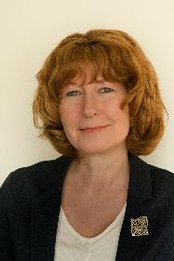
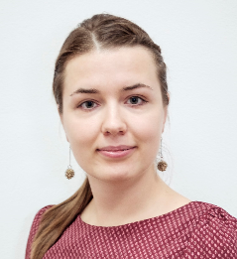
Who we are & how we are involved
Margreet Nieborg
University of Groningen Library,
University of Groningen Press
Mira Buist-Zhuk
University of Groningen Library,
Education Support
Notes:
But first, we’d like to introduce ourselves.
Beiden
I am Margreet Nieborg, project manager and coordinator of the University of Groningen Press.
And I am Mira Buist-Zhuk, an academic information specialist at the University of Groningen Library and an Open Education pillar leader at our university’s Open Science program.

Slide 3

University of Groningen Press | UGP
Part of the University of Groningen Library
Started in 2017 with OA journals, 2019 - with OA books, 2021 - with open textbooks and in 2022 with inaugural lectures
UGP is a New University Press (NUP)
Common characteristics are:
Diamond open access
Digital first
Library-based
Often offer a smaller set of services than a traditional publisher
Notes:
Margreet
First a few words about the University of Groningen Press. We are still a relatively young press in an old, internationally oriented research university located in the North of the Netherlands.
Once we made the decision to start a university publishing press in 2017, things moved quickly and and our portfolio expanded rapidly. We concentrated on journals first because we already had some experience with this form of scholarly publishing.
In 2019, we started with Open Access books and in 2021 with Open Textbooks.
UGP is a so-called New University Press. These university presses are often library-led, with an academic-led steering group or editorial board. We do not offer all the publishing services in-house. For copy editing, typesetting and Printing on Demand, we work closely with an external content processing bureau. Additionally, for a maximal exposure of our books in a printed form, we work together with a small commercial publisher also located in Groningen.

Slide 4

New university press as an Open Science platform
NUP as a playground for connecting
the building blocks of Open Science
More sustainable transfer of know-how
Better dissemination of knowledge
Closer engagement with the open agenda
Faster transition to more open and accessible
research and education
NUP are reflecting, facilitating and spurring greater uptake of open practices and contributing to a better synergy between the Open Science elements
Notes:
Mira
Along with other new university presses, the UG Press has been reflecting and at times spearheading the changes in scholarly communication, research and education cultures.
Beside their other, more traditional, roles, NUP are realizing their potential to better connect segments of open science and foster fruitful collaborations among them.
A new university press could serve as a natural playground for connecting the building blocks of Open Science: open access, open data, open peer review, open educational resources,
and encouraging the adoption of open practices.
Such developments thus allow for a more sustainable transfer of know-how, better dissemination of knowledge, and closer engagement with the wider “open” agenda.
It also facilitates better-equipped and faster transition to more open and accessible research and education
~~~~
Image credits:
Model by CompVis and Stability AI, licensed with a CreativeML Open RAIL-M license.

Slide 5

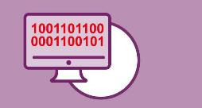



UG Press as an Open Science platform
Open access scholarly publishing
Open infrastructure
Open practices
Engaging with the public
Open educational resources
Notes:
Mira
Most new university presses started in the slipstream of the open access movement with the growing dissatisfaction with the traditional publishing models, the rising costs and expensive packages deals.
In a new university press, you can naturally combine open access publishing also using open educational resources, open practices and open infrastructure (particularly, platforms based on the open source software) and create through its open nature a good exposure to the interested public.

Slide 6
Supporting the Open Textbook pilot
In-house expertise from UGP built on experience of OA publishing projects
In-house expertise from OER team at University Library
Invited expertise: didactic and pedagogical experts at Education Support & Innovation
Platforms: OMP and Pressbooks
Publishing
OER
Didactic
Technical
Notes:
Mira
Let’s take a look at what it takes to support an in-house open textbook pilot and how other elements of OS could be involved.
UGP offers custom support in publishing an open textbook. Its staff act as local experts for researchers and teachers, providing guidance on intellectual property, scholarly communication, and the publishing process including the technical aspects
For the Open Educational Resources (or OER) -related support and guidance, and for best practices and connections with the authors, we rely on the expertise of the in-house OER team at the Library.
Currently, we are running 7 OT pilots. Due to the diverse nature of these open textbooks, we see the need to invite colleagues with didactic expertise, educational experts and trainers.
Such expertise is highly relevant, especially during the stage of developing open textbooks.

Slide 7
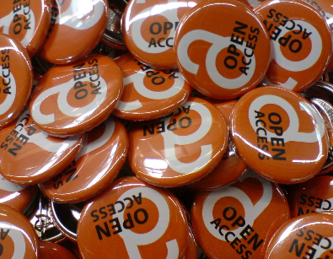
Lessons learned from OA publishing projects
How to
  Publishing expertise, visibility and findability
  Quality matters
  Plan a (sustainable) publishing workflow
  Copyright awareness, open licenses
  What to pay attention to when negotiating with publishers
How not to
  Danger to fall into the same pitfalls as OA movement
  Inequality: power relations & influence still disproportionately skewed towards big publishers and affluent countries, institutions, authors
  Costs are rising hard, sustainability considerations
Notes:
When we started with the implementation of the open textbook publishing pilot in 2021, we already had 5 years’ worth of experience with other Open Science practices, such as open access publishing of journals and books, open source infrastructure, and some forms of public engagement.
For our open textbook pilot, this experience in the “how to” and “how not to” section were for us equally important to learn from.
In terms of successes, at UGP we already build up some experience with visibility and findability of publications with the help of the university library, with indexing and metadata, providing DOI with OAI harvesting.
We developed a better understanding in quality matters and in handling the publishing workflow and processes. These were all things we had to learn from scratch and from our peers in the Netherlands and in Europe. We learned a lot about copyright and the importance of open licenses and in giving the proper advice of using that licenses. The proper use of licensing and copyright are indispensable in the world of scholarly publishing and it is important that our authors are more aware of copyright and what they are giving away.
“How not to” section:
During the COVID pandemic we saw how important open educational resources and open access publications are for our educational system. But we also see the rise of a new verdienmodel with the big commercial publishers choosing for the gold open access route. We as a university still have to pay a lot of money now not to read the research but to publish the research. We see that is so difficult to get a grip on this market, and we are worried about the the future of the open educational resources and open access publishing. Still our costs are rising and with that inequality is also still rising.
The same publishers who generated huge profits and controlled the subscription market now also partially control the open access market through article-processing charges. This development often prevents the authors from lower income countries from publishing in these larger journals under open access.
Image credits:
"Open Access Buttons" by h_pampel is licensed under CC BY-SA 2.0.

Slide 8
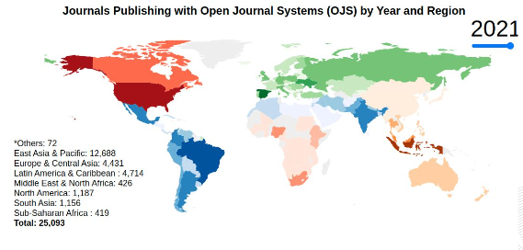
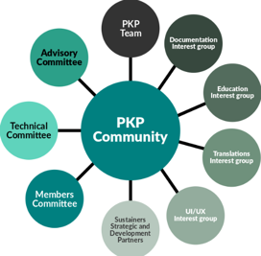
Platform choice
UGP uses the open source platforms
of the Public Knowledge Project (PKP):
Open Journal System (OJS) for journals, 2014
Open Monograph Press (OMP) for books, 2019
Why PKP:
Open-source
Globally widely used platform
Community-based: large active community that influences new features
Fixed team of developers
Special interest groups and sprints in the community
Notes:
Margreet
PKP platforms:
can be used for managing the editorial workflow, internal and external reviews, editing, cataloguing, production and publication. OMP has also a website with a catalog;
are licensed as Open Source Software (OS) (GNU; General Public License);
developed by Public Knowledge Project (PKP) & Simon Fraser University;
downloaded and installed on local servers (CIT);
OMP and OJS base URL available to harvesters and databases (EBSCO);
interoperable with systems such as ORCID, Creative Commons, Crossref, DOAJ, DOAB, I-thenticate and persistent archiving systems.

Slide 9
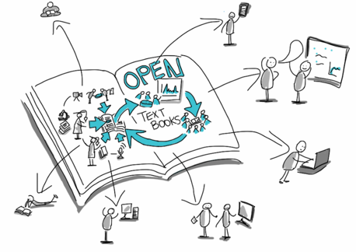
Why choose a different platform for OT?
At the start of OT project: intake with wishes and requirements by teachers
  7 applications
  → 4 pilots chosen (2021)
  → grew to 7 pilots (2023) + more in pipeline
  Going beyond the classic textbook
  Interactive content
  Student involvement and co-creation
    Key considerations
  Open source
  Interactive, multimedia-enabled, responsive web-books + print-on-demand
  Funding & staff availability
Notes:
Margreet
When we started with our open textbook publishing pilot in 2021, we already had some experience with other Open Science practices, such as open access publishing of journals and books, open source infrastructure, and some forms of public engagement.
For our open textbook pilot, the how to and how not to experience we had with UGP was really important
In terms of how to at UGP we already build up some experience with visibility and findability of publications with the help of the university library, with indexing and metadata, providing DOI with OAI harvesting
We developed a better understanding in quality matters and in handling the publishing workflow and processes. These were all things we had to learn from scratch and from our peers in the Netherlands and in Europe. We learned a lot about copyrights and the importance of open licenses and in giving the proper advice of using those licenses. The proper use of licensing and copyright are so important in the world of scholarly publishing.

Slide 10
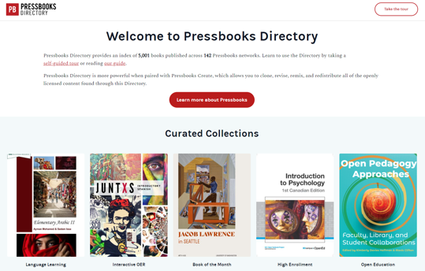
Why Pressbooks for OT?
Pressbooks is software that allows you to design, format and export books
Responsive to authors' needs and ideas "beyond the textbook"
Large selection of interactive features (H5P, 40+ types)
Wide choice of export possibilities (10+ formats)
Social annotation layer: Hypothesis
Appearance
Large catalogue/repository to clone and customize content and interactive features (~6,000)
Various possibilities for integration into LMS
Standalone or hosting? → UG has chosen for hosting
Institutional support and training
Large and active community: Already widely used by US, CA, Australian institutions (100+)
Notes:
Margreet
Pressbooks key features: Embedding multimedia, H5P interactivity, cloning/adapting others’ content, social annotation layer (Hypothesis), MathJax, Google Analytics
Outsourcing hosting & development services: personnel costs money too, difficult to find skilled technical personnel

Slide 11
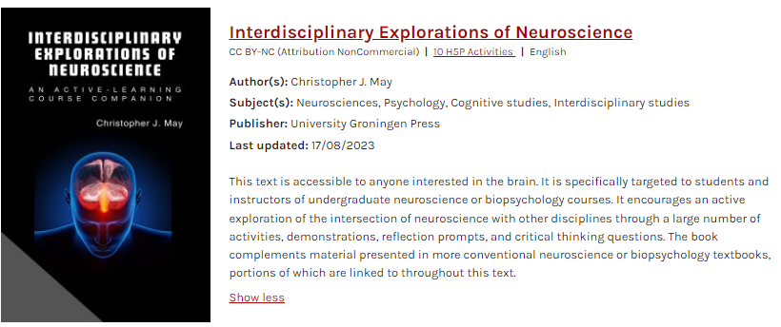
Pressbooks Frontend
https://opentextbooks.rug.nl/interdisciplinaryexplorationsofneuroscience/
Notes:
Margreet

Slide 12
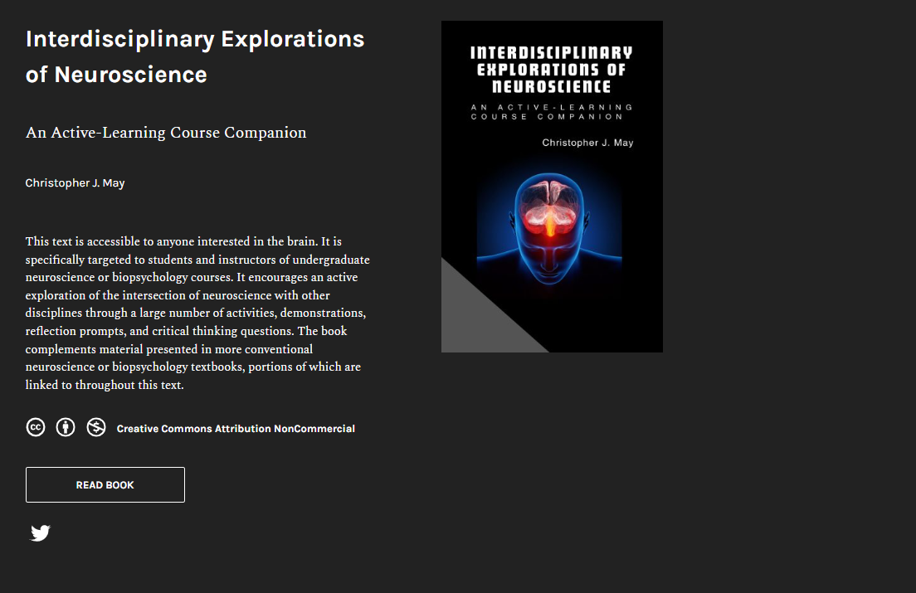
Notes:
Margreet

Slide 13
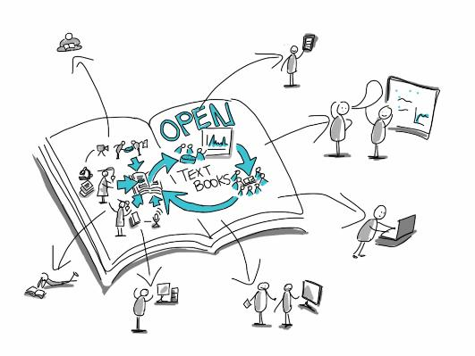
Lessons learned from the open textbook pilot
How to
  Help unite research output and teaching
  Produce innovative & pedagogically sound materials
  Integrate the (often missing) student element, encouraging student agency and empowerment
  Step-by-step approach: pilot first chapters with students and learning communities
How not to
  Use one-size-fits-all approach
  Be too ambitious and vague with time-
  planning
  Leave (student) co-authors without a framework to work in
  Forget about the learning curve with the publishing platform
Guide: bit.ly/CreateTextbook
Notes:
Mira
To examine how different facets of OS engage in often mutually beneficial interaction through the media of NUP, we have also looked at the first lessons learned from the ongoing open textbook pilot.
The pilot envisages the development of OER in a form of open textbooks. We are busy with 4 OT projects at the moment, spanning different disciplines.
Besides reaching the obvious project objectives and institutionalizing open textbook publishing as a service at our university,
we also hope to enrich the open access portfolio of our university press,
and provide a space to be creative and innovative for teachers, students, and ourselves - scholarly communication professionals.
With the development of OER in a form of an open textbook, we:
Help bring together the sometimes divided nexuses of research output and teaching excellence and innovation
Place student needs & open pedagogical practices as focal points, encouraging student agency and empowerment
In line with the Open Science values and attitudes, such collaborative open pedagogical projects involving students as co-authors of open textbooks,
allow us to continuously look at students as future scientists & critically thinking, informed citizens, rather than just the objects of educational processes happening at a university
These experiences, undoubtedly, will also benefit the other areas of OS, along with some words of caution against:
Using one-size-fits-all approaches and not taking into account the diverse needs and creative solutions of open authors
Being too ambitious with the timeframe & publishing software
Or leaving co-authors without a working framework for collaborative content creation
Image credits:
Open textbooks image by Giulia Forsythe, licensed under CC 0 (Public domain).

Slide 14
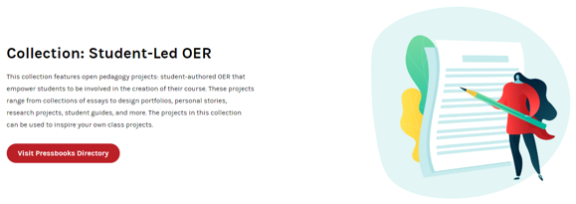
What’s next?
Looking for an optimal mix between more traditional and more innovative OT projects, their integration in education, students’ and teachers’ needs
Sustainable transition from pilot to service
Project funding → structural costs
Exit strategy and prevention of vendor lock-in
Ownership of data
Didactics and integration in learning design
Further integration with LMS/Brightspace on demand
Expansion of offerings and types of projects: campus publications, project work, train-the-trainer materials
Preparing for more involvement of students as co-creators of content
Keeping our options open!
pressbooks.com/collection-student-led-oer/
Notes:
Mira

Slide 15

Let’s keep discussing this together!
Mira Buist-Zhuk
Academic Information Specialist
Pillar leader Open Education
(Open Science programme)
University of Groningen
University of Groningen Library
Education & Research Support
Broerstraat 4, 9712 CP Groningen
Postbus 559, 9700 AN Groningen
T: +31 (0)50 3639565
E: m.zhuk@rug.nl
W: rug.nl/research/openscience/
Margreet Nieborg
Project manager
Coordinator UGP
University of Groningen
University of Groningen Library
Development & Innovation
Broerstraat 4, 9712 CP Groningen
Postbus 559, 9700 AN Groningen
T: +31 (0)50 363 5027
E: m.nieborg@rug.nl
W: rug.nl/bibliotheek
W: www.rug.nl/ugp
Notes:
We are looking forward to continuing this discussion; please feel free to get in touch with us if you have any questions, comments or suggestions.
Thank you for your attention!
Image credits:
Corporation by Gonza from NounProject.com, CC BY 3.0.

Slide 16

Terms of Use
Except where otherwise noted, content in this presentation
is licensed under a Creative Commons Attribution license (CC BY 4.0)
Mira Buist-Zhuk and Margreet Nieborg
University of Groningen, 2023
Slides available at: bit.ly/UGP-UAconf

