Slide 1
How Can Libraries Empower Research Excellence?
HUMAN SIDE OF TECHNOLOGY
Research Information Services, KTU Library
giedrius.dabasinskas@ktu.lt
Notes:
Hello,
My name is Giedrius Dabasinskas, I am from Research Information Services Department of the KTU Library.
I am going to talk about how the libraries can empower research excellence, and I am going to focus on bibliometrics role, based on my experience as a data manager in the KTU Library.

Slide 2
What bibliometric services can a library offer?
For researchers
Trainings
Individual consultations
Bibliometric services
University
Open Access promotion
DMP support
For departments
Reports
Bibliometric networks
For the Library
Support for decisions
Enrichment of research documentation
Feedback improves support quality
Based on Juan Gorraiz
Notes:
Bibliometrics is the statistical analysis of research outputs (for example, publications), using metrics such as citation counts and downloads to measure impact, track trends, and identify research strengths. It helps to understand how research is produced, organized, and disseminated, informing decisions for institutions, funding bodies, and individual researchers. Key applications include evaluating research performance, identifying collaboration patterns, monitoring research output, and mapping the evolution of scientific fields.
Libraries use bibliometrics for a variety of services:
Research support: involves individual consultation about publishing, like choosing/checking a journal;
Department level support: monitoring departmental research output and providing insights based on it, creating bibliometric networks to identify patterns between researches, different departments, institutions etc.
University level: Library plays important role in providing support for Open Science, Open Access, Data Management.
For Library itself: bibliometrics provide insight into decision making, enriching research documentation, feedback from research community enhances support quality

Slide 3
Requirements for bibliometric analyses
To conduct effective citation analyses, the following framework requirements should be considered:
Selection of Appropriate Data Sources: Choose databases that are most relevant to the research field and objectives.
Coverage in Databases: Ensure that the selected databases provide comprehensive coverage of the relevant literature.
Differentiation of Publication Types: Differentiate between various document types (e.g., articles, book chapters, conference papers) during analysis to accurately assess their impact.
Publication Window: Consider the time frame during which publications were produced for a meaningful analysis of trends and impact (5-7 years).
Aggregation Level: Recognize that the requirements and needs differ significantly at various aggregation levels:
  Micro Level (Individual Researchers): Requires detailed and personalized citation metrics to assess individual academic contributions.
  Meso Level (Research Groups or Departments): Focuses on aggregated metrics that reflect the collective output and collaborative dynamics within a group.
  Macro Level (Universities or Countries): Emphasizes broad impact indicators that capture the overall research influence and policy implications at institutional or national levels.
Based on Juan Gorraiz
Notes:
To conduct effective citation analyses, the following framework requirements should be considered:
Selection of Appropriate Data Sources: Choose databases that are most relevant to the research field and objectives.
Coverage in Databases: Ensure that the selected databases provide comprehensive coverage of the relevant literature.
Differentiation of Publication Types: Differentiate between various document types (e.g., articles, book chapters, conference papers) during analysis to accurately assess their impact.
Publication Window: Consider the time frame during which publications were produced for a meaningful analysis of trends and impact (5-7 years).
Aggregation Level: Recognize that the requirements and needs differ significantly at various aggregation levels:
Micro Level (Individual Researchers): Requires detailed and personalized citation metrics to assess individual academic contributions.
Meso Level (Research Groups or Departments): Focuses on aggregated metrics that reflect the collective output and collaborative dynamics within a group.
Macro Level (Universities or Countries): Emphasizes broad impact indicators that capture the overall research influence and policy implications at institutional or national levels.

Slide 4










Bibliometric analyses for KTU faculties
Bibliometric analyses at a department level
Insights for publishing strategy:
  Recommended publishers and journals
  Open Access opportunities and international collaboration
  APC (Article Processing Charge) discounts
Practical guides for selecting the most impactful journals in relevant research areas
Meetings with KTU departments where analyses are discussed.
Notes:
So, what actual bibliometric services does the KTU Library actually offer?
Bibliometric analyses at a department level
Insights for publishing strategy:
Recommended publishers and journals
Open Access opportunities and international collaboration
APC (Article Processing Charge) discounts
Practical guides for selecting the most impactful journals in relevant research areas
Meetings with KTU departments where analyses are discussed.

Slide 5



Data sources & methodology
Data sources (“librarian rule” – at least 3 databases) differ in coverage and relevance:
Data is filtered / grouped / merged depending on the case using MS Excel and R
For example, S1 is a publication in the journal indexed in Web of Science
eLABa: all publications at university / department / research group / individual level
Web of Science: indicators (IF, Quartile)
Scopus: indicators (SNIP, Quartile)
Notes:
Bibliometric analysis starts from data sources that will be used. As a general (librarian) rule, 3 databases should be used, in order to ensure good coverage and relevance. In our case, we use national repository eLABa, and scientific databases Web of Science and Scopus. eLABa consists of all publications at university / department / research group / individual levels. Web of Science and Scopus are used because of their metrics and thematic classification.
Data is then filtered / grouped / merged depending on the case using MS Excel and R
For example, S1 is a publication in the journal indexed in Web of Science, and is most relevant for research output in Natural and Technological research fields.
This way a dataset is prepared consisting information from all three databases.

Slide 6
Publisher trends
Allows to track popularity of each publisher
Identify trends of more or less relevant publishers
Notes:
One of the insights that bibliometric analysis provides is publisher popularity and trends. This can be useful if we want to monitor particular publishers, and if, for example, a department, or university, would like to shift towards a more relevant publisher. It also reflects if researchers use those publishers that the KTU has APC discount agreements with.

Slide 7
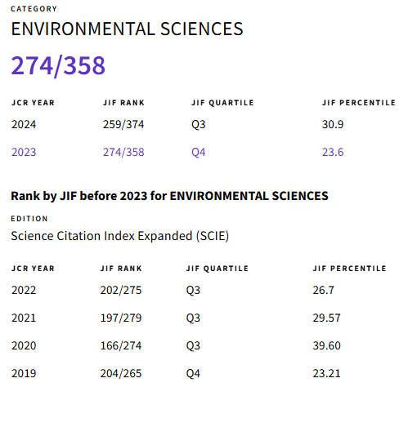
Journal trends
Publication trends by WoS / Scopus quartiles
To track the quality of research output
Journals that changed quartiles are highlighted
Journal Environmental Fluid Mechanics:
Journal Citation Reports - Journal Profile
Notes:
Bibliometric analysis also provides insights into journal popularity and quality trends. In particular, Quartiles in Web of Science and Scopus are important, as it gives the overview of the research output and its trends at individual, department or institutional level. Since quartile are updated every year, it is very important to track those changes, because difference between Q3 and Q4 can impact researcher’s performance assessment at the university.

Slide 8
Journal quality
Highlighting the top journals by their metrics (WoS / Scopus) helps to select the best journals according to their metrics
Notes:
Highlighting research output in terms of journal quality allows to monitor department’s performance and offers suggestions to avoid or prefer certain journals, thus ensuring that research output is published in the quality journals.

Slide 9
Bibliometric analysis according to research assessment at KTU
Research output at KTU is assessed depending on research subject (NTMA or HS):
NTMA research output is assessed using WoS SCIE Index
HS research output is assessed using WoS SSCI Index and / or Scopus database
Notes:
It is important perform bibliometric analysis according to university’s research assessment policy:
NTMA research output is assessed using WoS SCIE Index
HS research output is assessed using WoS SSCI Index and / or Scopus database

Slide 10






Open Access (OA)
KTU promotes Open Science and Open Access publishing
Trend analysis of OA publishing proportions
APC discounts for KTU research output in OA:
Context is important: what do we compare it with?
Notes:
KTU encourages Open Science movement and Open Access publishing. Thus, it is important to monitor how Open Science ideas are spreading at the university.
Bibliometric analysis allows to monitor the extent of OA publishing and compare it to other departments of the university, to the whole university, or other institutions.
Library also provides consultations and support for individual researchers in selecting the Open Access journal to publish. KTU has agreements with several publishers and we provide thorough lists of journals with available APC discounts. The listsalso include relevant metrics.

Slide 11
International collaboration
Allows to track any trends
Compare different departments
Again - context is important
Notes:
International collaboration is another important aspect of the research output.
Tracking international collaboration might departments or university’s involvement in the international scientific community, its participation in international research projects etc.
Context is very important in bibliometric analysis: what do we want to see, what do we wan to compare with, what can it be used for?

Slide 12
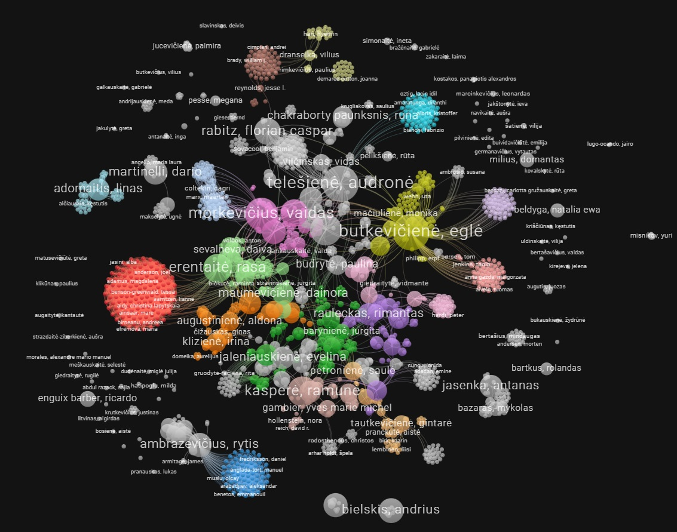
Bibliometric networks for KTU departments
Bibliometric networks of departments display:
Most productive authors
Frequent collaborators
Comparative insights into research group interactions and potential restructuring
Opportunities for new collaborations
Bibliometric network of FSSAH research articles:
Source: VOSviewer
Notes:
Another part of bibliometric is networking analysis. This provides insights into several things: individual researcher’s productivity and connectivity with other researchers, at the same institution, or another. It also displays any clusters that tend to publish together. A department might use such analysis to reorganize its structure, for example, rearranging research groups. It can also give insight into new opportunities for collaboration.

Slide 13


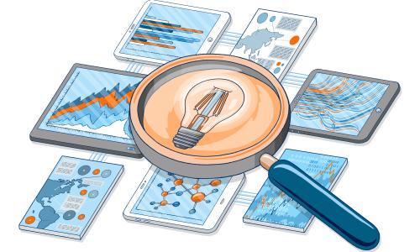
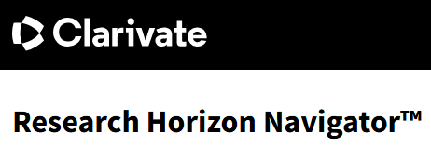
Training sessions for researchers
Training topics:
Research assessment indicators and tools: Bibliometrics, KTU regulations for research assessment, Web of Science and Scopus indicators, Metrics levels (journal, article, author), alternative metrics, qualitative research assessment
Finding the right journal to publish: Databases, Journal finders, Open Access, Predatory publishing
AI tools for researchers: AI in research, Scopus AI, Web of Science Research Horizon Navigator, Web of Science Research Assistant
How to Write a Data Management Plan
Source: Elsevier
Notes:
Finally, it is important to spread the knowledge about bibliometrics to university’s research community, so Library organizes training on several relevant subjects:
Research assessment indicators and tools: Bibliometrics, KTU regulations for research assessment, Web of Science and Scopus indicators, Metrics levels (journal, article, author), alternative metrics, qualitative research assessment
Finding the right journal to publish: Databases, Journal finders, Open Access, Predatory publishing
AI tools for researchers: AI in research, Scopus AI, Web of Science Research Horizon Navigator, Web of Science Research Assistant
How to Write a Data Management Plan

Slide 14
How Can Libraries Empower Research Excellence?
HUMAN SIDE OF TECHNOLOGY
Research Information Services, KTU Library
giedrius.dabasinskas@ktu.lt

