Slide 1



Bridge of Knowledge
experiences, difficulties and challenges of developing a new platform for researchers from the Gdańsk University of Technology
Kamila Kokot-Kanikuła
Dnipro National University of Railway Transport, October 7-8, 2021

Slide 2
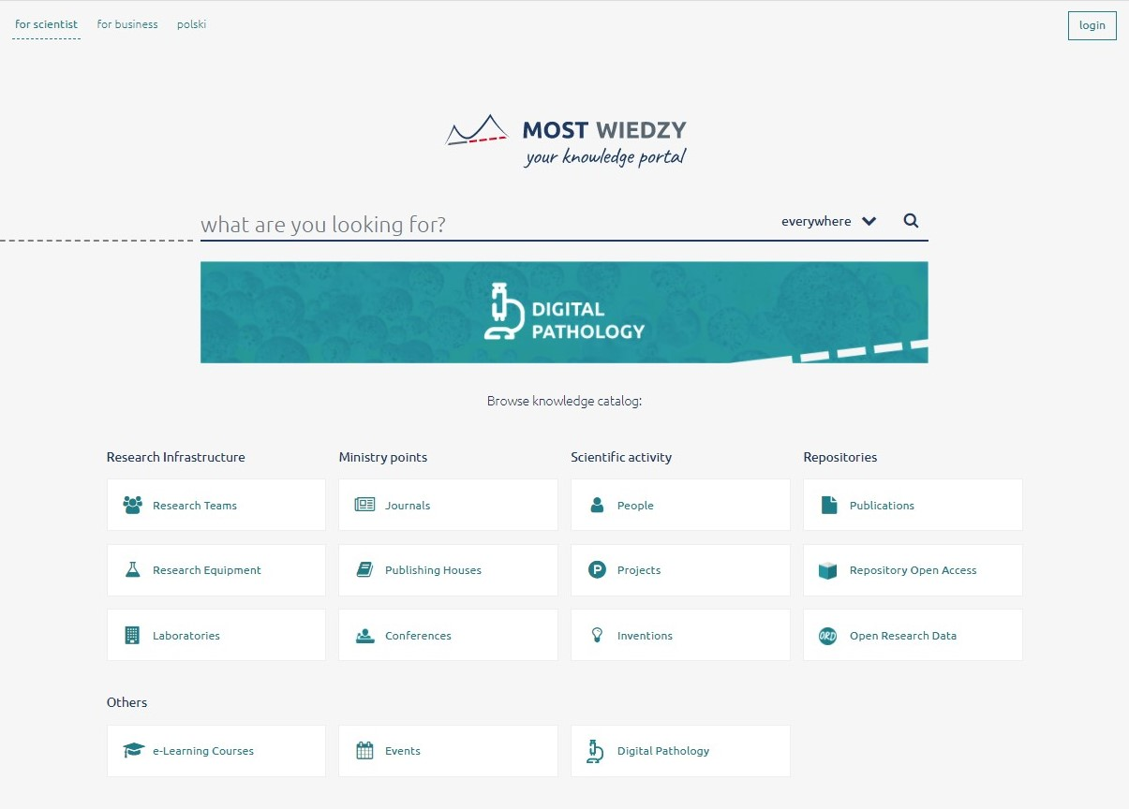
Bridge of Knowledge platform at Gdańsk University of Technology
https://mostwiedzy.pl/en/
Kamila Kokot-Kanikuła © 2021, CC BY 4.0

Slide 3
Bridge of Knowledge platform at Gdańsk University of Technology
https://mostwiedzy.pl/en/
Bridge of Knowledge platform at Gdańsk Tech is:
place, where you can present your research;
system, that manages current research information from the Gdańsk University of Technology;
institutional repository of scientific outputs and research data;
database of copyright and Open Access self-archiving policies of Polish scientific journals;
Kamila Kokot-Kanikuła © 2021, CC BY 4.0

Slide 4
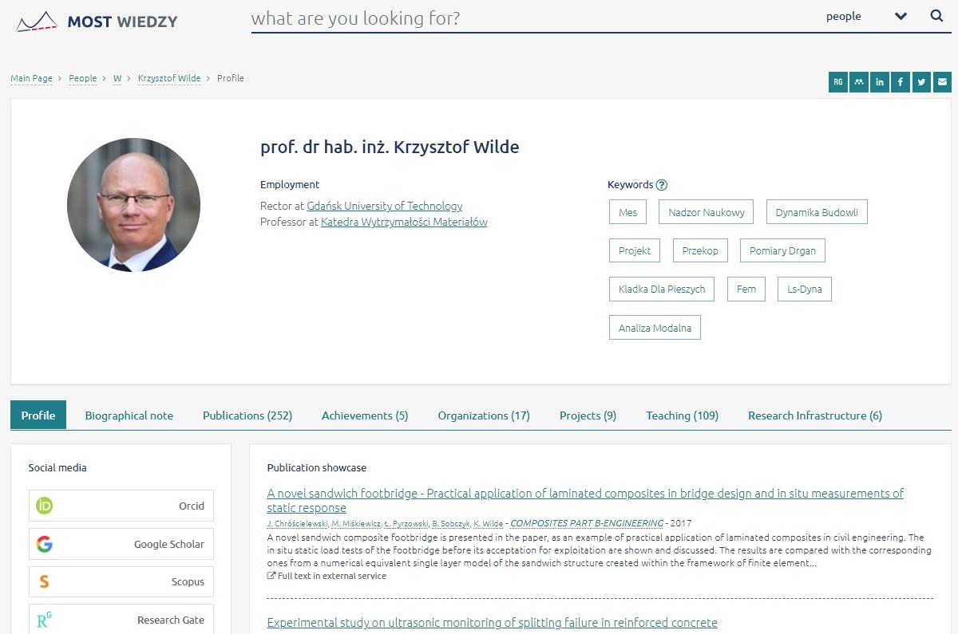
Bridge of Knowledge platform
scientific profile module
Kamila Kokot-Kanikuła © 2021, CC BY 4.0

Slide 5
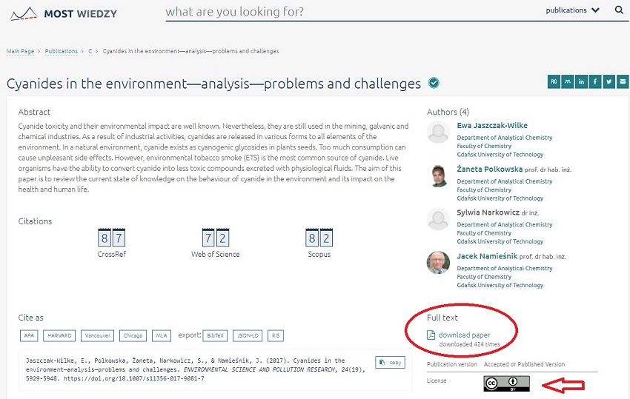
Bridge of Knowledge platform
Institutional Repository
Kamila Kokot-Kanikuła © 2021, CC BY 4.0

Slide 6
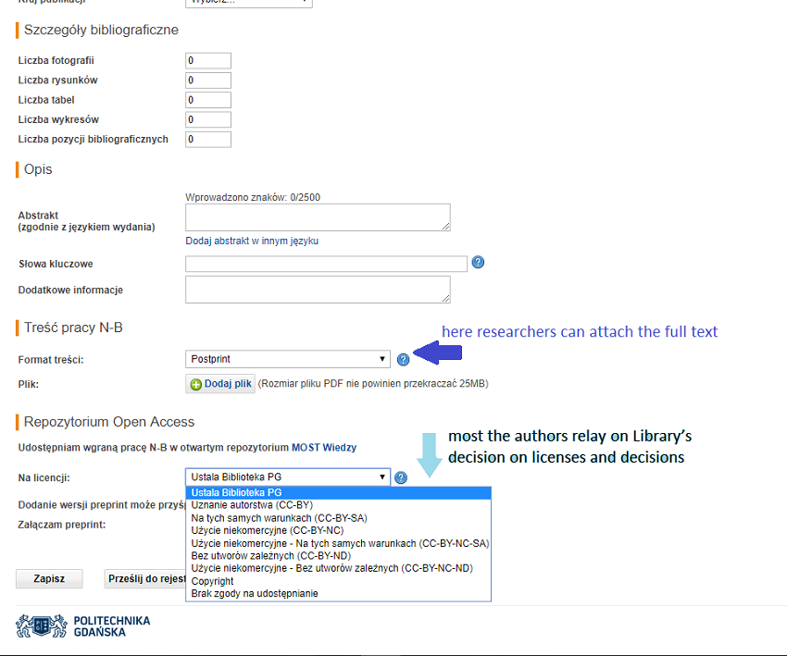
Bridge of Knowledge platform
Institutional Repository
Kamila Kokot-Kanikuła © 2021, CC BY 4.0

Slide 7
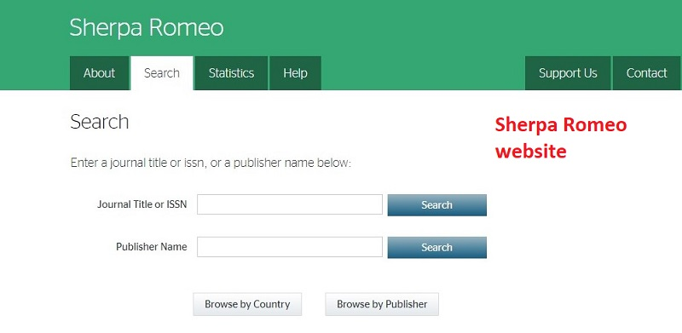
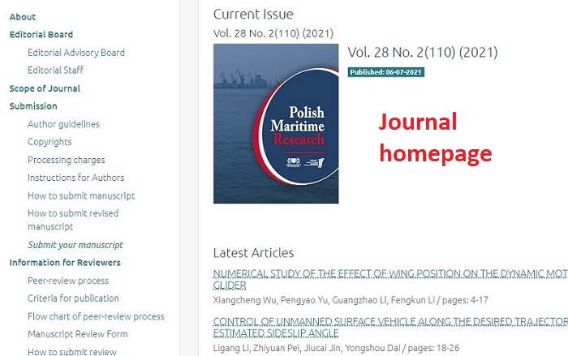
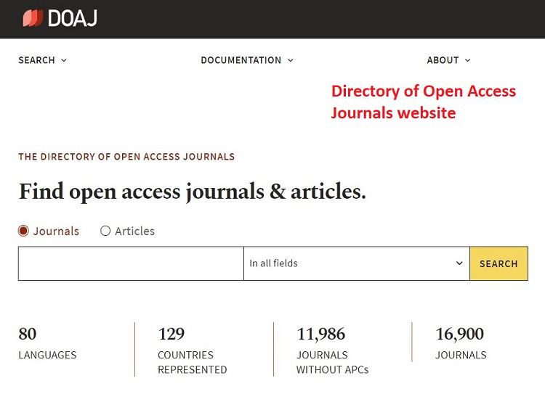
Institutional Repository
checking Publisher’s self-archiving policy
1.
2.
3.
Kamila Kokot-Kanikuła © 2021, CC BY 4.0

Slide 8
Institutional Repository
checking Publisher’s self-archiving policy
1.
2.
Don't be afraid to contact the Publishers!
3.
Kamila Kokot-Kanikuła © 2021, CC BY 4.0

Slide 9
Why researchers do not deposit their articles?
Why researchers do not deposit their articles in repositories?
they don’t know the benefits of Open Access Publication model (gaining more citations, better recognition, promotion and dissemination);
they don’t know authors’ rights;
they don’t know which repository is the most suitable for their discipline/type of the publication;
they are unsure about copyright and licensing;
they don’t know where to find information about publishers’ policy;
Kamila Kokot-Kanikuła © 2021, CC BY 4.0

Slide 10
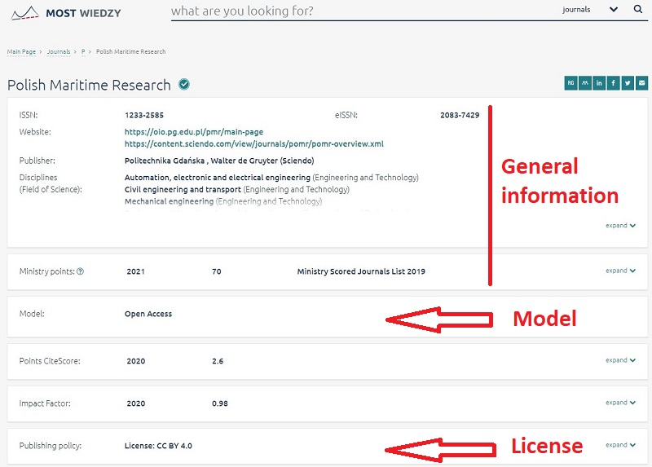
Database of copyright and Open Access self-archiving policies
of Polish scientific journals
Kamila Kokot-Kanikuła © 2021, CC BY 4.0

Slide 11
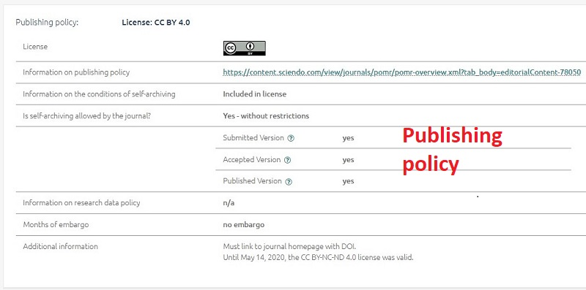
Database of copyright and Open Access self-archiving policies
of Polish scientific journals
Polish Maritime Research – self-archiving policy
Kamila Kokot-Kanikuła © 2021, CC BY 4.0

Slide 12
Bridge of Knowledge platform
Promotional activities
Promotional activities:
trainings
  how to complete scientific profile in the Bridge of Knowledge platform;
  where to check publishers’ policy;
  presenting database of copyright and Open Access self-archiving policies of Polish scientific journals;
  elements of author’s rights related to Green Open Access and self-archiving;
Bridge of Knowledge Open Days;
The Pomeranian Open Science Conference;
Kamila Kokot-Kanikuła © 2021, CC BY 4.0

Slide 13
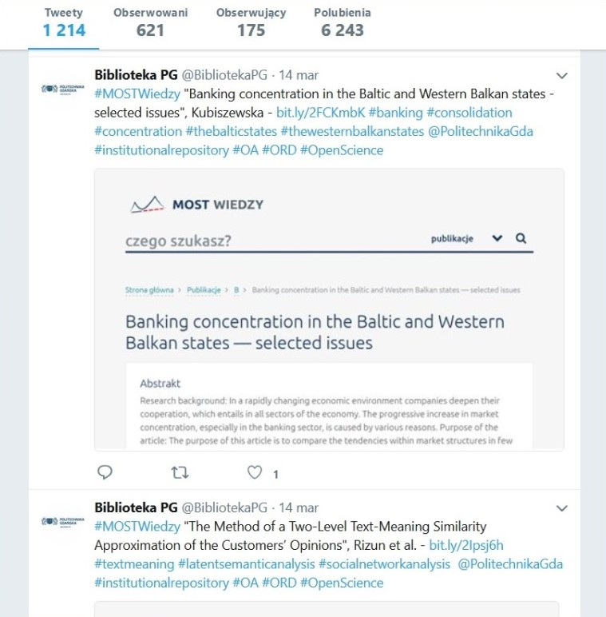
Custom Tweets
Kamila Kokot-Kanikuła © 2021, CC BY 4.0

Slide 14
‘Bridge of Data. Multidisciplinary Open Knowledge Transfer System - stage II: Open Research Data’ project is co-financed by the European Regional Development Fund under the Operational Program Digital Poland 2014-2020
Kamila Kokot-Kanikuła © 2021, CC BY 4.0

Slide 15
Thank you

