Slide 1

The contribution of special libraries in providing information services based on social inclusion
A case study Center for Library and Agricultural Technology Dissemination (PUSTAKA) Ministry of Agriculture, Indonesia
Andri Yanto | Prijana | Tita Nursari

Slide 2

The majority of special libraries fulfill the information needs of their work environment to support the development and improvement of the duties and functions of the institution and its human resources. However, several service innovations have been carried out by creating social inclusion-based service programs for the general public. One such special library is the Center for Library and Dissemination of Agricultural Technology (PUSTAKA) of the Ministry of Agriculture, Indonesia.

Slide 3
This research aims to provide an overview of how the PUSTAKA special library can be involved in creating service innovations for the public through social inclusion programs.

Slide 4
METHOD
The method used is a qualitative method with a descriptive approach.

Slide 5
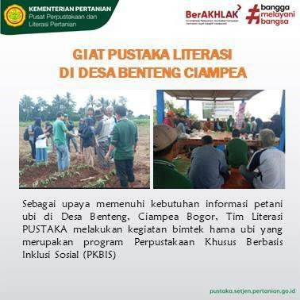
RESULT
The study results illustrate that PUSTAKA contributes to the community by improving the skills of farmers related to crop pest management, from planting to post- harvest.

Slide 6
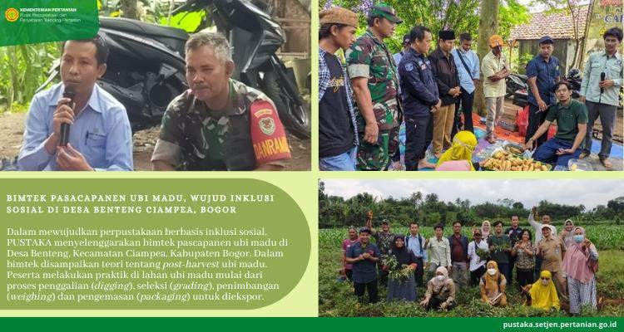

Slide 7
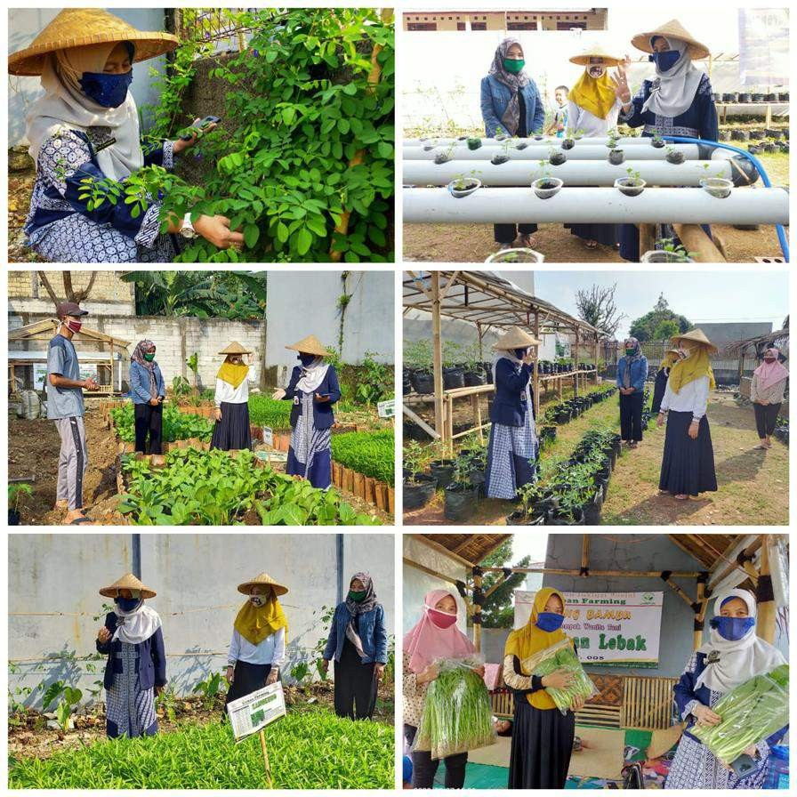
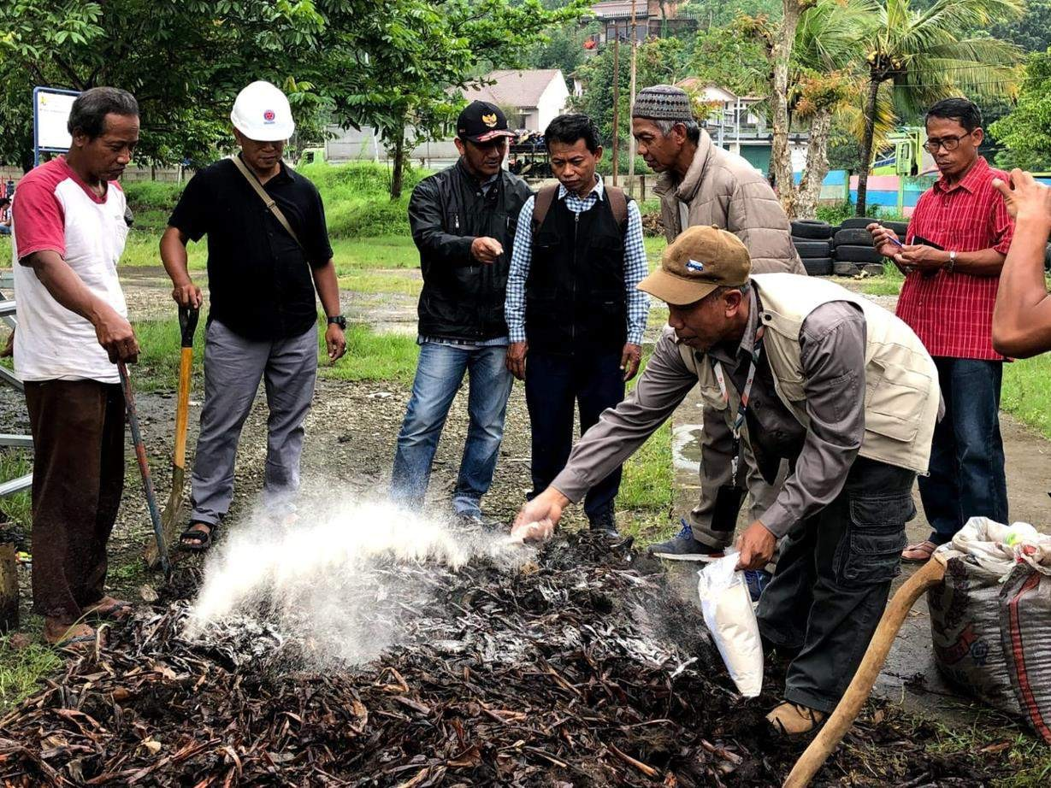

Slide 8
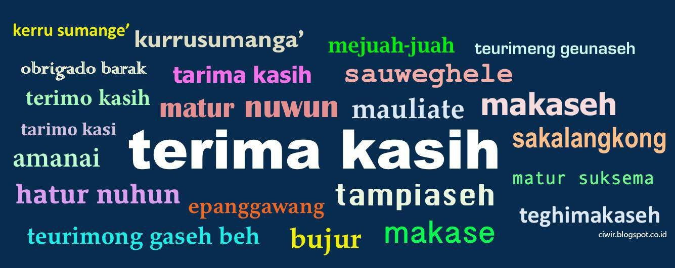


https://lis.fikom.unpad.ac.i d

